Slide 1
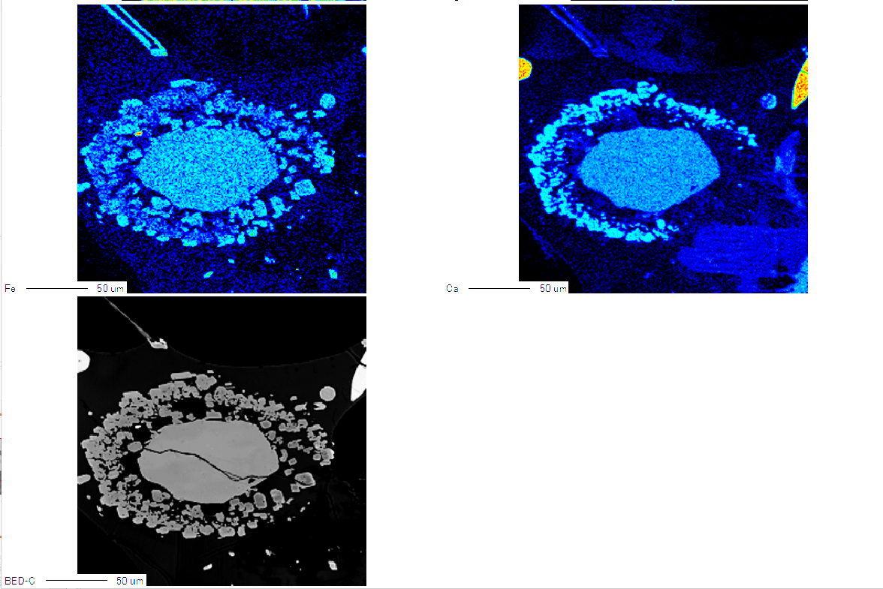
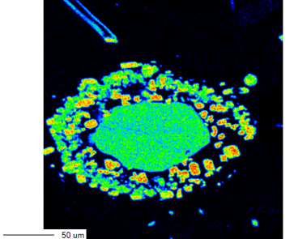
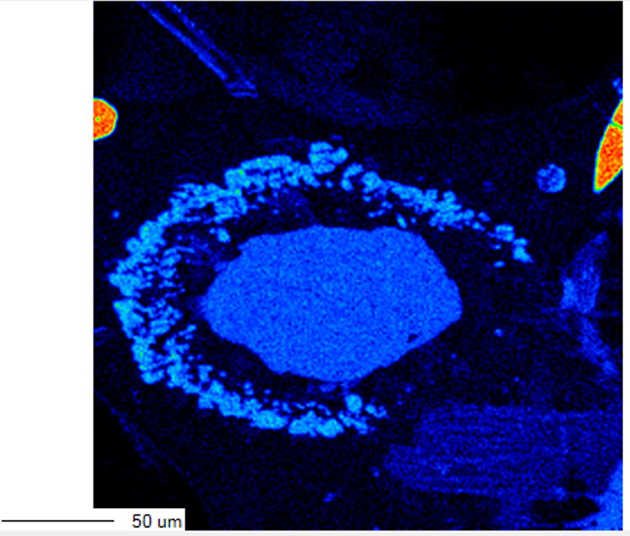
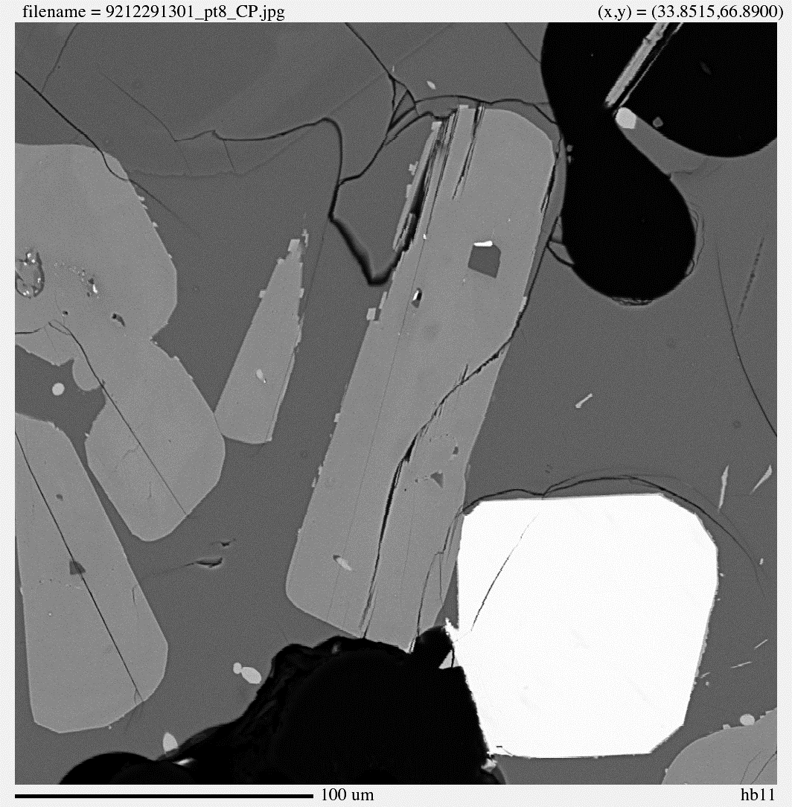
(a)
Backscattered electron map
(b)
Mg
(c)
Ca
Clinopyroxene
Amphibole
Clinopyroxene
Orthopyroxene
Orthopyroxene
(d)
Fe
(e)
BSE image
Amphibole
100µm
Examples of BSE images and elemental maps of amphibole reaction rims in crystal clots. Panels (a)–(d) show an amphibole crystal apparently surrounded by two pyroxenes: (a) BSE image, (b) Mg map, (c) Ca map, and (d) Fe map. Panel (e) shows a BSE image of an amphibole reaction rim that is not apparently associated with two surrounding pyroxenes (sample 92_1). Variations in brightness and color reflect differences in elemental concentrations.

