Slide 1
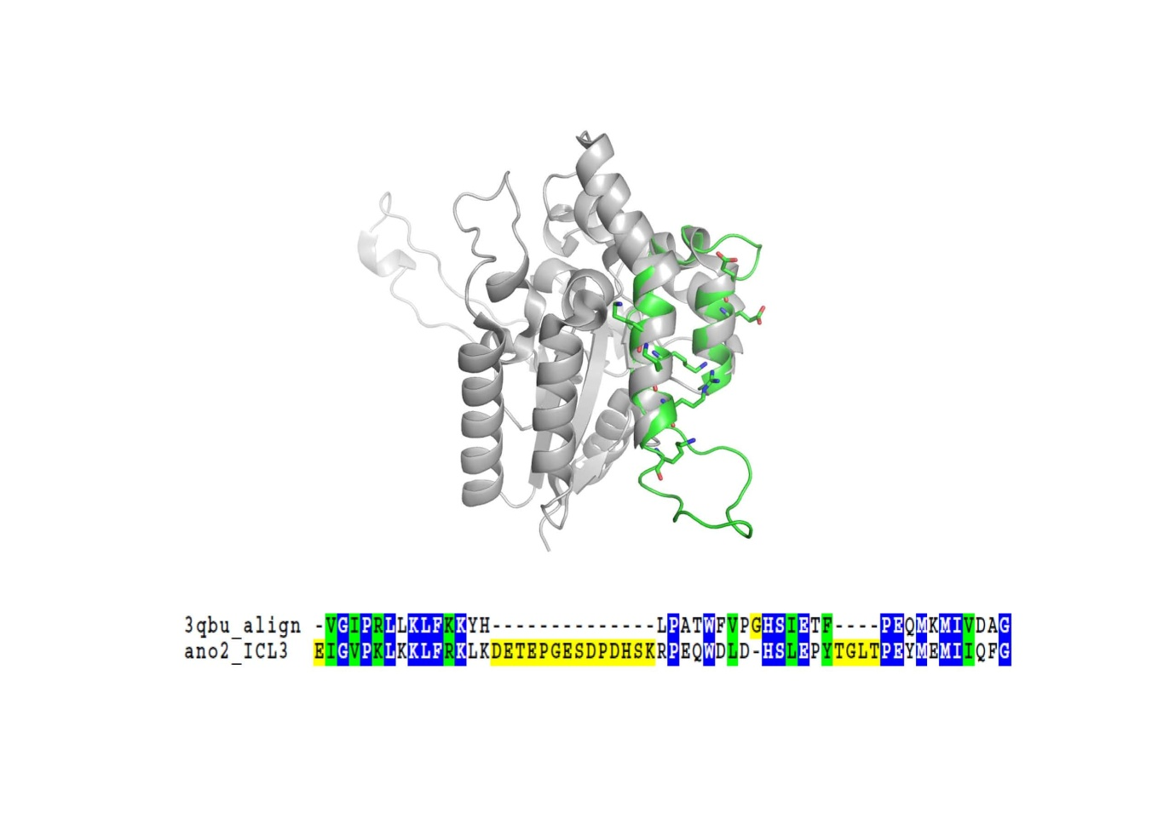
Supplementary Figure 1.

