Slide 1
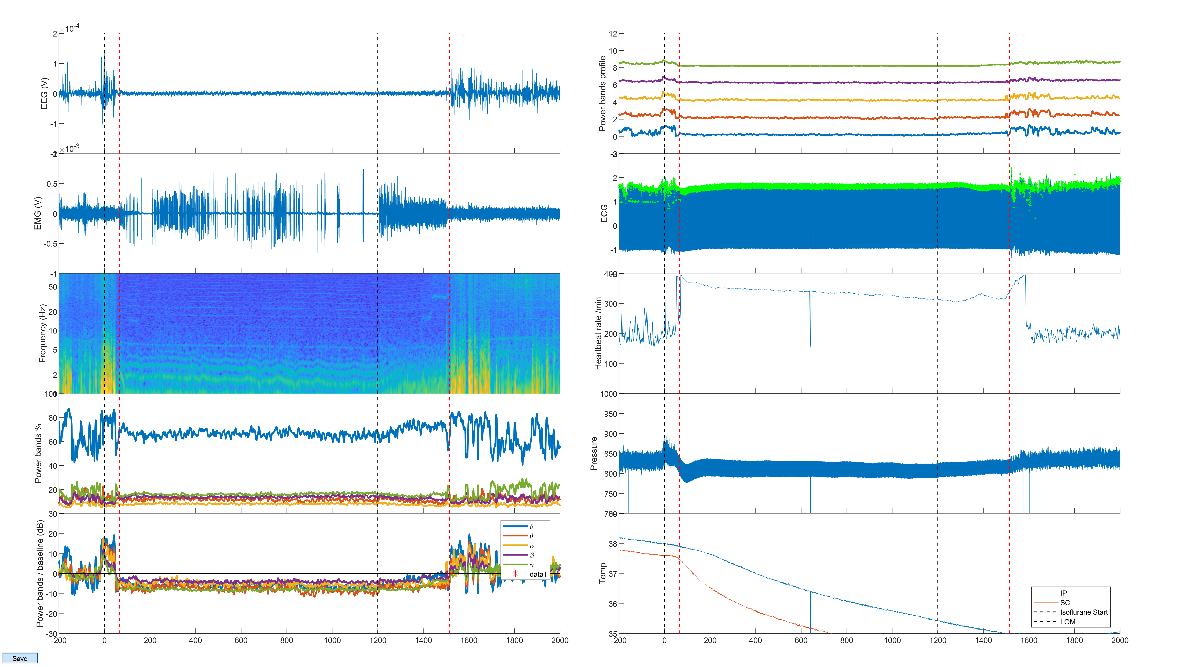
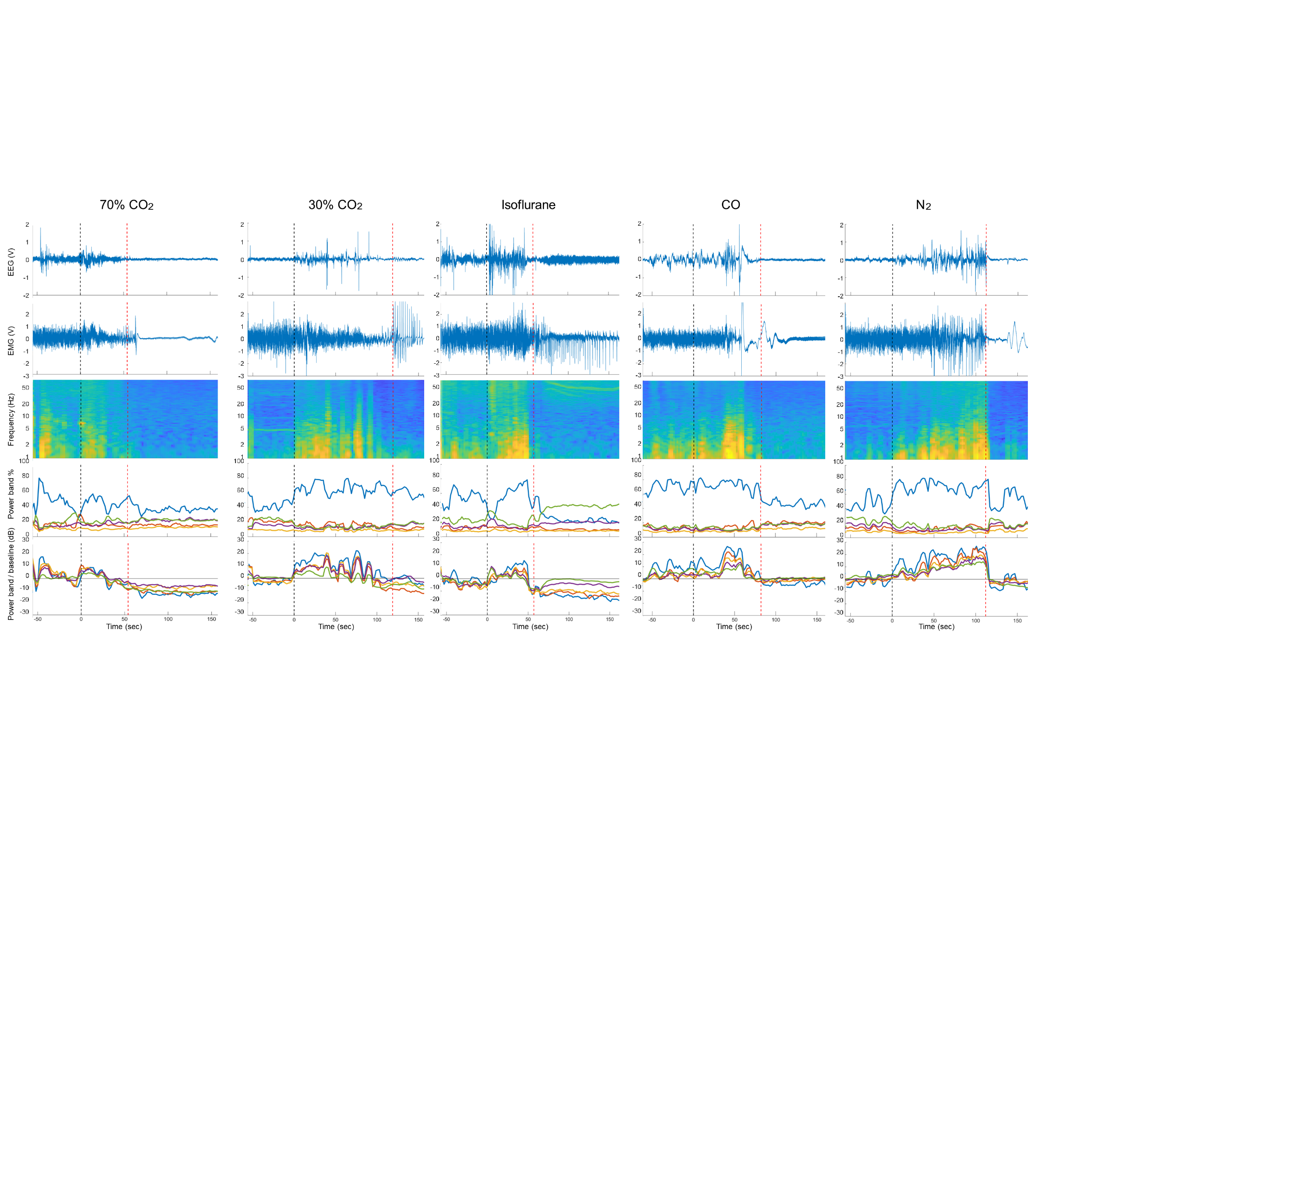
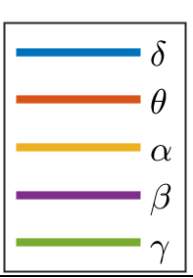
A. CO2 (30 % and 70 % VDRM)
a
Handling –
acclimatization
Surgery*
Euthanasia CO₂
-7
0
+15
Time (days)
B. CO and N2
Handling –
acclimatization
Surgery*
Blood collection
Isoflurane anesthesia
Euthanasia CO and N₂
-7
0
+5
+8
+15
Time (days)
b
❷
❸
❺
❻
❶
❹
❼
Supplementary Fig. 1: Study design and dynamics of the EEG and EMG over time during anesthesia with isoflurane to determine loss of consciousness (LOC). a) Study design, * indicates that surgery was performed under isoflurane anesthesia. For b-f an example is given. b) EEG raw signal c) EMG raw signal d) spectrogram of the EEG frequencies (Hz) e) percentage of each EEG wave relatively to others f) EEG waves normalized to the baseline values (dB). The numbers refer to: 1= baseline period, 2= induction of isoflurane anesthesia, 3= loss of motion (LOM), 4= maintenance of isoflurane anesthesia, 5= stop of isoflurane anesthesia, 6= wake-up of the animal, 7= recovery period. During maintenance of anesthesia (4), animals are unconscious. LOM (3) is associated to a decrease of EEG waves indicating LOC, then animals are unconscious (4) and wake-up (6) is associated to and increase of EEG waves indicating return of consciousness (ROC). The EEG waves are represented as follow: delta 1-4 Hz (blue), theta 4-8 Hz (orange), alpha 8-12 Hz (yellow), beta 13-30 Hz (purple), gamma 30-80 Hz (green).
c
d
Power (dB)
-40
e
-100
f

Slide 2
a
b
c
d
e
f
g
h
Supplementary Fig. 2: Morphometric analysis workflow. a) For each hematoxylin and eosin-stained lung section, the lung was manually outlined and annotated as a region of interest (ROI; green dashed line). b) An APP (Analysis Protocol Package) designed in Visiopharm for accurate tissue detection and total lung area (µm²; green area) quantification was run on all ROIs. The scale bars depict 1 mm. c and d) Specifically designed APPs were run on all the lung tissue for classification of tissue as erythrocytes or air spaces (classified area; µm²; green area in c and d respectively). The scale bar depicts 100 µm. The percentage of positive area, expressed as the ratio between the classified area and the total area, was obtained for each animal according to the following formula: ([classified area (µm²)]/[total lung area (µm²)]) × 100. e) For each section stained for albumin with immunohistochemistry, the lumens of 10 randomly selected transversally sectioned pulmonary arteries were manually outlined (blue dashed line). f) An APP, based on a threshold method, was used to measure the intraluminal albumin-positive area (intraluminal classified area; µm²; green area). g) The lumen outline was enlarged by 50 pixels at 1× (equal to 230 microns) and the total perivascular area (µm²; blue dashed line) was measured. h) The albumin-positive area was assessed in the total perivascular area with the APP (perivascular classified area; µm²; green area). The scale bar depicts 100 µm. The intramural and perivascular albumin-positive area was assessed as the difference between the perivascular classified area and intraluminal classified area. The percentage of positive area, expressed as the ratio between the intramural and perivascular albumin-positive area and the total perivascular area, was obtained for each animal according to the following formula: ([intramural and perivascular albumin-positive area (µm²)]/[total perivascular area (µm²)]) × 100.

Slide 3
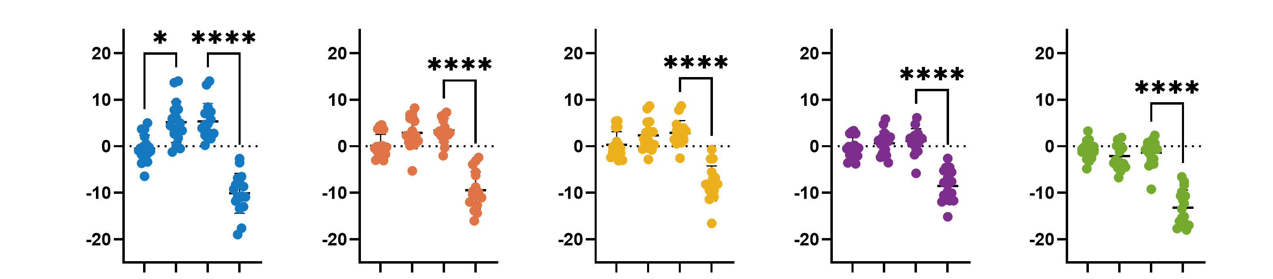
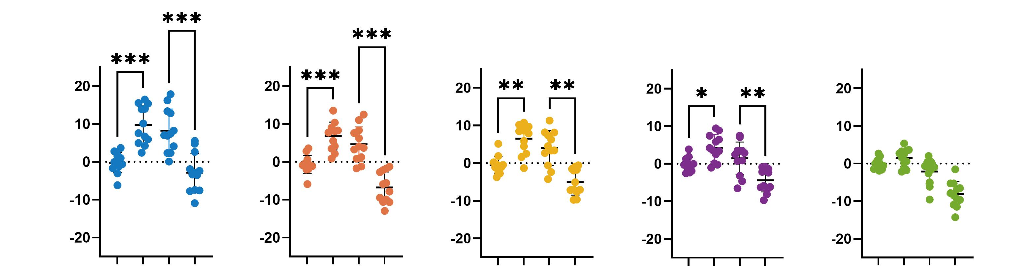
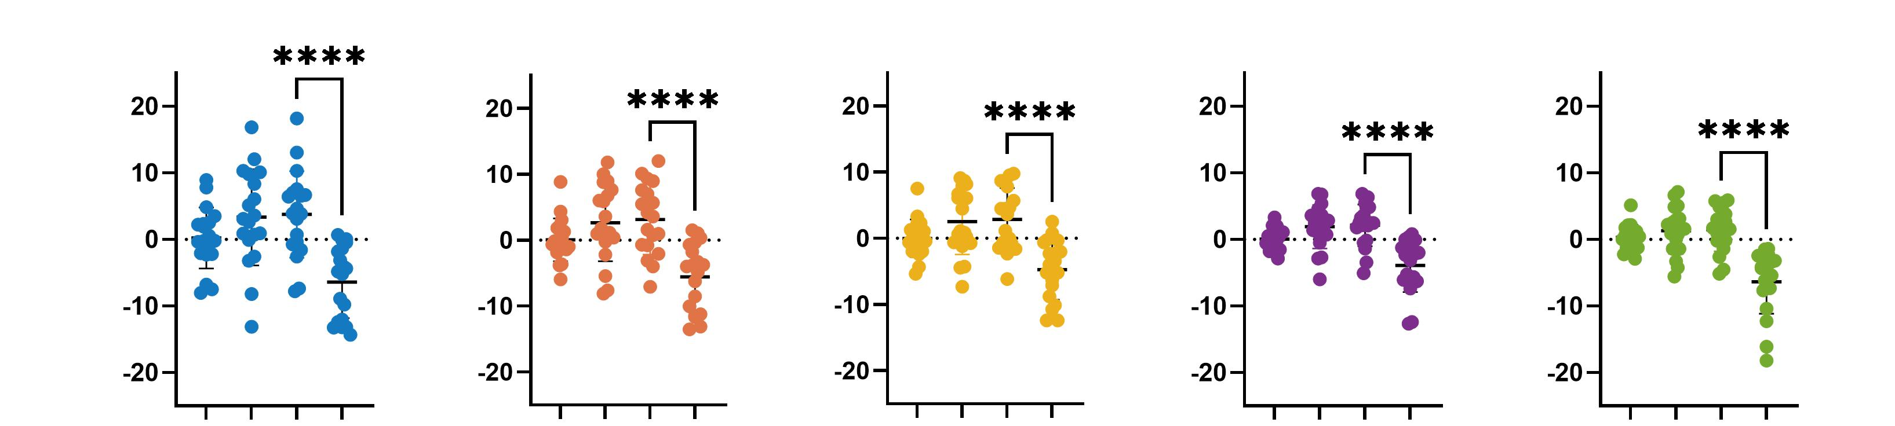
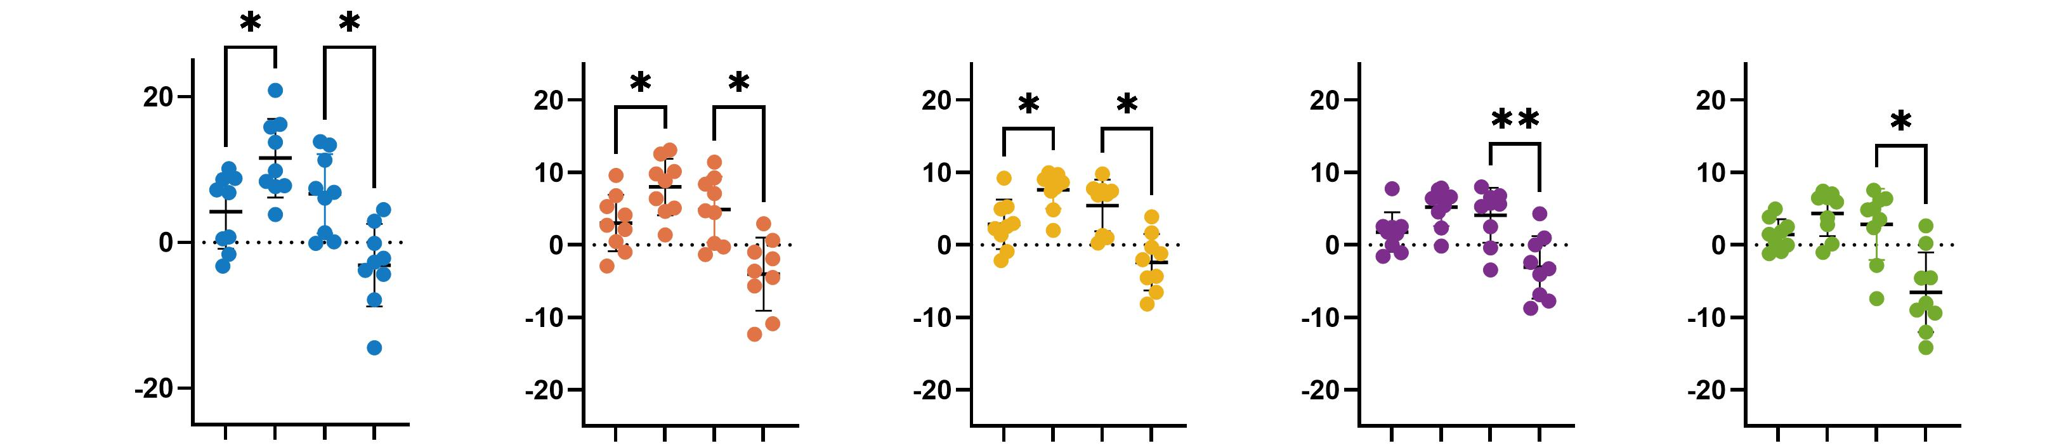
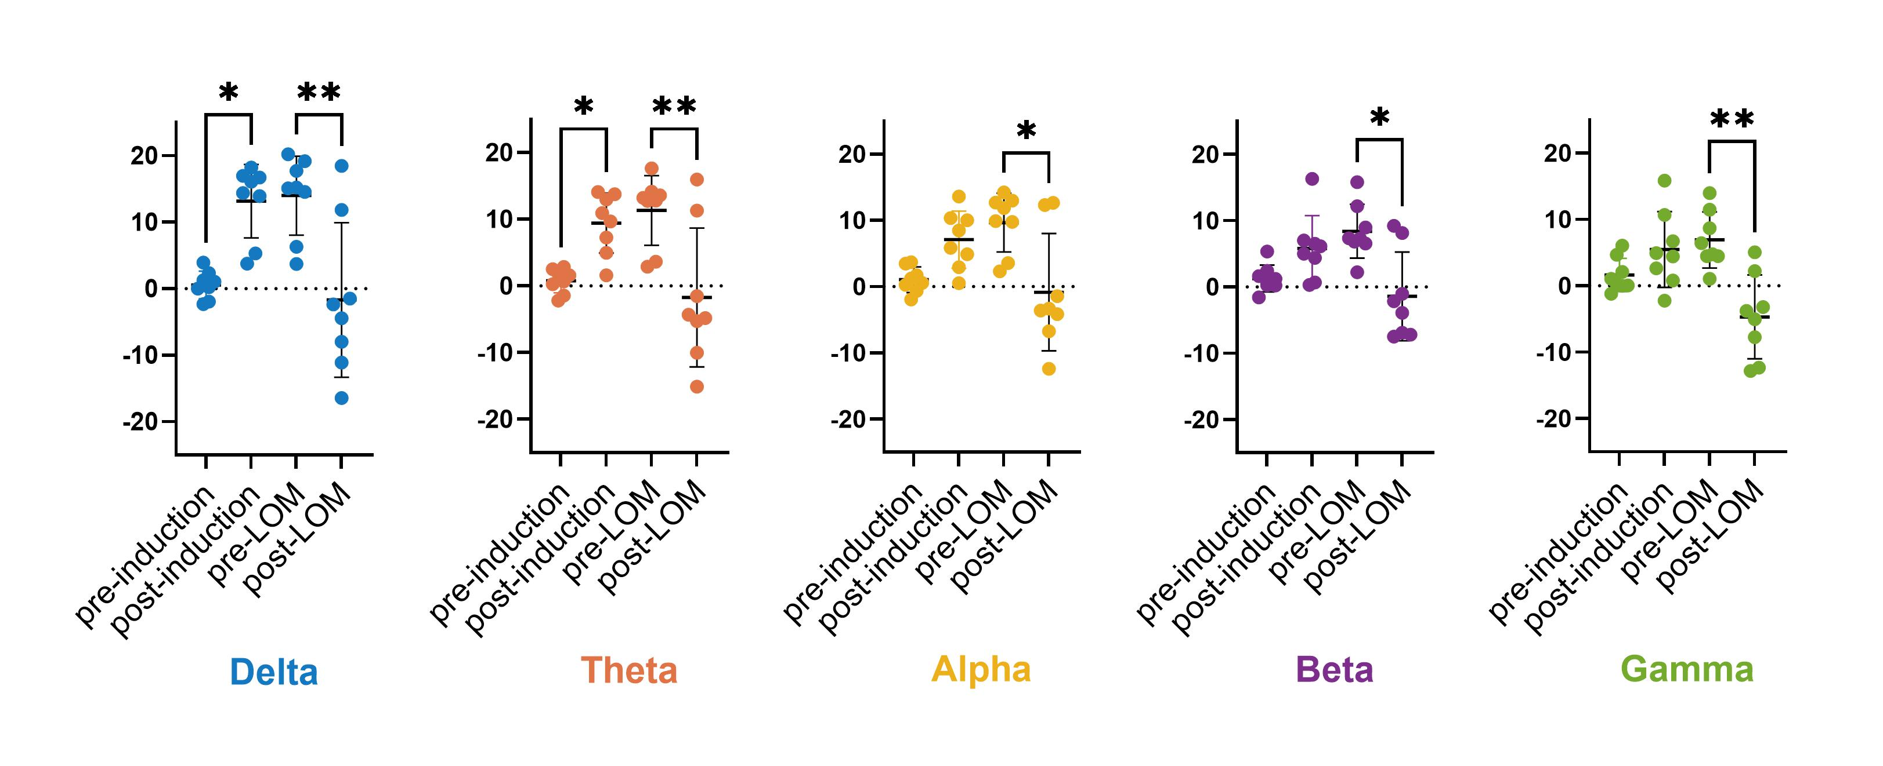
a
70% CO₂
Mean power/baseline (dB)
b
30% CO₂
Mean power/baseline (dB)
c
Isoflurane
Mean power/baseline (dB)
d
CO
Mean power/baseline (dB)
e
N₂
Mean power/baseline (dB)
Supplementary Fig. 3: Dynamics of the EEG waves pre- and post- induction and pre- and post-LOM under anesthesia with isoflurane or euthanasia with 70% CO₂, 30% CO₂, CO and N₂. EEG mean power was normalized to the baseline values for each wave: delta 1-4 Hz (blue), theta 4-8 Hz (orange), alpha 8-12 Hz (yellow), beta 13-30 Hz (purple), gamma 30-80 Hz (green). Log10 (Mean Power/baseline) is represented at different time points: pre- and post-induction of the gas, pre- and post-LOM (loss of motion) for 70% CO2 (a, n=17), 30% CO2 (b, n=12), isoflurane (c, n=19), carbon monoxide (d, n=9) and nitrogen (e, n=8). Statistical analysis was performed with Friedman tests between pre- and post-induction and between pre- and post-LOM:

Slide 4
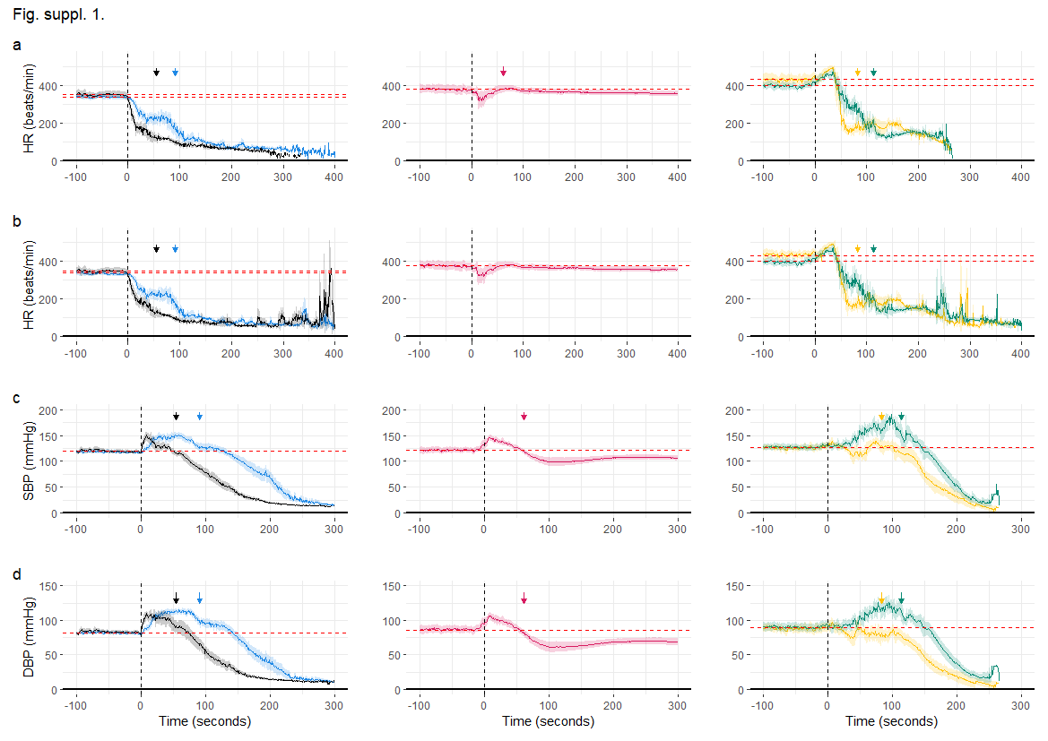
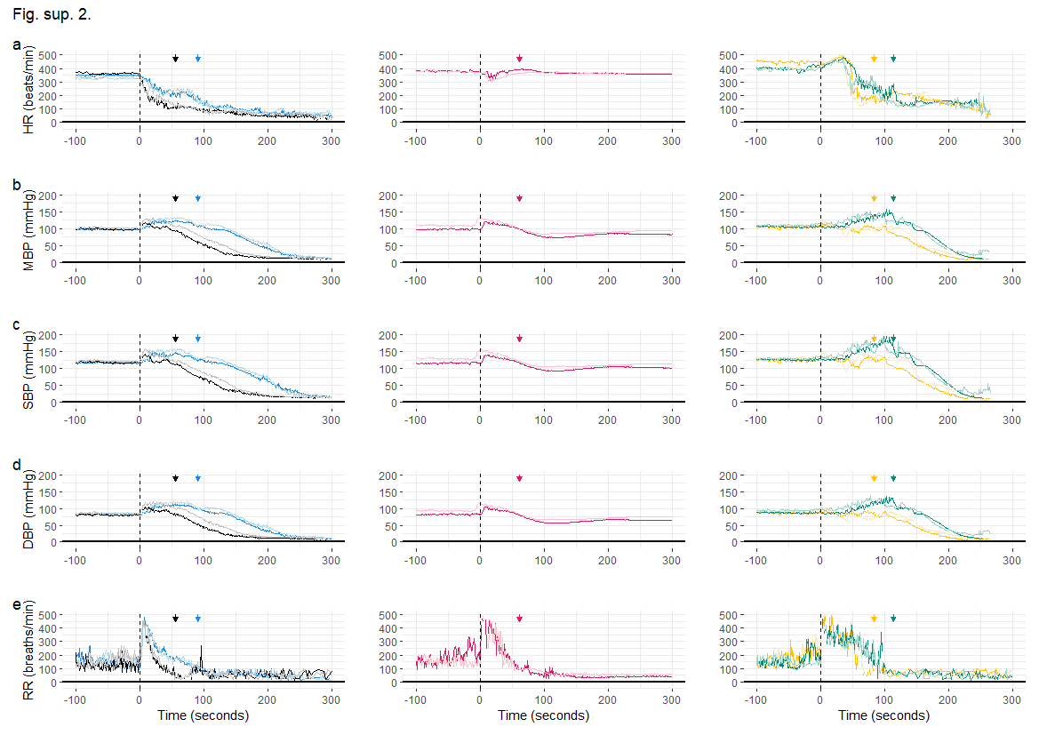
All animals together
Animals by sex
70% CO₂
e
30% CO₂
CO
N₂
f
*
*
g
h
i
Supplementary Fig. 4: Cardiovascular parameters in rats before and after exposure to different gases. . Cardiorespiratory parameters over time plotted for 30% CO₂ (blue, n=18 HR, BP -19 RR), 70% CO₂ (black, n=18), CO (yellow, n=9 RR, -10 HR, BP) and N₂ (green, n=9 RR -10 HR, BP). a) heart rate (HR) derived from the blood pressure data, b) HR derived from the ECG data, c) and d) systolic and diastolic blood pressures (SBP, DBP) were averaged over time. e-i comparison of male and female rats, e) heart rate (HR) derived from the blood pressure data, f-h) mean, systolic and diastolic blood pressures (MBP, SBP, DBP), i) respiratory rate (RR) were averaged over time. Females are represented with dark colors and males with light colors. The dotted lines represent the gas influx at time point 0. The arrows represent the time to loss of motion (LOM) for each group. The stars represent the final arrhythmias. The shaded areas show the mean ± 2 SEM of each parameter for illustration purpose of the group difference as a function of time.

Slide 5
All animals together
Animals by sex
a
d
b
e
*
c
f
Supplementary Fig. 5: Cardiorespiratory parameters in rats before and after exposure to isoflurane. Cardiovascular parameters over time plotted for animals anesthetized with isoflurane (pink, n=19 RR, - 20 HR, BP). a) Heart Rate (HR) derived from the ECG data, b) and c) systolic and diastolic blood pressures (SBP, DBP) were averaged over time. Males and females were compared in d-h: d) HR derived from the blood pressure data, e-g) mean, systolic and diastolic blood pressures (MBP, SBP, DBP), h) respiratory rate (RR) were averaged over time. The shaded areas show the mean ± 2 SEM of each parameter for illustration purpose of the group difference as a function of time. The average at baseline was estimated at the level shown in the red dashed line. The dotted lines represent the gas influx at time point 0. The arrows represent the loss of motion (LOM). Females are represented with dark colors and males with light colors.
g
h

Slide 6
Supplementary Fig. 6: Statistical analyses for different variables after anesthesia with isoflurane or euthanasia with CO₂, CO or N₂.
Reference in text | Variable | Factor | Overall group comparison | Pairwise comparisons | Median Difference (95% CI)
a | Maximal HR | Gas condition | Kruskal–Wallis: H = 54.86, p < 0.0001; Dunn post hoc: 30% CO₂ vs isoflurane, p = 0.0227; 30% CO₂ vs CO, p < 0.0001; 30% CO₂ vs N₂, p < 0.0001; 70% CO₂ vs isoflurane, p = 0.0080; 70% CO₂ vs CO, p < 0.0001; 70% CO₂ vs N₂, p < 0.0001; isoflurane vs CO, p = 0.0421. | Mann–Whitney: CO vs 30% CO₂: U = 0, p < 0.0001; CO vs isoflurane: U = 4, p < 0.0001; isoflurane vs 30% CO₂: U = 37, p < 0.0001; isoflurane vs 70% CO₂: U = 40.5, p < 0.0001; N₂ vs 30% CO₂: U = 0, p < 0.0001; N₂ vs 70% CO₂: U = 0, p < 0.0001; CO vs 70% CO₂: U = 0, p < 0.0001 | CO vs 30% CO₂: 159 (138 - 177); CO vs isoflurane: 93.5 (60 - 127); isoflurane vs 30% CO₂: 59.5 (32 - 92); isoflurane vs 70% CO₂: 64.5 (40 - 97); N₂ vs 30% CO₂: 134 (116 - 166); N₂ vs 70% CO₂: 143 (112 - 170); CO vs 70% CO₂: 164 (138 - 185)
b | Maximal MBP | Gas condition | Kruskal–Wallis: H = 28.38, p < 0.0001; Dunn post hoc: 30% CO₂ vs N₂, p = 0.0206; 70% CO₂ vs N₂, p = 0.0034; isoflurane vs N₂, p = 0.0002; CO vs N₂, p < 0.0001. | Mann–Whitney: N₂ vs 30% CO₂: U = 10, p < 0.0001; N₂ vs isoflurane: U = 9, p < 0.0001; N₂ vs CO: U = 3, p < 0.0001; N₂ vs 70% CO₂: U = 9, p < 0.0001 | N₂ vs 30% CO₂: 25.81 (17.74 - 31.66); N₂ vs isoflurane: 31.45 (20.32 - 38.68); N₂ vs CO: 42.38 (24.56 - 49.56); N₂ vs 70% CO₂: 26.91 (17.31 - 36.80)
c | Onset of arrhythmias | Gas condition | Kruskal–Wallis: H = 51.80, p < 0.0001; Dunn post hoc: 30% CO₂ vs 70% CO₂, p = 0.0182 ; 30% CO₂ vs CO, p = 0.0199; 30% CO₂ vs N₂, p = 0.0131; 70% CO₂ vs isoflurane, p < 0.0001; 70% CO₂ vs CO, p < 0.0001; 70% CO₂ vs N₂, p < 0.0001 | Mann–Whitney: N₂ vs 30% CO₂: U = 1.5, p < 0.0001; isoflurane vs 70% CO₂: U = 16, p < 0.0001; N₂ vs 70% CO₂: U = 0, p < 0.0001; 70% CO₂ vs 30% CO₂: U = 12, p < 0.0001; CO vs 70% CO₂: U = 0, p < 0.0001; CO vs 30% CO₂: U = 0, p < 0.0001 | N₂ vs 30% CO₂: 30 (23 - 37); isoflurane vs 70% CO₂: 21 (15 - 32); N₂ vs 70% CO₂: 42 (38 - 50); 70% CO₂ vs 30% CO₂: -12 (-15 - -10); CO vs 70% CO₂: 42 (35 - 44); CO vs 30% CO₂: 27 (22 - 33)
d | Maximal RR | Gas condition | Kruskal–Wallis: H = 6.43, p = 0.1693 | - | -
e | Maximal TV | Gas condition | Kruskal–Wallis: H = 41.61, p < 0.0001; Dunn post hoc: 30% CO₂ vs isoflurane, p = 0.0014; 70% CO₂ vs isoflurane, p < 0.0001; isoflurane vs CO, p = 0.0115; isoflurane vs N₂, p < 0.0001. | Mann–Whitney: CO vs isoflurane: U = 10, p < 0.0001; N₂ vs isoflurane: U = 4, p < 0.0001; isoflurane vs 30% CO₂: U = 17, p < 0.0001; isoflurane vs 70% CO₂: U = 12, p < 0.0001 | CO vs isoflurane: 5.419 (3.448 - 7.184); N₂ vs isoflurane: 11.23 (6.786 - 15.85); isoflurane vs 30% CO₂: -4.543 (-5.873 - -3.589); isoflurane vs 70% CO₂: -6.738 (-9.624 - -5.107)
f | Maximal MV | Gas condition | Kruskal–Wallis: H = 41.67, p < 0.0001; Dunn post hoc: 30% CO₂ vs isoflurane, p < 0.0001; 30% CO₂ vs CO, p = 0.0243; 70% CO₂ vs isoflurane, p = 0.0011; isoflurane vs N₂, p = 0.0001. | Mann–Whitney: isoflurane vs 30% CO₂: U = 19, p < 0.0001; CO vs 30% CO₂: U = 16, p = 0.0002; N₂ vs isoflurane: U = 11, p < 0.0001; isoflurane vs 70% CO₂: U = 24, p < 0.0001 | isoflurane vs 30% CO₂: -698.9 (-878.1 - -573.5); CO vs 30% CO₂: -367.4 (-625.4 - -204.8); N₂ vs isoflurane: 716.8 (459.4 - 992.1); isoflurane vs 70% CO₂: -521.0 (-622.6 - -402.5)
g | Lung inflation (air) | Gas condition | Kruskal–Wallis H = 33.08, p < 0.0001; Dunn post hoc: CO vs 30% CO₂: p = 0.0015; N₂ vs 30% CO₂: p <0.0001; 70% CO₂ vs CO: p =0.0074; 70% CO₂ vs N₂: p<0.0001 | Mann–Whitney: N₂ vs 70% CO₂: U = 1, p < 0.0001; CO vs 70% CO₂: U = 4, p < 0.0001; N₂ vs 30% CO₂: U = 0, p < 0.0001; CO vs 30% CO₂: U = 1, p < 0.0001 | N₂ vs 70% CO₂: 0.3025 (0.2268 - 0.3634); CO vs 70% CO₂: 0.2244 (0.1519 - 0.2686); N₂ vs 30% CO₂: 0.3198 (0.2530 - 0.3838); CO vs 30% CO₂: 0.2536 (0.1777 - 0.2917)
h | Edema | Gas condition | Two-way ANOVA: F(3,32) = 5.157, p = 0.0051. | Mann–Whitney: U = 16, p = 0.009 | -
i |  | Sex | Two-way ANOVA: F(1,32) = 4.326, p = 0.0456. | - | Females – Males: 3.53 (0.073–6.984).
 |  | Gas × Sex interaction | Two-way ANOVA: F(3,32) = 3.494, p = 0.0267. Šídák post hoc: N₂ p = 0.0319, others ns. | - | N₂: Females – Males = 9.54 (0.629–18.44), p = 0.0319. All others ns.
j | Sniffing/min | Gas condition | Kruskal–Wallis: H = 40.14, p < 0.0001; Dunn post hoc: Baseline vs 70% CO₂, p = 0.0002; Baseline vs 30% CO₂, p < 0.0001; Baseline vs isoflurane, p = 0.0433; Baseline vs CO, p = 0.0794; Baseline vs N₂, p = 0.0050. | Mann–Whitney: 30% CO2 vs Baseline: U = 21, p < 0.0001; Isoflurane vs Baseline: U = 196, p = 0.0092; N2 vs Baseline: U = 44, p = 0.0002; 70% CO2 vs Baseline: U = 90, p < 0.0001 | 30% CO2 vs Baseline: -27.24 (-34.58–-20.16) Isoflurane vs Baseline: -10.55 (-19.70–-2.947) N2 vs Baseline: 17.67 (9.387–25.96) 70% CO2 vs Baseline: -18.23 (-24.79–-11.19)
k | Sniffing | Gas condition | Kruskal–Wallis: H = 34.96, p < 0.0001; Dunn post hoc: 70% CO₂ vs 30% CO₂, p = 0.0002; 70% CO₂ vs N₂, p = 0.0017; 30% CO₂ vs isoflurane, p < 0.0001; isoflurane vs N₂, p = 0.0008. | Mann–Whitney: 30% CO2 vs 70% CO2: U = 10, p < 0.0001; Isoflurane vs 30% CO2: U = 37, p < 0.0001; N2 vs Isoflurane: U = 23, p = 0.0003; N2 vs 70% CO2: U = 12, p < 0.0001 | 30% CO2 vs 70% CO2: 37.24 (26.73–45.56) Isoflurane vs 30% CO2: -40.70 (-51.50–-27.75) N2 vs Isoflurane: 40.26 (19.50–53.26) N2 vs 70% CO2: 36.48 (23.81–47.56)
l | Circling/min | Gas condition | Kruskal–Wallis: H = 57.18, p < 0.0001; Dunn post hoc: Baseline vs 70% CO₂, p < 0.0001; Baseline vs 30% CO₂, p < 0.0001; Baseline vs isoflurane, p = 0.0099; Baseline vs CO, p = 0.2662; Baseline vs N₂, p = 0.0003. | Mann–Whitney: 30% CO2 vs Baseline: U = 31, p < 0.0001; Isoflurane vs Baseline: U = 139, p = 0.0002; N2 vs Baseline: U = 17, p < 0.0001; 70% CO2 vs Baseline: U = 27, p < 0.0001 | 30% CO2 vs Baseline: -8.314 (-9.395–-6.492) Isoflurane vs Baseline: -3.919 (-5.715–-2.357) N2 vs Baseline: 7.298 (5.023–8.463) 70% CO2 vs Baseline: -10.02 (-12.35–-8.282)
m | Circling | Gas condition | Kruskal–Wallis: H = 31.32, p < 0.0001; Dunn post hoc: 30% CO₂ vs isoflurane, p = 0.0003; 30% CO₂ vs CO, p = 0.0092; isoflurane vs N₂, p = 0.0002; CO vs N₂, p = 0.0040. | Mann–Whitney: CO vs 30% CO2: U = 21, p = 0.0019; N2 vs CO: U = 7, p = 0.0005; Isoflurane vs 30% CO2: U = 35, p < 0.0001; N2 vs Isoflurane: U = 12, p < 0.0001 | CO vs 30% CO2: -8.356 (-14.00–-4.451) N2 vs CO: 9.088 (5.501–14.50) Isoflurane vs 30% CO2: -9.200 (-13.25–-5.258) N2 vs Isoflurane: 9.710 (5.922–13.50)
n | Gasping | Gas condition | Kruskal–Wallis: H = 39.06, p < 0.0001; Dunn post hoc: 70% CO₂ vs isoflurane, p < 0.0001; 70% CO₂ vs CO, p = 0.0036; 70% CO₂ vs N₂, p = 0.0115; 30% CO₂ vs isoflurane, p < 0.0001; 30% CO₂ vs CO, p = 0.0128; 30% CO₂ vs N₂, p = 0.0356. | Mann–Whitney: Isoflurane vs 70% CO2: U = 30, p < 0.0001; CO vs 70% CO2: U = 27.5, p = 0.0008; N2 vs 70% CO2: U = 30, p = 0.0014; Isoflurane vs 30% CO2: U = 30, p < 0.0001; CO vs 30% CO2: U = 24.5, p = 0.0019; N2 vs 30% CO2: U = 28, p = 0.0054 | Isoflurane vs 70% CO2: -7.000 (-13.00–-2.000) CO vs 70% CO2: -4.000 (-13.00–-2.000) N2 vs 70% CO2: -4.000 (-13.00–-2.000) Isoflurane vs 30% CO2: -5.000 (-12.00–-2.000) CO vs 30% CO2: -4.000 (-12.00–-2.000) N2 vs 30% CO2: -4.500 (-12.00–0.000)
o | Time to LOM | Gas condition | Kruskal–Wallis: H = 45.56, p < 0.0001; Dunn post hoc: 70% CO₂ vs 30% CO₂: p < 0.0001; 70% CO₂ vs CO: p = 0.0030; 70% CO₂ vs N₂: p < 0.0001; 30% CO₂ vs isoflurane: p = 0.0004; isoflurane vs N₂: p = 0.0004. | Mann–Whitney: 30% CO2 vs 70% CO2: U = 3.5, p < 0.0001; CO vs 70% CO2: U = 7, p < 0.0001; N2 vs 70% CO2: U = 19, p = 0.0002; 30% CO₂ vs isoflurane: U = 9, p < 0.0001, isoflurane vs N₂: U = 22, p = 0.0002 | 70% CO2 vs 30% CO2: 35 (25.00–43.00); CO vs 70% CO2: 26 (20.00–33.00); N2 vs 70% CO2: 70 (43.00-80.00); 30% CO₂ vs isoflurane: -29.5 (-31--19), isoflurane vs N₂: 63 (38-74)
p | Time to LOM by sex | Gas condition | Two-way ANOVA: F(4,64) = 32.41, p < 0.0001. | - | -
 |  | Sex | Two-way ANOVA: F(1,64) = 1.813, p = 0.1829 (ns). | - | Females vs Males: 5.05 (–2.443 to 12.54).
 |  | Gas × Sex interaction | Two-way ANOVA: F(4,64) = 2.945, p = 0.0268. Šídák post hoc: N₂ p = 0.0061, others ns. | - | N₂: Females – Males = 32.8 (7.142–58.46), p = 0.0061 (significant). All other gases nonsignificant.
q | isoelectric EEG | Gas condition | Kruskal–Wallis: H = 27.99, p < 0.0001, Dunn pust hoc: 70% CO₂ vs 30% CO₂: p < 0.0001; 70% CO₂ vs N₂: p = 0.0107; 30% CO₂ vs CO: p = 0.0115 | Mann–Whitney: 30% CO₂ vs 70% CO₂: U =24, p < 0.0001; N2 vs 70% CO₂: U= 22, p = 0.0004; CO vs 30% CO₂: U = 14, p = 0.003 | 30% CO₂ vs 70% CO₂: 74 (55-93); N2 vs 70% CO₂: 45.5 (27-65); CO vs 30% CO₂: -60 (-76--42)
r | Cessation of breathing | Gas condition | Kruskal–Wallis: H = 33.82, p < 0.0001, Dunn post hoc: 70% CO₂ vs 30% CO₂: p < 0.0001; 70% CO₂ vs N₂: p < 0.0001. | Mann–Whitney: 70% CO₂ vs 30% CO₂: U = 4.5, p < 0.0001; 70% CO₂ vs N₂: U = 4, p < 0.0001 | 70% CO₂ vs 30% CO₂: 74 (62–88); 70% CO₂ vs N₂: 78 (50–125)
s | Asystole | Gas condition | Kruskal–Wallis: H = 11.22, p = 0.0106, Dunn post hoc: 30% CO₂ vs CO: p = 0.0151. | Mann–Whitney: CO vs 30% CO₂: U = 26, p = 0.0009 | CO vs 30% CO₂: -132 (-201--57)
t | Time to LOC | Gas condition | Kruskal–Wallis: H = 36.45, p < 0.0001; Dunn post hoc: 70% CO₂ vs 30% CO₂: p = 0.0025; 70% CO₂ vs N₂: p < 0.0001; 30% CO₂ vs Isoflurane: p = 0.0138; Isoflurane vs N₂: p < 0.0001 | Mann–Whitney: 30% CO₂ vs 70% CO₂: U = 25.5, p < 0.0001; N₂ vs 70% CO₂: U = 0, p < 0.0001; Isoflurane vs 30% CO₂: U = 34, p = 0.0002; N₂ vs Isoflurane: U = 0, p < 0.0001 | 30% CO₂ vs 70% CO₂: 28 (18-39); N₂ vs 70% CO₂: 55 (45-65); Isoflurane vs 30% CO₂: -24 (-37--13); N₂ vs Isoflurane: 51 (40-65)
u | Number of spikes | Gas condition | - | Mann–Whitney: U = 12, p = 0.011 | 147 [25–328]
v | Duration of seizures | Gas condition | - | Mann–Whitney: U = 9, p = 0.004 | 15.62 [3.19–29.26]
w | Number of spikes | Sex under N₂ | Two-way ANOVA: F(1,14) = 12.78, p = 0.003; Šídák post hoc: p = 0.039 | - | 175.7 [8.85–342.5]
 | Duration of seizures | Sex under N₂ | Two-way ANOVA: F(1,14) = 13.78, p = 0.0023; Šídák post hoc: p = 0.048 | - | 14.93 [0.13–29.74]
x | Noradrenaline | Gas condition | Kruskal–Wallis: H = 46.61, p < 0.0001; Dunn post hoc: Baseline vs CO, p < 0.0001; Baseline vs N₂, p < 0.0001; Baseline vs 30% CO₂, p = 0.0033; 70% CO₂ vs CO, p = 0.0038; 70% CO₂ vs N₂, p = 0.0189. | Mann–Whitney: N₂ vs 70% CO₂: U = 4, p < 0.0001; CO vs 70% CO₂: U = 4, p < 0.0001. Wilcoxon matched-pairs signed rank test: 30% CO₂ vs Baseline: W = 91, p = 0.0002; CO vs Baseline: W = 55, p = 0.0020; N₂ vs Baseline: W = 55, p = 0.0020. | Baseline vs 30% CO₂: 198.8 [101.6–387.9]; Baseline vs CO: 448.4 [363.8–590.4]; Baseline vs N₂: 424.8 [366.5–472.3]; 70% CO₂ vs CO: 286.1 [185.2–375.4]; 70% CO₂ vs N₂: 240.6 [170.3–330.9]
y | ACTH | Gas condition | Kruskal–Wallis: H = 40.10, p < 0.0001; Dunn post hoc: Baseline vs 30% CO₂, p < 0.0001; Baseline vs 70% CO₂, p = 0.0003; Baseline vs N₂, p = 0.0004; Baseline vs CO, p = 0.0132. | Wilcoxon matched-pairs signed rank test: Baseline vs 30% CO2: W = 153, n = 17, p < 0.0001; Baseline vs 70% CO2: W = 151, n = 17, p < 0.0001; Baseline vs CO: W = 51, n = 10, p = 0.0059 ; Baseline vs N2: W = 55, n = 10, p = 0.002 | Baseline vs 30% CO₂: 2.7 [2.094–3.088]; Baseline vs 70% CO₂: 1.7 [1.068–2.596]; Baseline vs CO: 1.8 [0.601–2.854]; Baseline vs N₂: 2.2 [1.386–2.749]
z | Corticosterone | Gas condition | Kruskal–Wallis: H = 9.686, p = 0.0461; Dunn post hoc: 30% CO₂ vs 70% CO₂, p = 0.0446. | Mann–Whitney: U = 79, p = 0.008 | 30% CO₂ vs 70% CO₂: 102.8 [20.5–178.7]

Slide 7
 |  | Group | MBP (mmHg) | HR (beats/min) | RR (breaths/min) | TV (mL) | MV (mL/min) | SBP (mmHg) | DBP (mmHg) | HR (beats/min)
Timepoint | LOM | 30% CO₂ | 113.2 | 213.9 | 102.3 | 3.7 | 357.2 | 128.3 | 104.9 | 213.1
 |  | SD | 12.7 | 93.5 | 32.2 | 1 | 124.9 | 15.9 | 11.7 | 93.5
 |  | 70% CO₂ | 96.1 | 116.4 | 60.9 | 4.9 | 248.5 | 108.4 | 84.3 | 133.6
 |  | SD | 24.7 | 39.8 | 27.5 | 2.8 | 132.4 | 22.3 | 25.8 | 55.4
 |  | Isoflurane | 103.4 | 372.4 | 124.2 | 1.7 | 196.1 | 123.1 | 86 | 373.2
 |  | SD | 13.1 | 62.8 | 61 | 0.8 | 102.3 | 13.9 | 13.5 | 63.8
 |  | CO | 101.8 | 197.8 | 112.7 | 3.4 | 338 | 131.7 | 84.7 | 207
 |  | SD | 12.2 | 91.6 | 61.2 | 1.4 | 213 | 10.1 | 20 | 99.5
 |  | N₂ | 120.1 | 215.8 | 188.2 | 5.3 | 615.2 | 143.3 | 104.4 | 258.3
 |  | SD | 14.1 | 123.7 | 112 | 6.6 | 372.8 | 21.7 | 14.4 | 126.4
 | Maximum | 30% CO₂ | 139.7 | 350.8 | 510.7 | 8.3 | 1307.6 | 174.3 | 126.1 | 374.7
 |  | SD | 7.4 | 27.5 | 32 | 3 | 359.1 | 11.23 | 8.2 | 66.7
 |  | 70% CO₂ | 137.6 | 345.2 | 492.1 | 11.6 | 1024.5 | 170.8 | 126.4 | 430.2
 |  | SD | 11.6 | 30 | 43.9 | 5.3 | 150.3 | 17.7 | 13 | 137.6
 |  | Isoflurane | 135.4 | 413.2 | 503 | 3.3 | 575.1 | 162.05 | 117.8 | 465.4
 |  | SD | 10.5 | 43.6 | 135.3 | 2.4 | 381.3 | 15 | 10.5 | 32.3
 |  | CO | 126.4 | 506.20 | 490.3 | 8.3 | 862.5 | 159.4 | 115.7 | 574.3
 |  | SD | 14.5 | 17 | 82.6 | 2.3 | 176.4 | 15.1 | 13.1 | 91.4
 |  | N₂ | 163.8 | 495 | 475.5 | 14.6 | 1266.1 | 214.2 | 147.8 | 603.1
 |  | SD | 11.3 | 52.2 | 29.3 | 6.1 | 350.9 | 30.4 | 9.8 | 177.1
Supplementary Fig. 7: Cardiorespiratory values in rats exposed to different gases. Cardiorespiratory parameters were averaged at loss of motion (LOM) and at the maximum reached by each animal for 30% CO₂ (blue, n=18 HR, BP -19 RR, TV, MV), 70% CO₂ (black, n=18), isoflurane (pink, n=19 RR, TV, MV -20 HR, BP), CO (yellow, n=9 RR, TV, MV -10 HR, BP) and N₂ (green, n=9 RR, TV, MV -10 HR, BP). The means and standard deviations are given for the mean blood pressure (MBP), heart rate (HR) derived from the blood pressure signal, respiratory rate (RR), tidal volume (TV), minute volume (MV), systolic blood pressure (SBP), diastolic blood pressure (DBP) and HR derived from the electrocardiogram (ECG) signal.

Slide 8
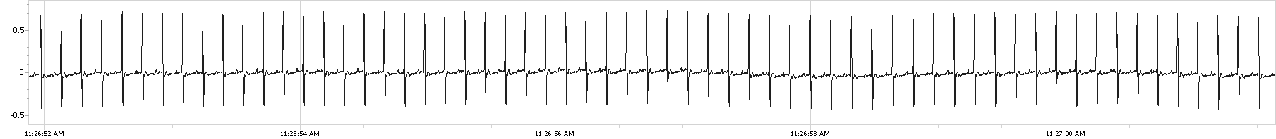
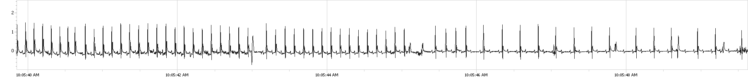
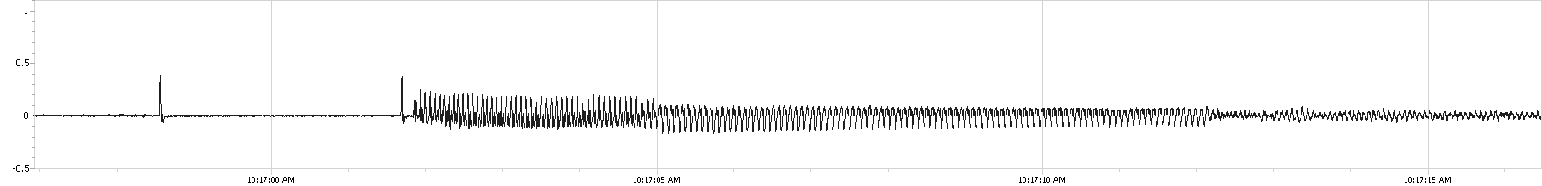
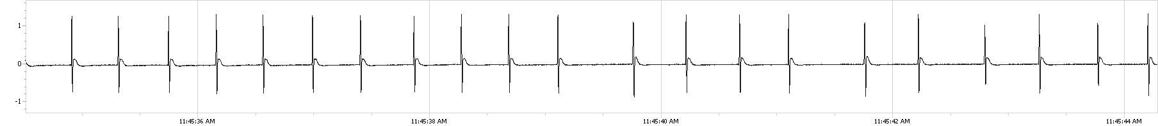
a
Time (sec) | 70% CO₂ | 30% CO₂ | Isoflurane¹ | CO | N₂
Onset of arrhythmias | 5.2±3.9* | 18.5±6.9* | 42.7±41.6**** | 45.1±5.6*/**** | 48.1±9.2*/****
b
ECG voltage (mV)
Normal rhythm
1 sec
*
+ Second degree atrio-ventricular block
ECG voltage (mV)
*
+
+
+
+
+
+
+
*
+
+
+
*
+
+
*
* Premature ventricular complex (PVC)
1 sec
‡
ECG voltage (mV)
‡ ventricular tachycardia
1 sec
ECG voltage (mV)
$
$ ventricular fibrillation
1 sec
ECG voltage (mV)
#
#
#
#
#
#
#
#
#
#
#
#
#
#
#
#
#
#
#
#
# Sinus pauses
1 sec
Supplementary Fig. 8: Arrhythmias observed in rats after exposure to different gases. Animals were attributed to one of the following groups: 70% CO₂ (black, n=19), 30% CO₂ (blue, n=18), isoflurane (pink, n=20), CO (yellow, n=10) or N₂ (green, n=10). a) onset of arrhythmias. b) Normal ECG (electrocardiogram) during baseline and examples of arrhythmias: second degree atrio-ventricular block, premature ventricular complex (PVC), ventricular tachycardia, ventricular fibrillation, sinus pauses. Statistical analysis was performed with Kruskal-Wallis with Dunn’s multiple comparisons test. Values are reported as means ± SD. Statistical significance is indicated as follows: ∗ p< 0.05; ∗∗ p< 0.01; ∗∗∗ p< 0.001, ∗∗∗∗ p< 0.0001. In blue each group is compared to 30% CO₂. In black each group is compared to 70% CO₂. ¹ only 70% of animals experienced arrhythmia during induction of anesthesia with isoflurane.

Slide 9
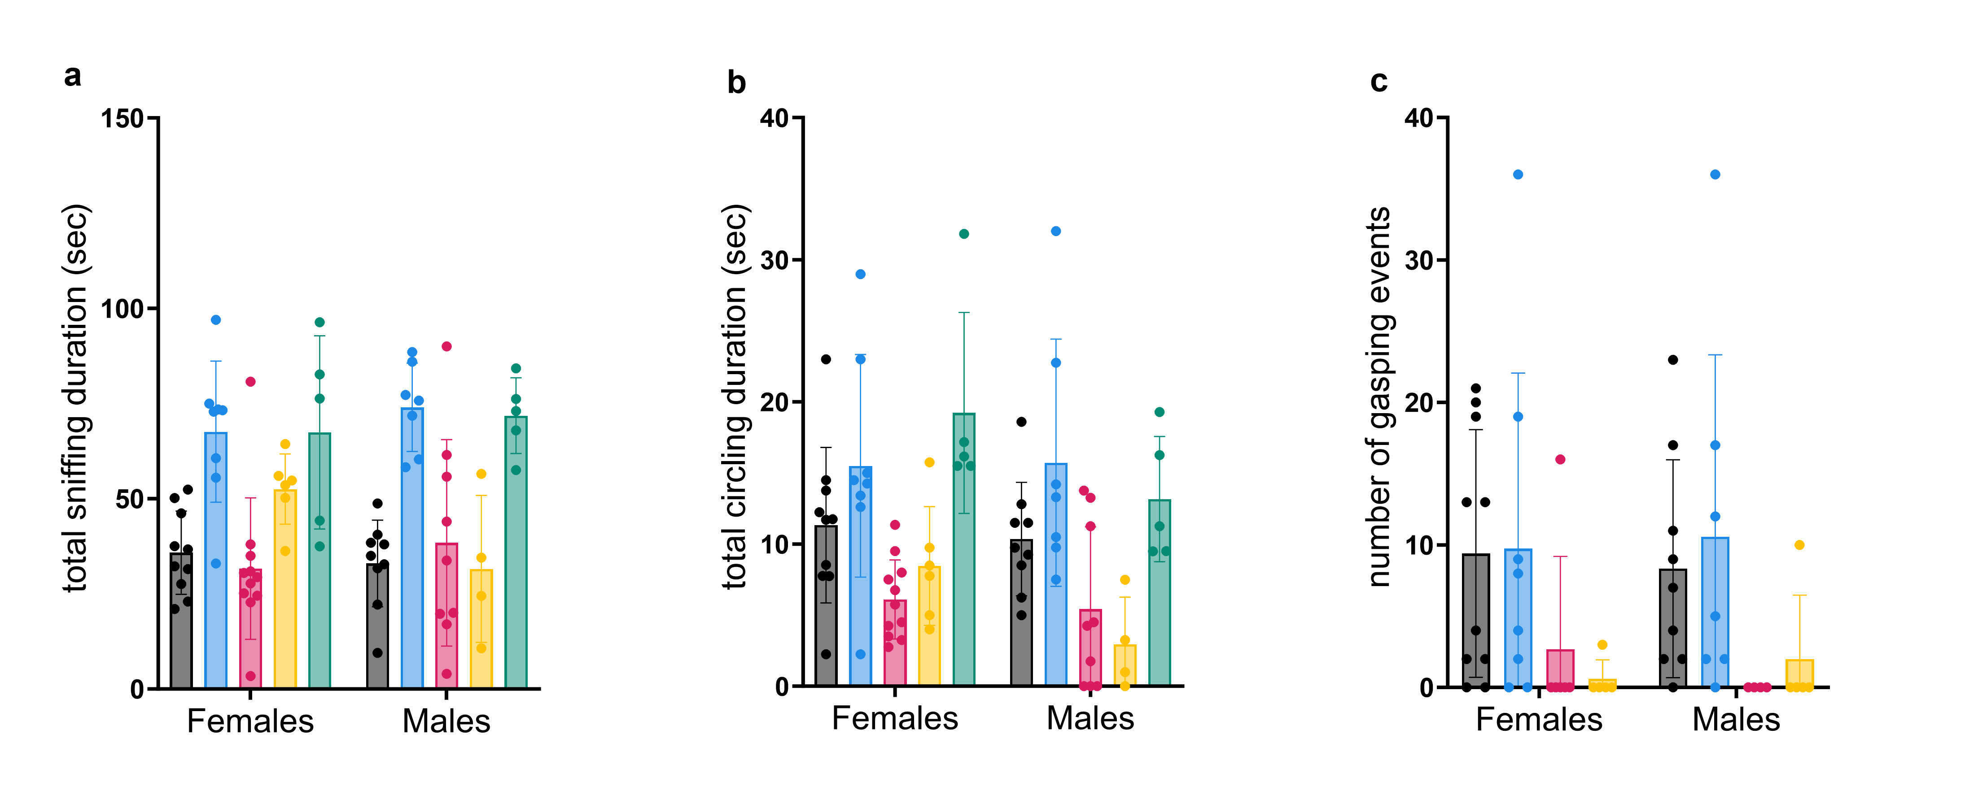
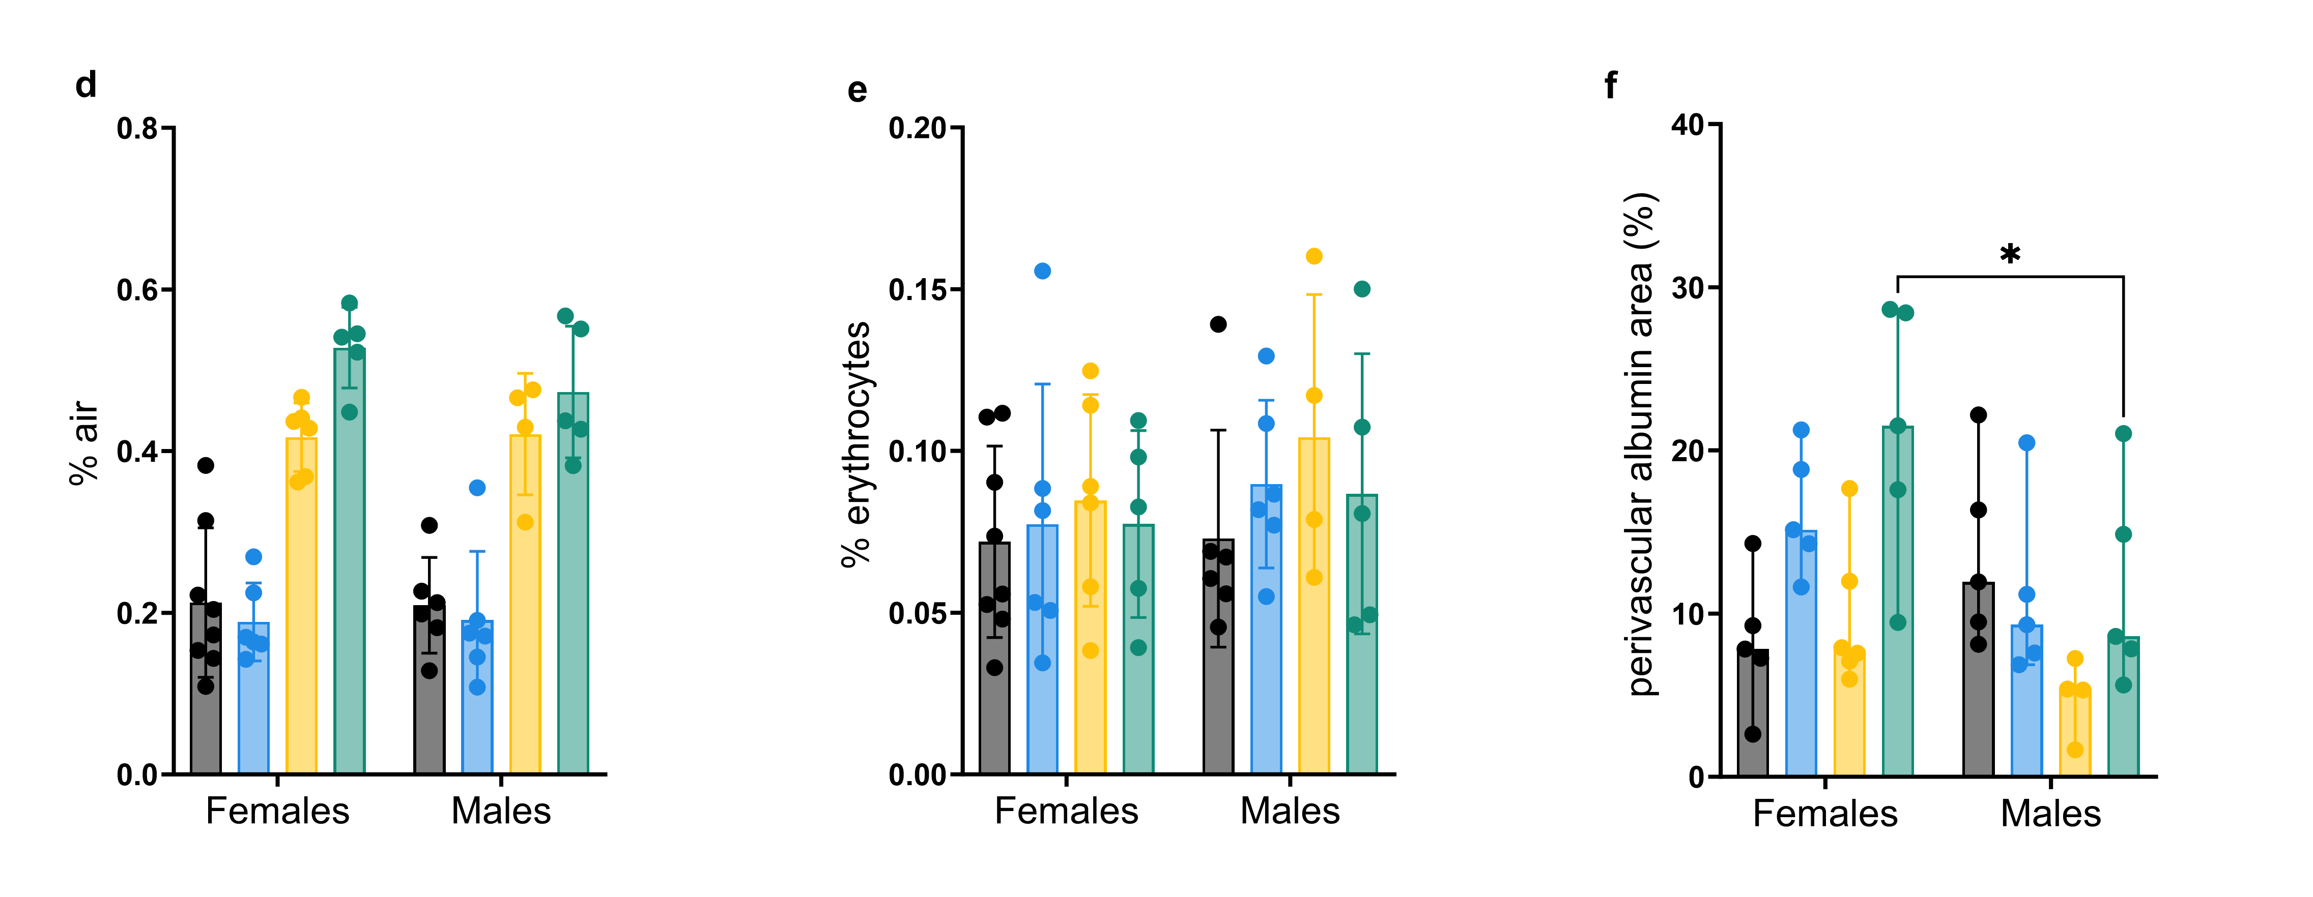
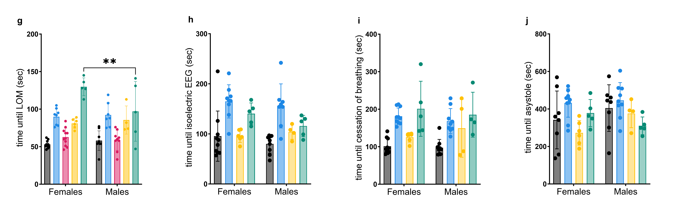
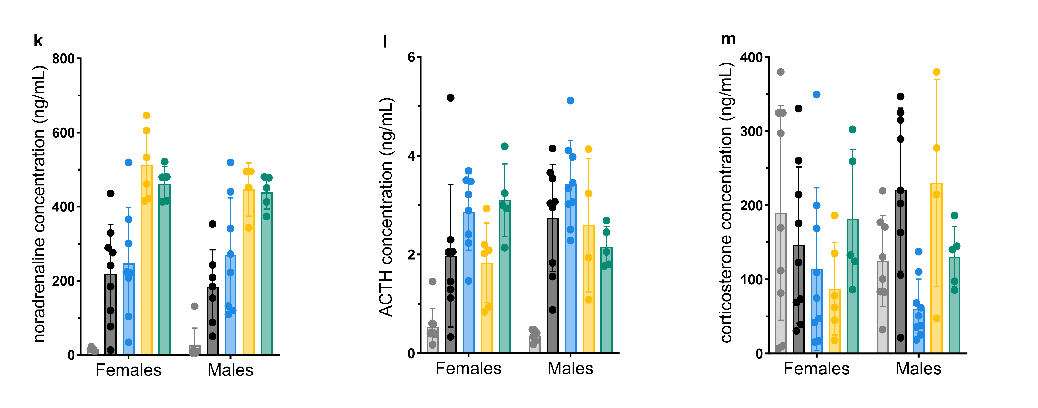
Baseline
70% CO₂
30% CO₂
Isoflurane
CO
N₂
Supplementary Fig. 9: Sexes differences in rats euthanized with 70% CO₂, 30% CO₂, CO or N₂ or anesthetized with isoflurane. a-b) Sniffing and circling durations. c) Number of gasping events. d-f) morphometric quantification of air spaces, number of erythrocytes and perivascular albumin area. g-j) Times until loss of motion (LOM), isoelectric electroencephalogram (EEG), cessation of breathing, and asystole. k-m) Stress hormone levels for noradrenaline, ACTH (Adrenocorticotropic hormone) and corticosterone. Statistical analysis was performed with 2-way-ANOVA with Šídák's multiple comparisons tests. Values are presented as means ± SD. Statistical significance is indicated as follows: ∗ p< 0.05; ∗∗ p< 0.01; ∗∗∗ p< 0.001, ∗∗∗∗ p< 0.0001.

Slide 10
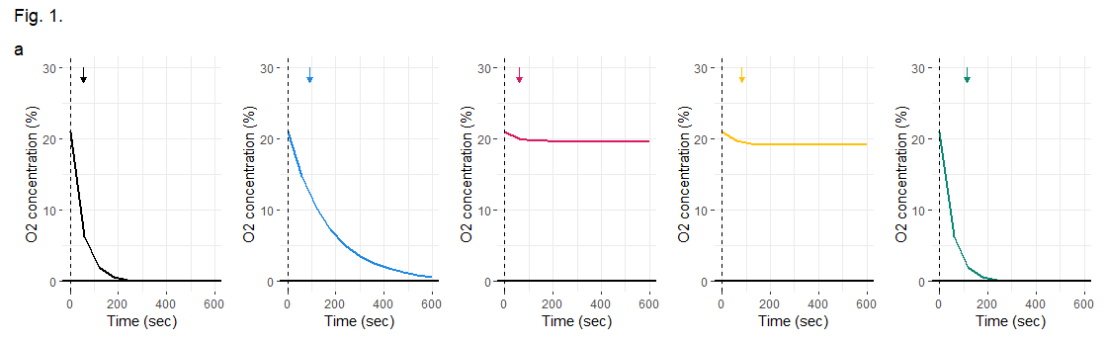
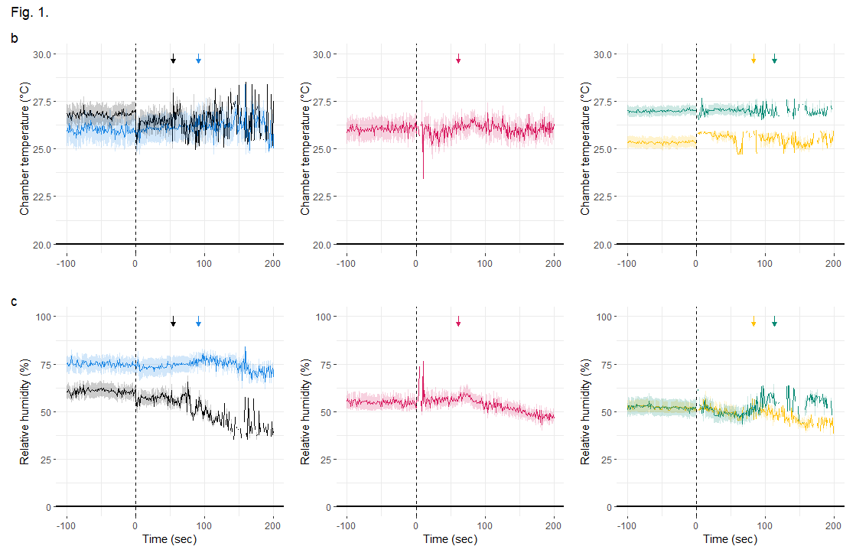
Supplementary Fig. 10: Oxygen concentration, chamber temperature and relative humidity during anesthesia or euthanasia with different gases. a) Oxygen (O₂) concentration was calculated over time for each gas. b-c) Chamber temperature (°C) and relative humidity (%) in the chamber over time for 30% CO₂ (blue, n=19), 70% CO₂ (black, n=19), isoflurane (pink, n=20), CO (yellow, n=10) and N₂ (green, n=10). The dotted lines represent the gas influx at time point 0. The arrows indicate the time of loss of motion for each group.

