Slide 1
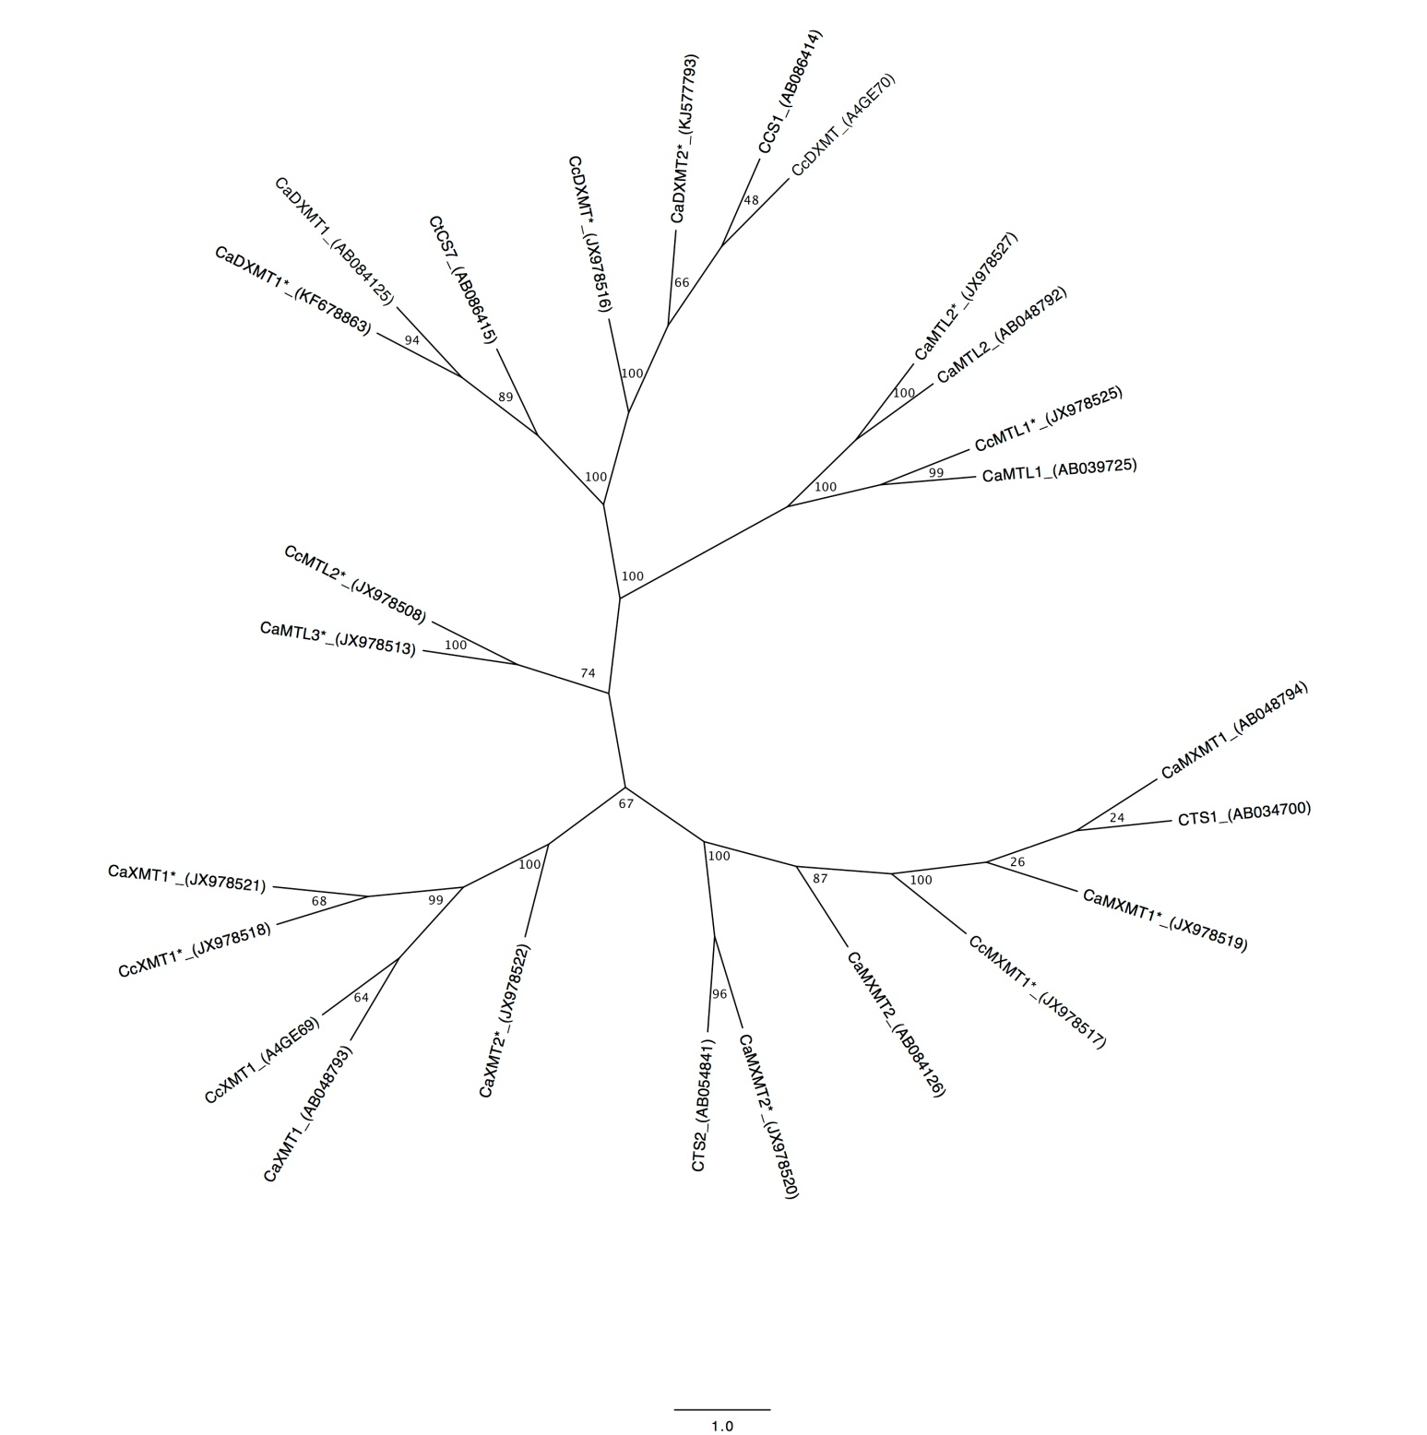
Cluster III
Cluster IV
Cluster I
Cluster II

