Slide 1
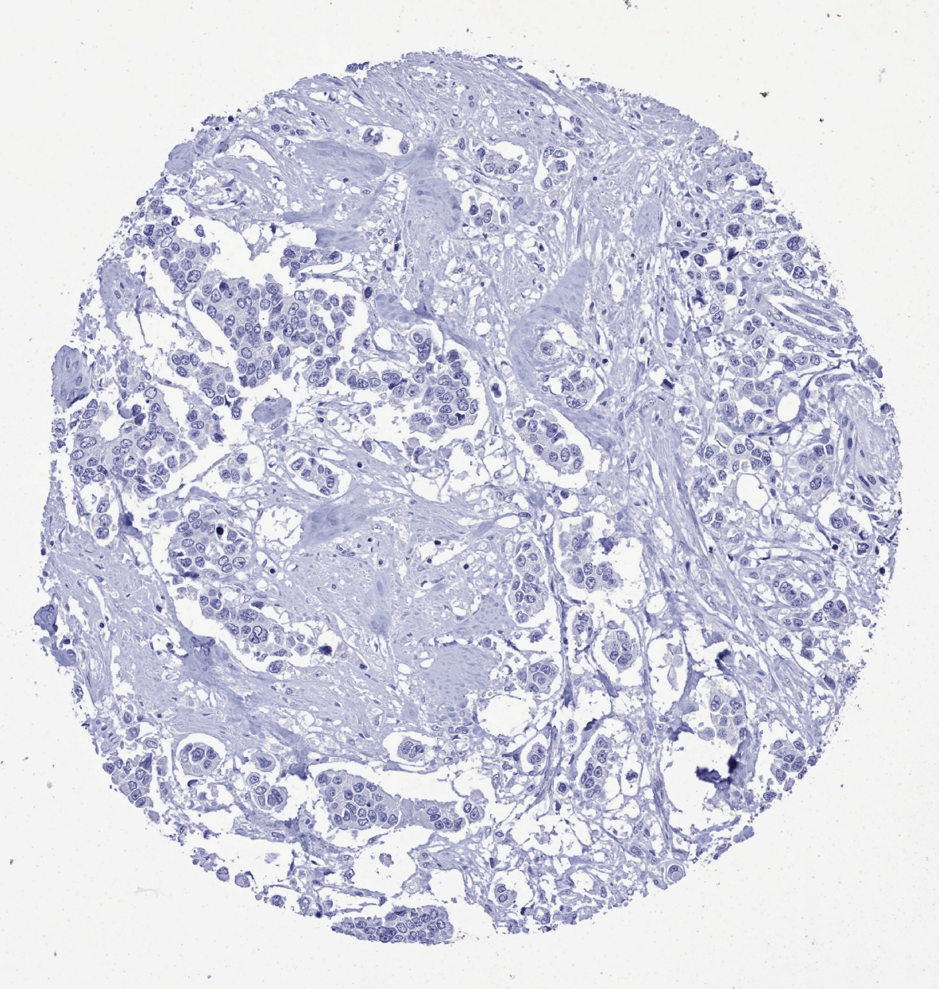
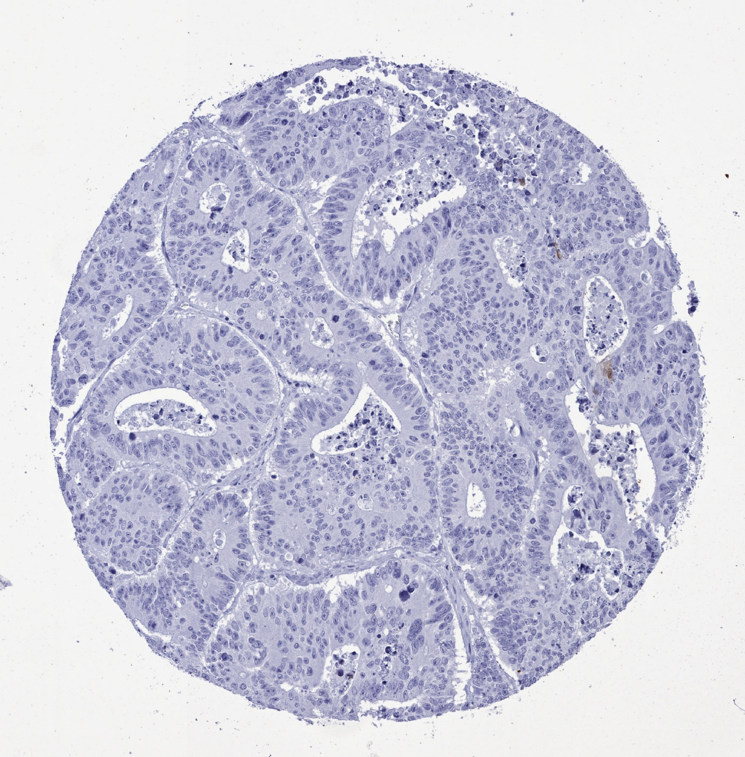
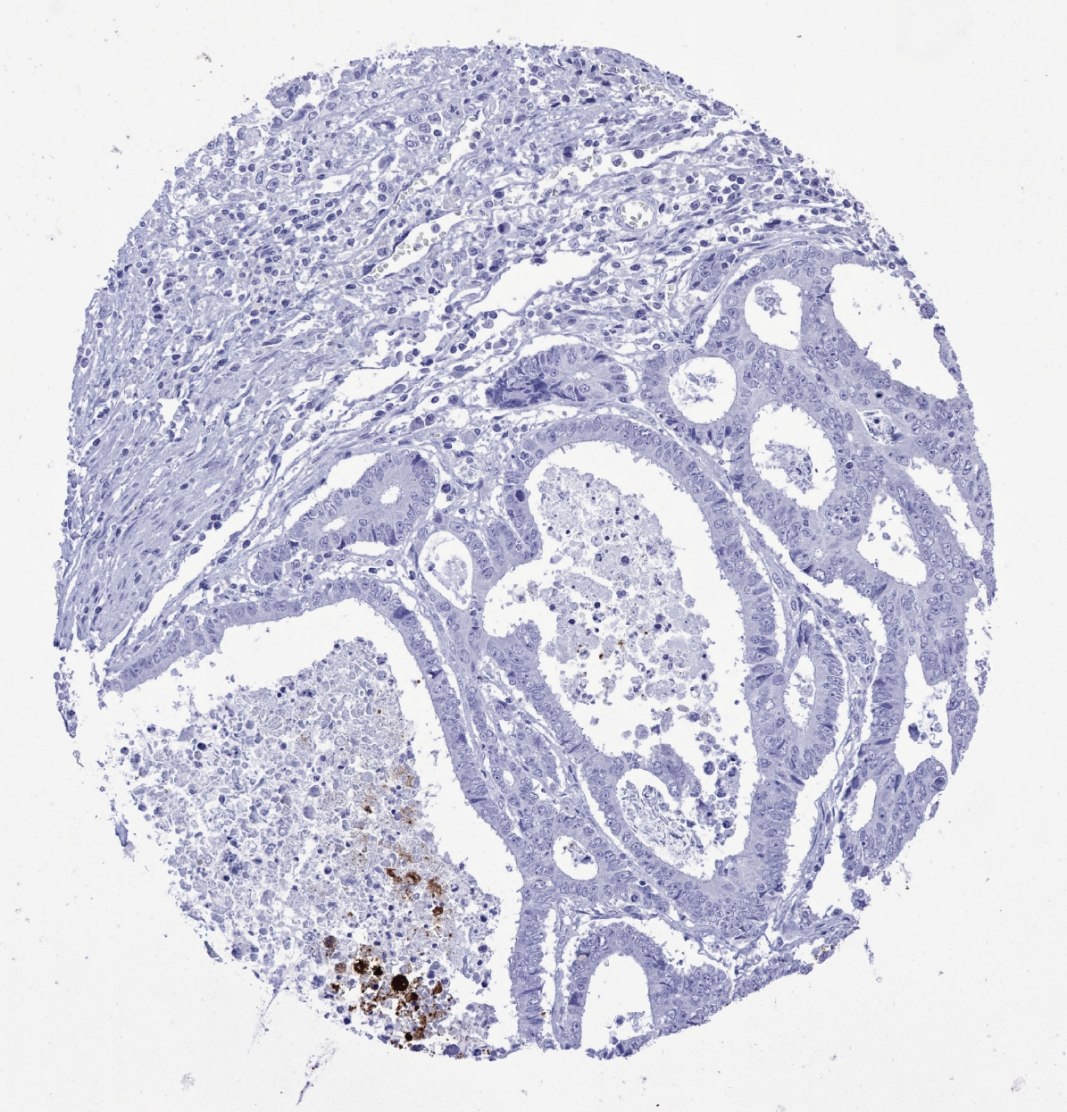
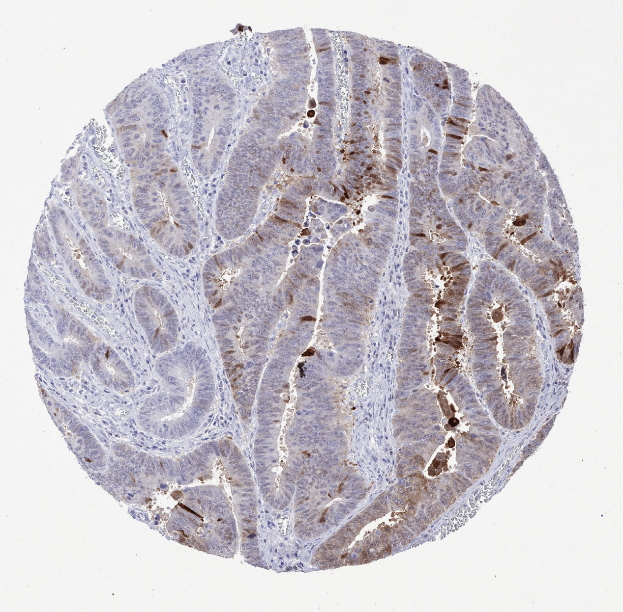
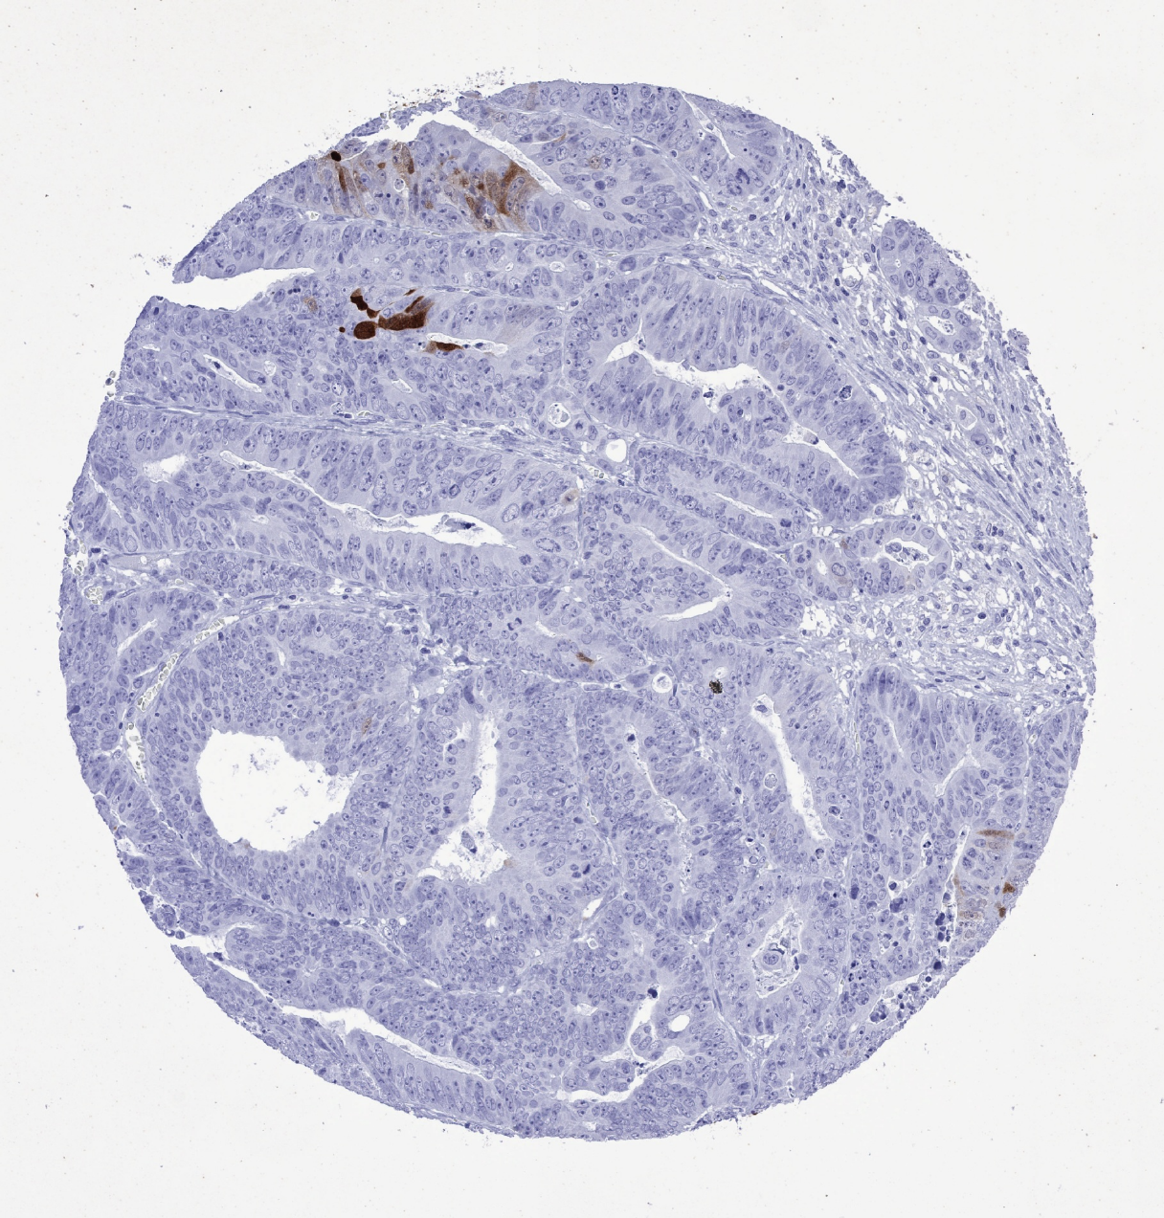
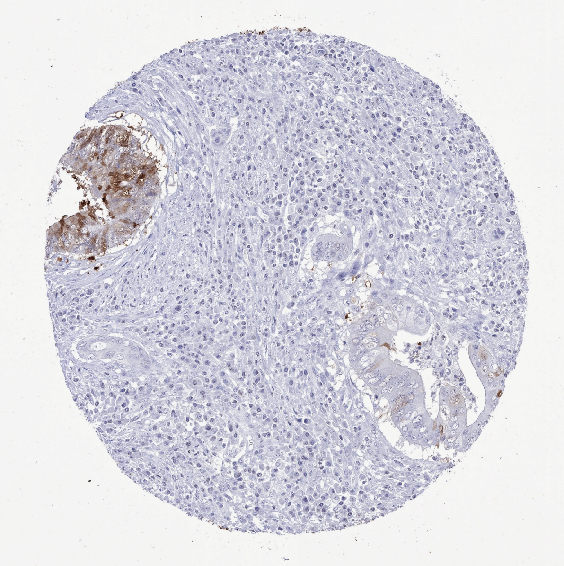
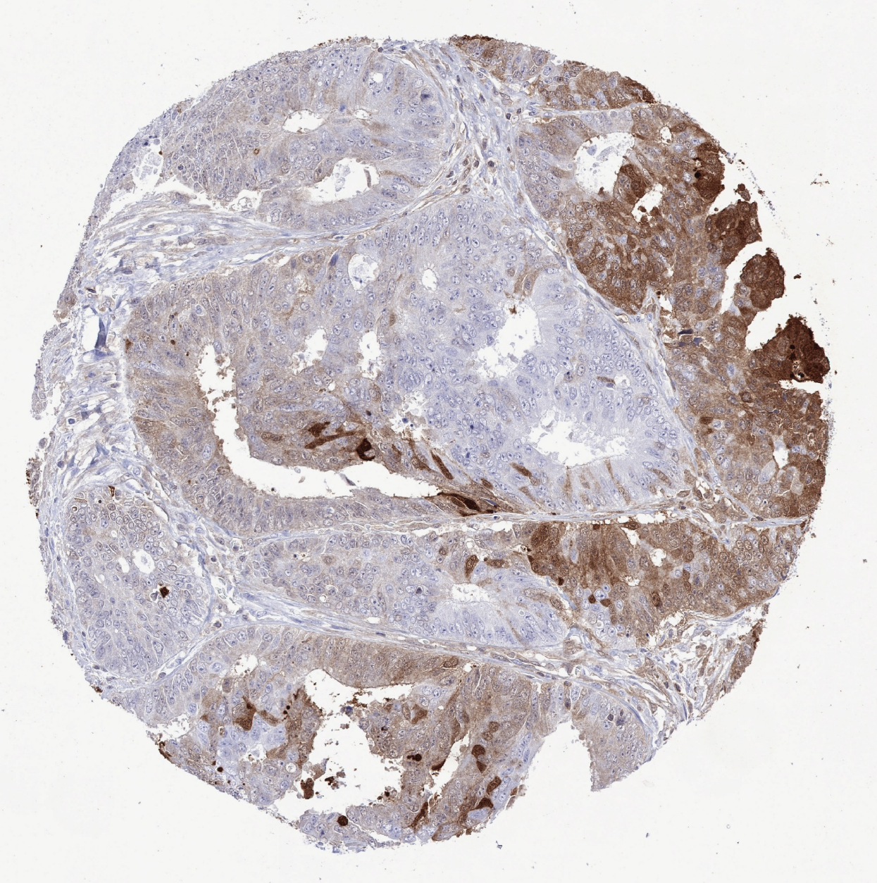
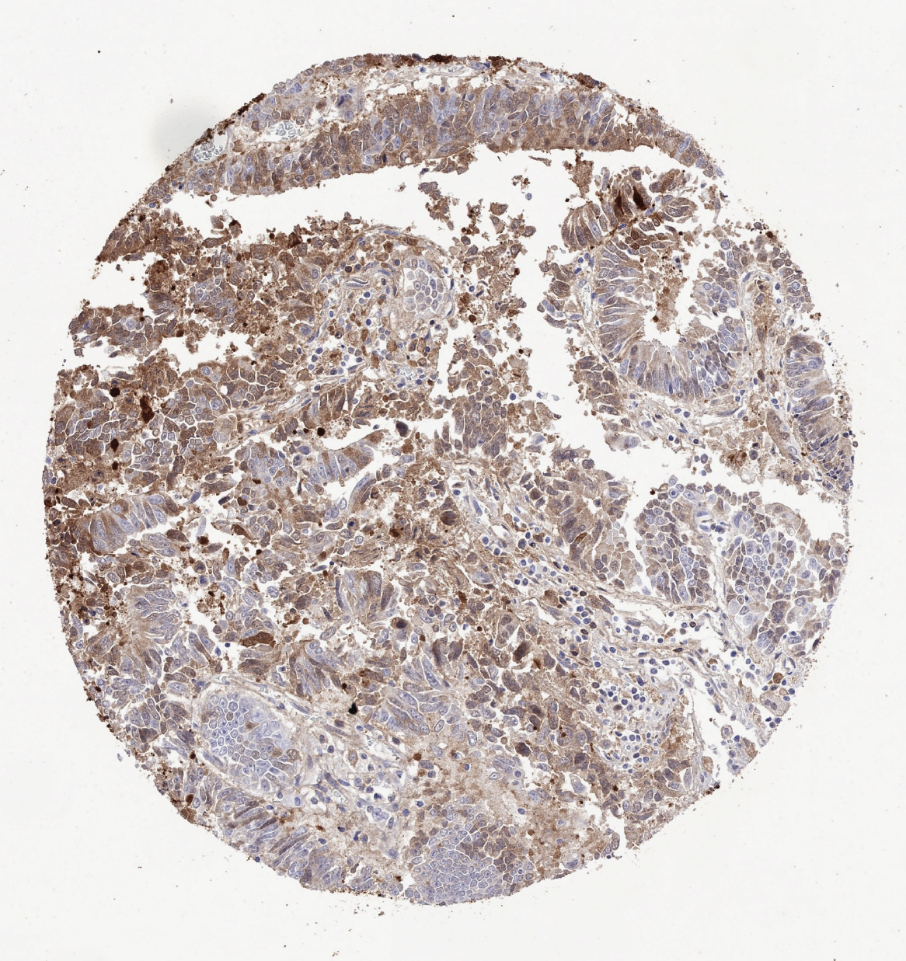
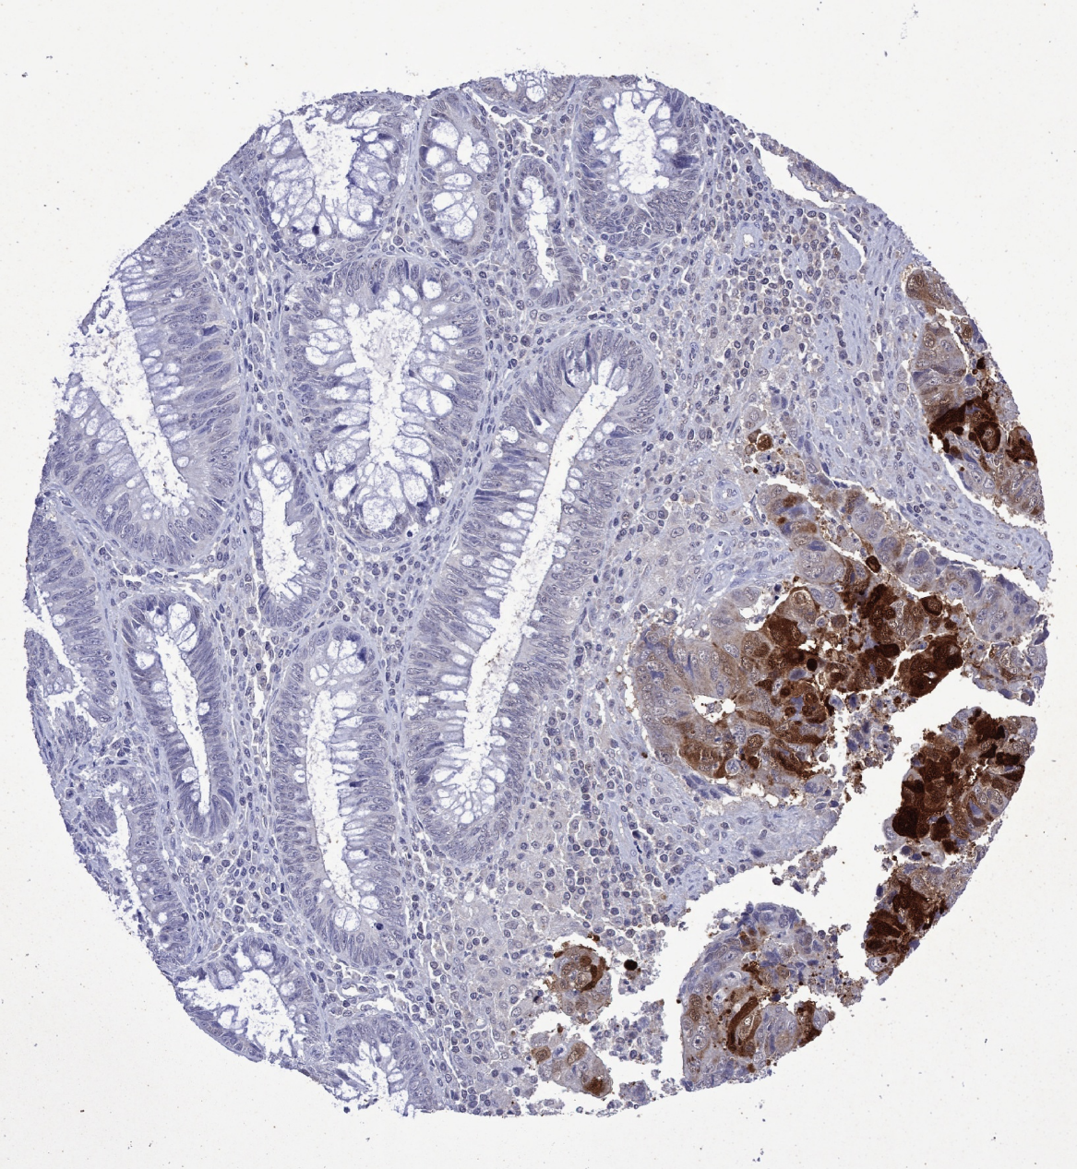
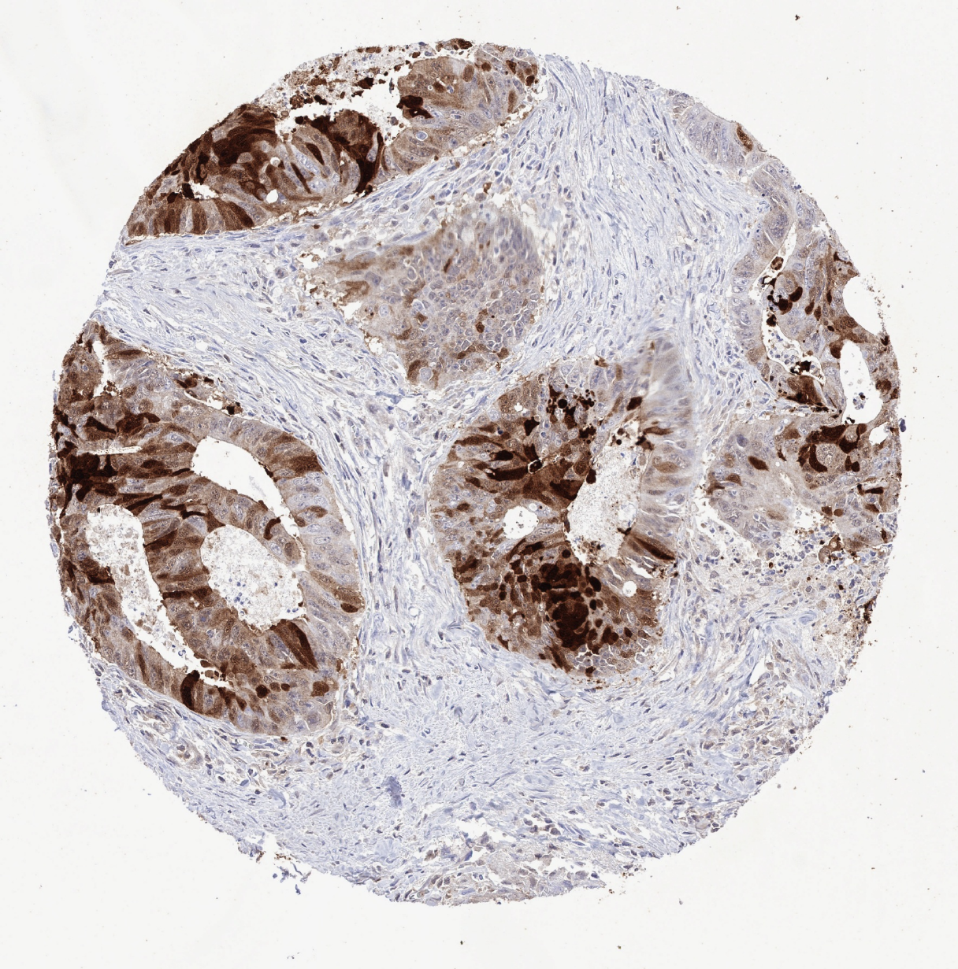
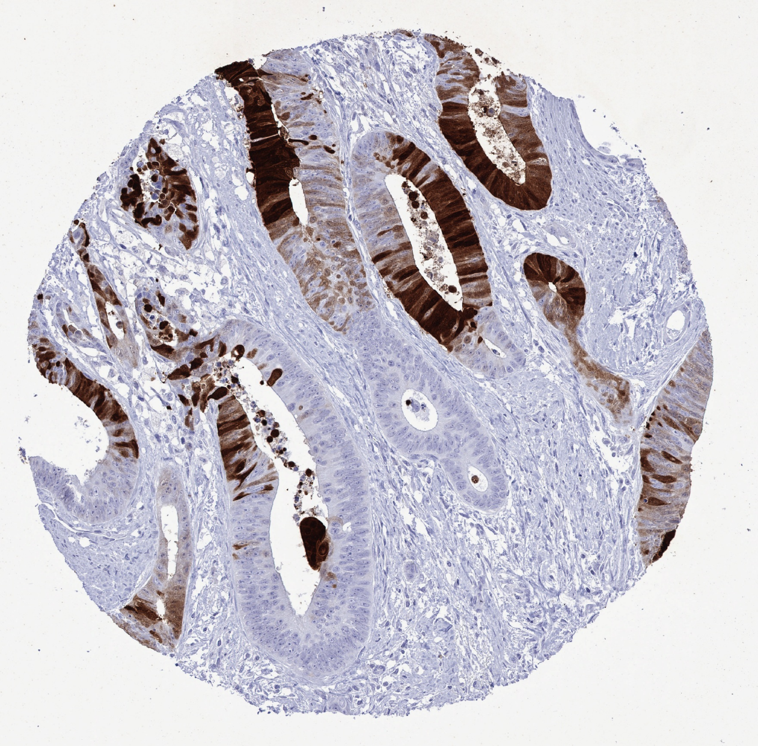
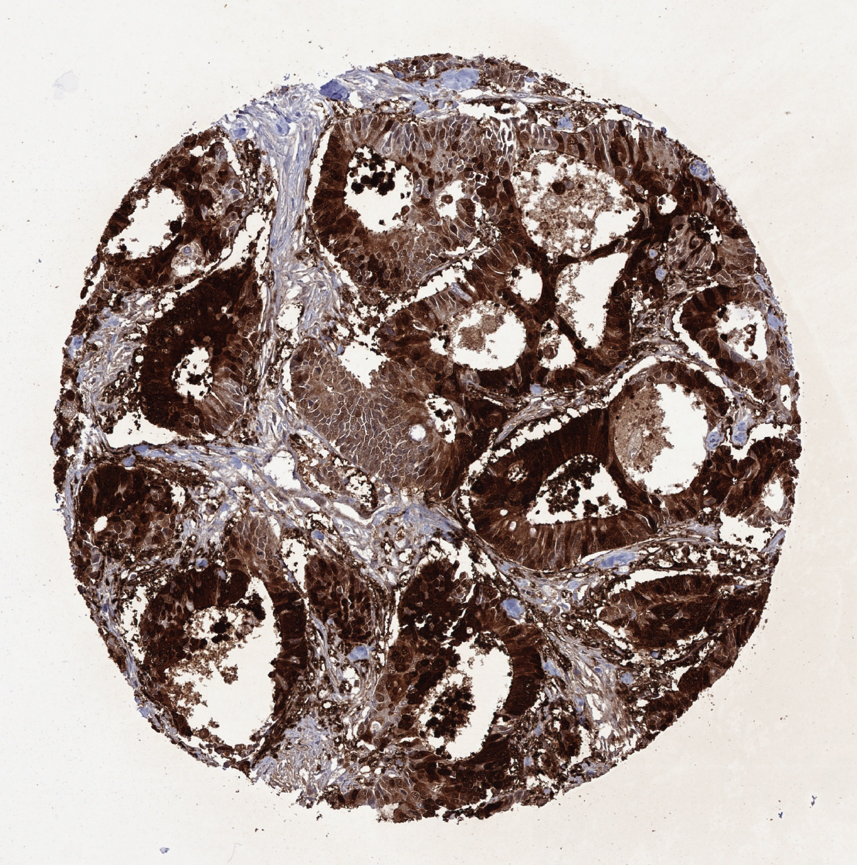
Supplementary Figure 1: Examples of FABP1 immunhistochemistry scores in colon adenocarcinomas.
negative
(0)
Pigment
weak
(1+ ≤70% or
2+ ≤30%)
1+
40%
2+
5%
2+
30%
moderate
(1+ >70% or
2+ >30 but ≤70%
or 3+ ≤30%
2+
40%
2+
60%
3+
20%
strong
(2+ >70% or
3+ >30%
2+
80%
3+
50%
3+
100%

