Slide 1
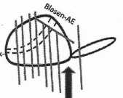
Case No.
Base
Bladder
Prostate/ Seminal Vesicle interface
Apex
Prostate/ Seminal Vesicle transition zone
Right
Left
ventral
dorsal
Apex

