Slide 1
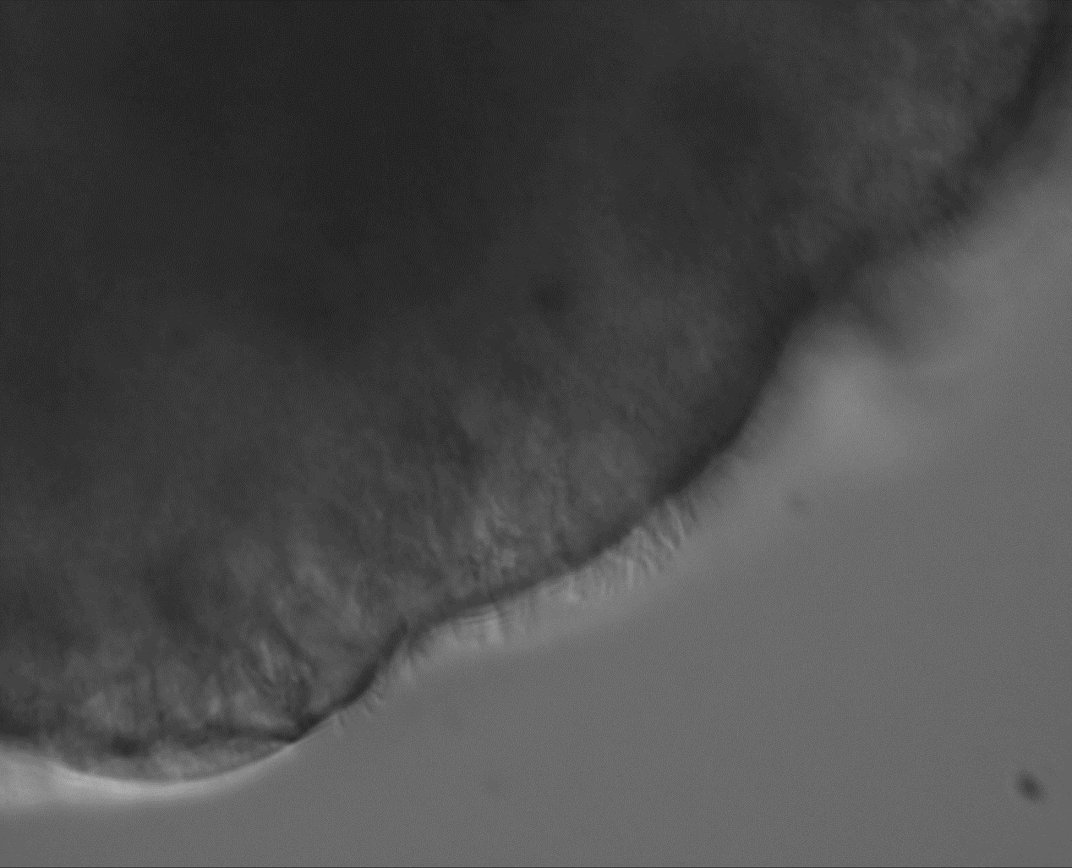
Suppl. Video 1
Supplementary Video 1. Airway Organoids express motile cilia on their exterior. Representative video recording demonstrating the presence of multiciliated cells on the outer side of human airway organoids. The cilia exhibited coordinated, wave-like beating patterns. Video was recorded at 37°C using a Zeiss Axiovert A1 microsope with a 40x objective.
Notes:
Principal component analysis (PCA) of AOAO transcriptomes that were mock-treated or infected with PA14 for 7 hrs (n = 4 per group).

