Slide 1
Supplementary Figure S2. GSEA of 247 genes linked by GREAT with 351 human-specific LTR7 and LTR5_Hs using the Enrichr bioinformatics platform (A – F).
Related to Figure 5. Inference of putative phenotypic impacts of human-specific LTR7 & LTR5_Hs loci based on GREAT algorithm-guided functional annotations of proximity placement-linked genes.

Slide 2
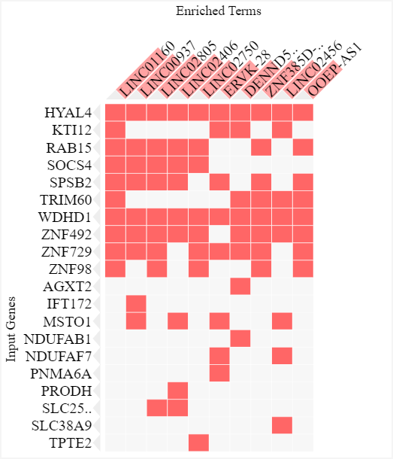
A
351 hs LTR7 & LTR5_Hs loci
247 genes:
lncHUB lncRNA co-expression database;
top 10 significantly enriched records

Slide 3
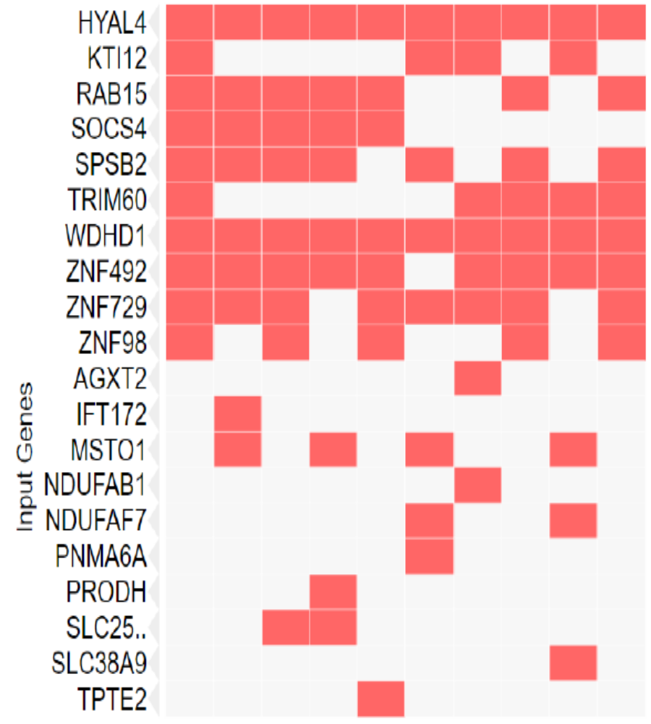
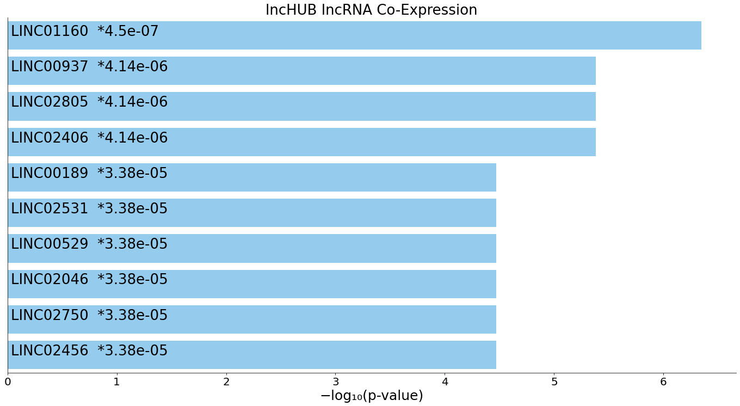
B
351 human-specific LTR7 & LTR5_Hs loci
247 genes
Fetal Gonad Marker Genes
Naïve Primed Pluripotent States Genes

Slide 4
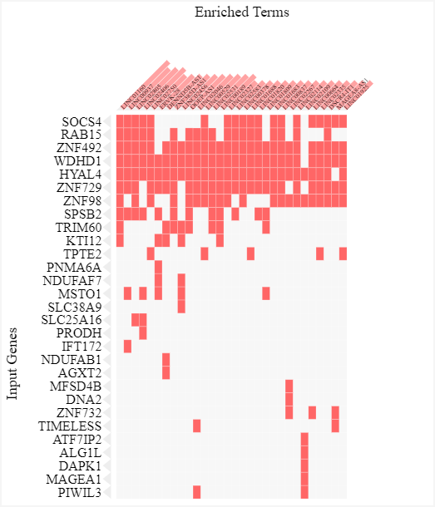
C
351 hs LTR7 & LTR5_Hs loci
247 genes:
lncHUB lncRNA co-expression database;
top 30 significantly enriched records

Slide 5
D
351 human-specific LTR7 & LTR5_Hs loci
247 genes
Fetal Gonad Marker Genes
Naïve Primed Pluripotent States Genes

Slide 6
E
Human-specific LTR7 and LTR5_Hs associated genes encoding markers of 12 distinct cell populations of fetal gonads
Gonadal Mitotic Phase Fetal Germ cells: Fetal Gonad | Leydig Precursor cells: Fetal Gonad | Gonadal Endothelial cells: Fetal Gonad | Sertoli cells: Fetal Gonad | Mitotic Fetal Germ cells: Fetal Gonad | Oogenesis Phase Fetal Germ cells: Fetal Gonad | Migration Phase Fetal Germ cell: Fetal Gonad | Endothelial cells: Fetal Gonad | Meiotic Prophase Fetal Germ cell: Fetal Gonad | Granulosa cell: Fetal Gonad | Leydig cell: Fetal Gonad | Mitotic Arrest Phase Fetal Germ cells: Fetal Gonad
RAB3B | SEMA5A | SEMA6A | HACD1 | DAPK1 | KMT2E | WDHD1 | WDHD1 | KMT2E | SEMA5A | PGRMC1 | SERPINE2
IFT172 | FSTL5 | STIM2 | CXADR | NVL | RBFOX1 | ZNF729 | KLHL7 | BTG3 | TFRC | CILP | HENMT1
COL22A1 | SERPINE2 | CD109 | CDH2 | TMEM51 | KCNK9 | NVL | IDH2 | NECAB1 |  | GSTA3 | DNAJB6
SLC25A16 | GOLIM4 | IDH2 | GSTA4 | KLF4 | GOLIM4 | ZNF486 | FAM126A | SETD2 |  | SPIDR | STIM2
FAM124B | EMP2 | DAB2IP | LIPH | SLC25A16 | TMEM64 |  |  | DR1 |  |  | TBL1XR1
EFEMP1 | PDE5A | PLXNA2 | PRUNE2 | CAPN13 | ADARB2 |  |  | ATF7IP2 |  |  | GFPT2
DNMBP | ITM2C | TIMELESS | C21ORF91 | FAM124B | SVIP |  |  | PHKB |  |  | DCAF12L1
RAB15 |  | PDE4B | OSBPL11 | EFEMP1 | RUFY1 |  |  | FOXK1 |  |  | GOLIM4
NDUFAB1 |  | ST3GAL6 | GGT1 | ZNF729 | FA2H |  |  | TMEM64 |  |  | SIRPA
PLXNA2 |  | ADM | HS6ST1 | RAB15 | FSTL5 |  |  | OSBPL11 |  |  | CA8
STOM |  | LRIG3 | SVIP | NDUFAB1 | TBL1XR1 |  |  | FAM126A |  |  | RAD9B
SOCS4 |  | KLF4 |  | STOM | KLHL7 |  |  | PGRMC1 |  |  | SH3GL2
ITM2C |  |  |  | PRODH | PSD3 |  |  | BOC
 |  |  |  | ZNF486 | ACO1 |  |  | POT1
 |  |  |  | ITM2C | SGK1 |  |  | RAD9B
 |  |  |  |  | FOLR1 |  |  | LHX8
 |  |  |  |  | PFKP |  |  | CNTLN
 |  |  |  |  | SH3GL2
 |  |  |  |  | LHX8

Slide 7
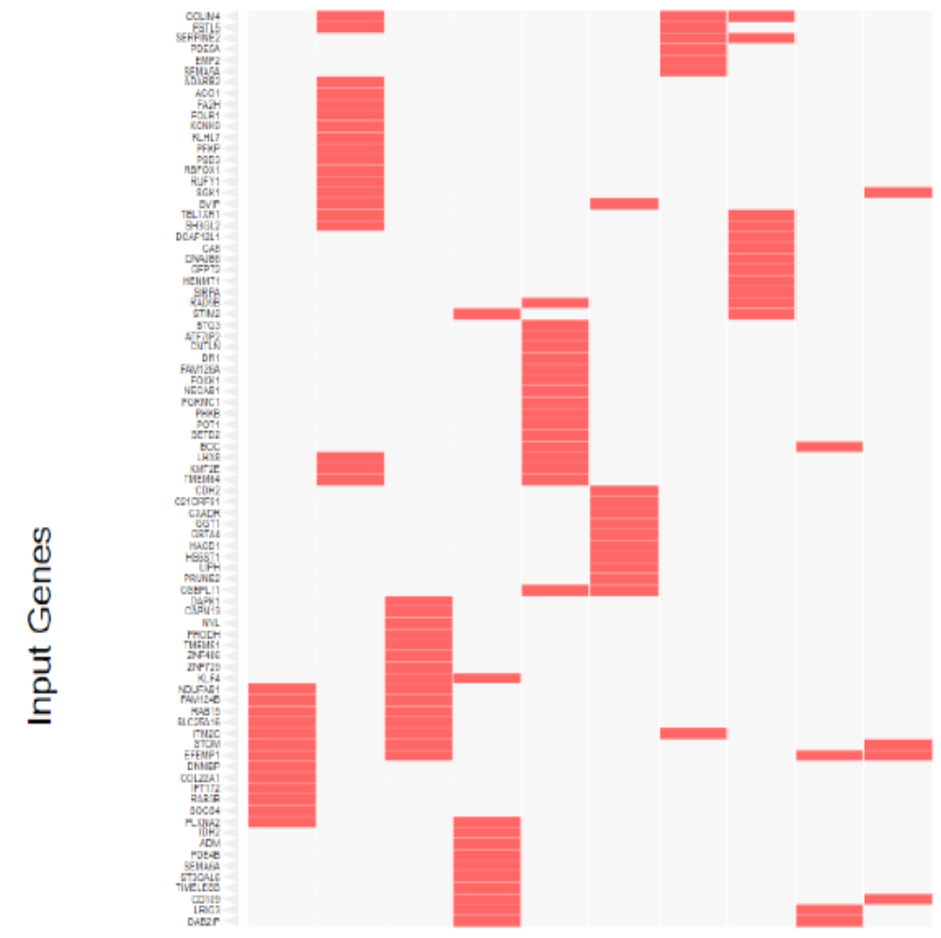
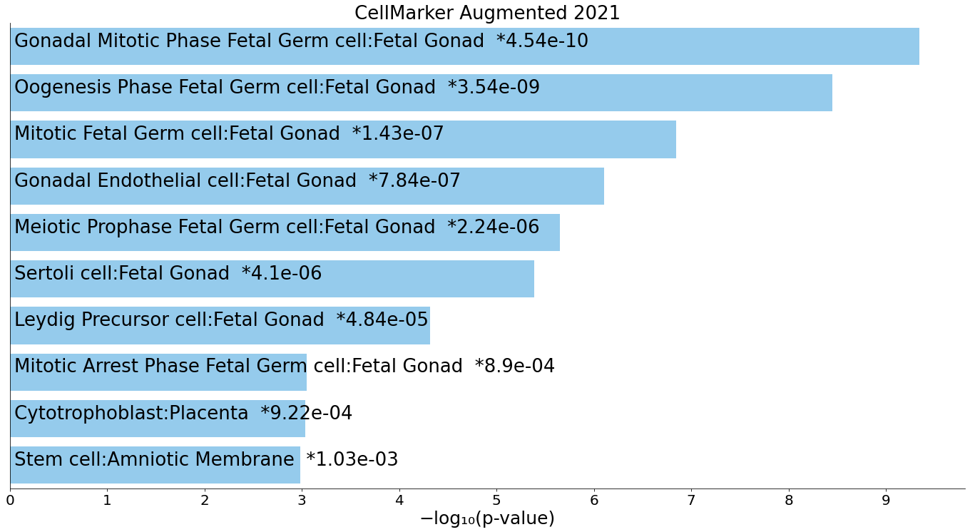
F
Human-specific LTR7 and LTR5_Hs associated genes encoding markers of distinct cell populations of fetal gonads
Top 10 significantly enriched records

