Slide 1
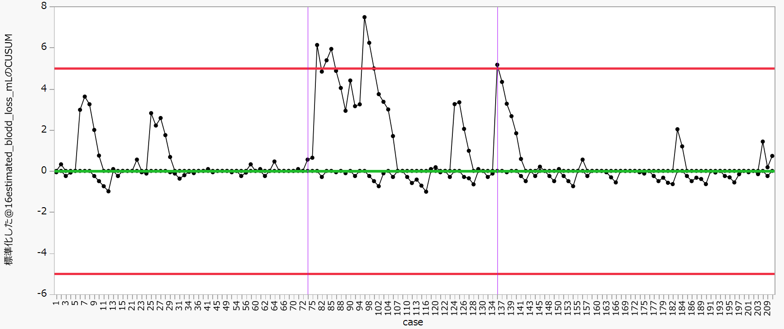
Supplement Figure. 2b: CUSUM analysis of EBL in minor resection.
Supplement Figure 2b
The upper and lower red lines represent the upper control limit (UCL) and lower control limit (LCL).
Blue line shows the learning curve effect
Purple line shows the Deterioration in learning effectiveness

