Slide 1
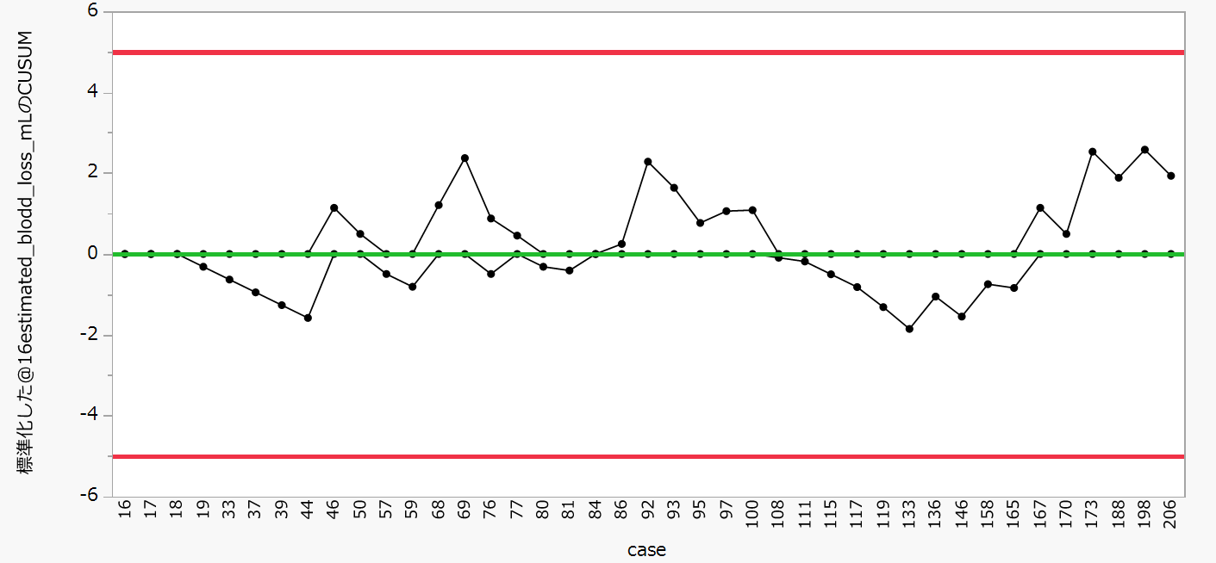
Supplement Figure. 2c: CUSUM analysis of EBL in major resection.
Supplement Figure 2c
The upper and lower red lines represent the upper control limit (UCL) and lower control limit (LCL).
Blue line shows the learning curve effect

