Slide 1
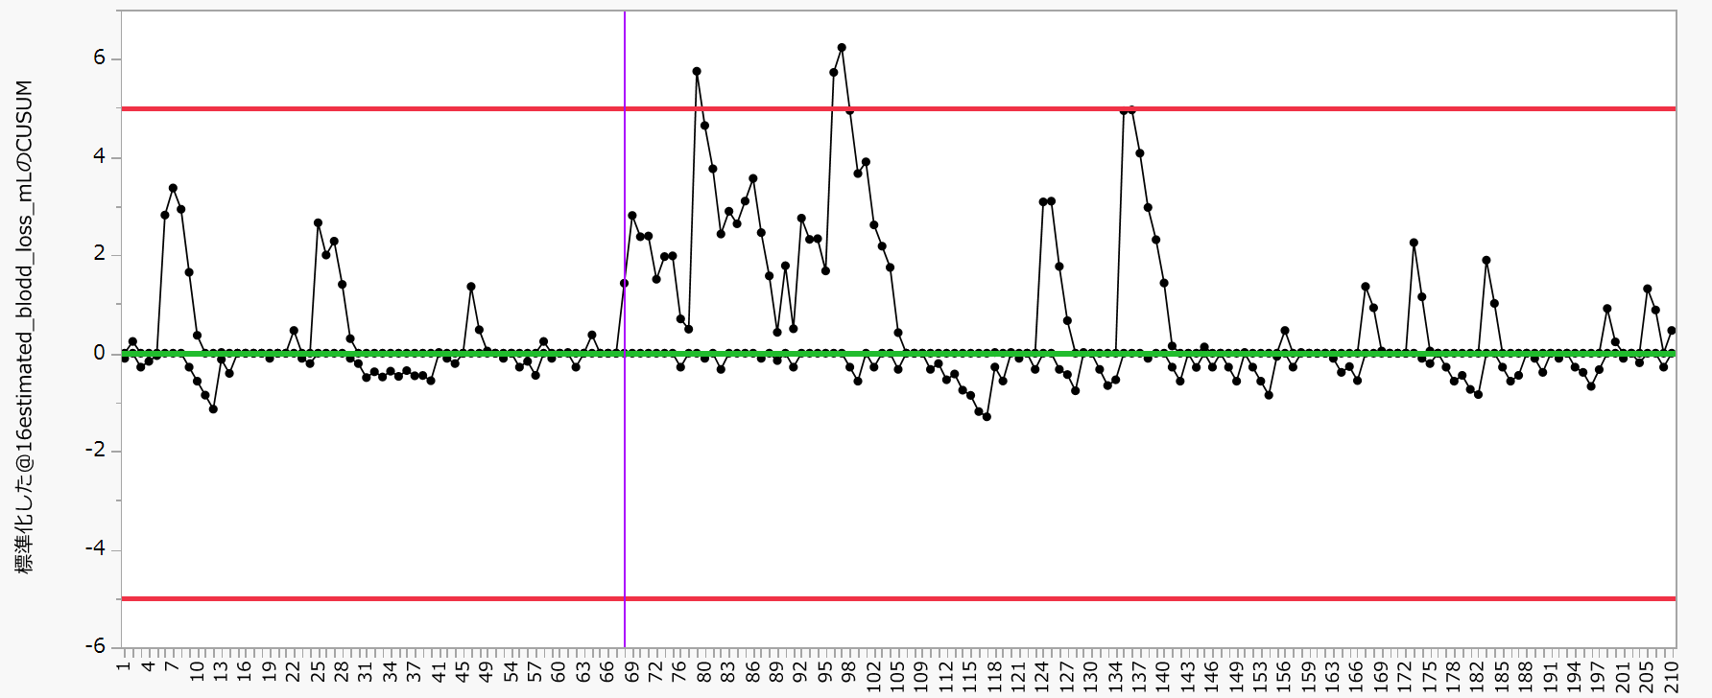
Supplement Figure. 2a: CUSUM analysis of EBL in all cases
Supplement Figure 2a
The upper and lower red lines represent the upper control limit (UCL) and lower control limit (LCL).
Blue line shows the learning curve effect
Purple line shows the Deterioration in learning effectiveness

