Slide 1
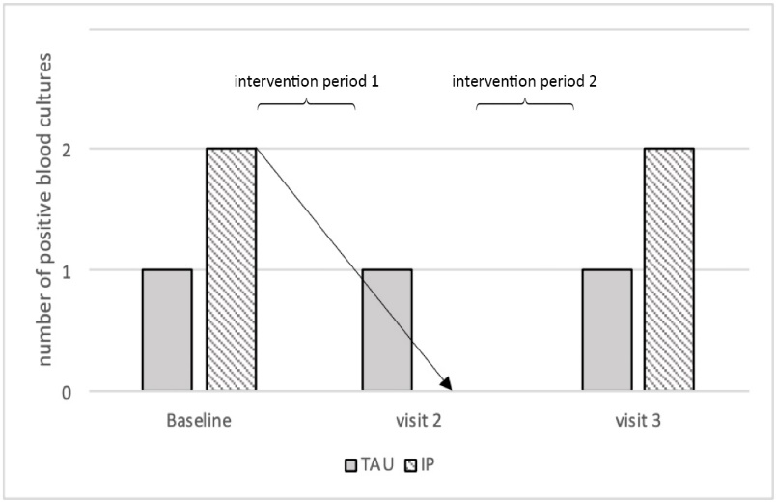
The impact of a needs-oriented dental prophylaxis program on bacteremia
after toothbrushing and systemic inflammation in children, adolescents and
young adults with chronic kidney disease
HYPOTHESIS: Dental prophylaxis can reduce bacteremia after toothbrushing and chronic inflammation in CKD patients
DESIGN & OUTCOMES:
1. Blood sampling after toothbrushing
BACTECTM:
9.5% positive
affecting 26% of the patients 8 bacterial species
Pilot study
Intensive dental prophylaxis (IP)
Treatment as usual (TAU)
Intensive dental prophylaxis reduced bacteremia risk (n.s.)
27 CKD patients
6–26 years
Gingivitis
Randomised controlled trial
No significant change in CRP after intervention
2. Blood sampling after toothbrushing
Gingivitis reduction by IP in CKD patients (p = 0.001)
CONCLUSION: Intensive dental prophylaxis reduced gingivitis and bacteremia risk. Whether IP might also be a promising approach in reducing systemic inflammation needs to be shown in future studies.
Höfer, Turnowsky et al. 2021

