Slide 1
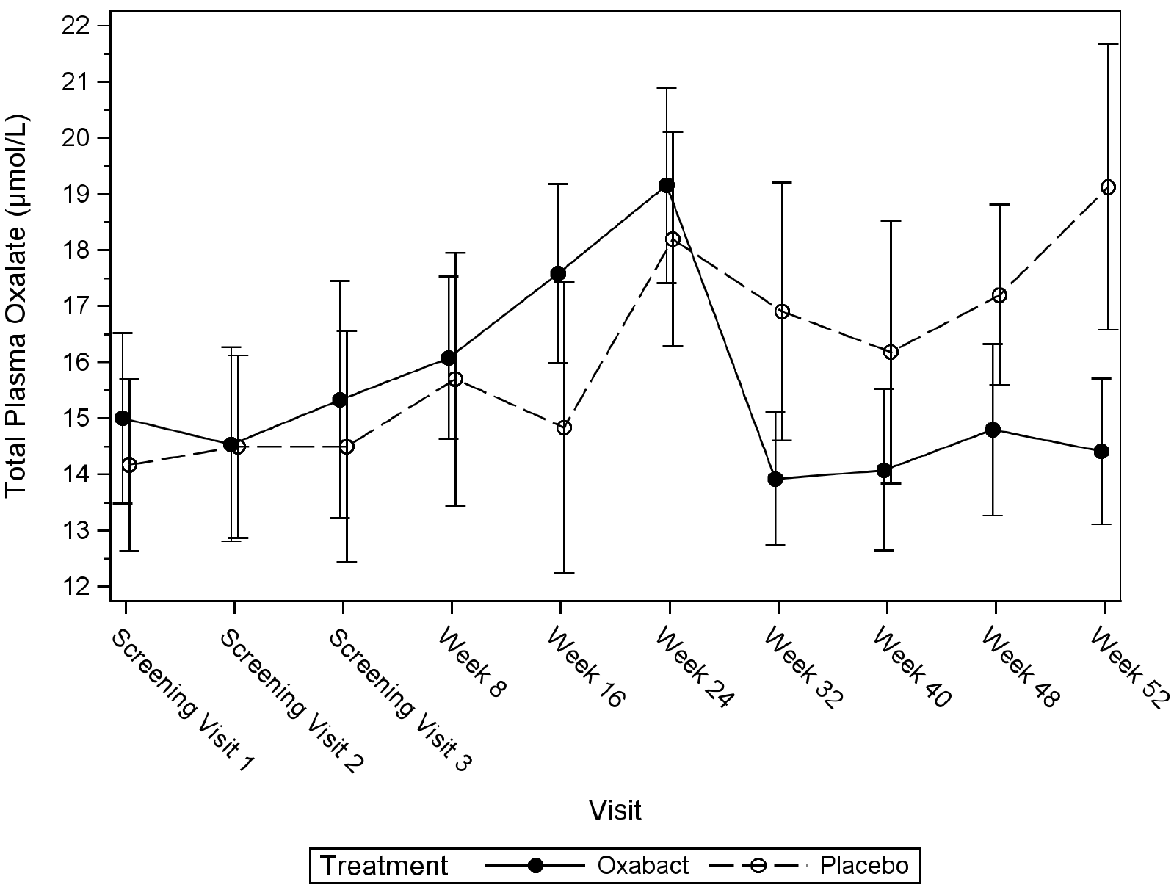
ePHex: A Phase 3, Double-blind, Placebo-controlled, Randomized Study to Evaluate Long-term Efficacy and Safety of Oxalobacter formigenes in Patients with Primary Hyperoxaluria
HYPOTHESIS: Treatment with Oxalobacter formigenes (OxabactTM) may improve the excretion of oxalate in patients with Primary Hyperoxaluria (PH)
DESIGN & OUTCOMES:
Primary Endpoint
25 Patients with PH
(eGFR <90mL/min/1.73m²)
Twice Daily,
52 weeks
Change in Plasma Oxalate (Pox) from baseline
Total Pox appeared stabilized in Oxabact vs Placebo
(BUT no sig change: p=0.064)
Total Pox
Oxabact group
N=13
p=0.064
Secondary Endpoints
Kidney function
Kidney function (no sig change)
Placebo group
N=12
Kidney stone events
Subtle reduction in kidney stone parameters
CONCLUSION: Treatment with Oxabact did not cause a significant reduction in Pox over 12 months. However, Oxabact may have a beneficial role in preventing kidney stones.
Ariceta et al. 2022

