Slide 1
Detection of Urine Protein by Boiling

Slide 2
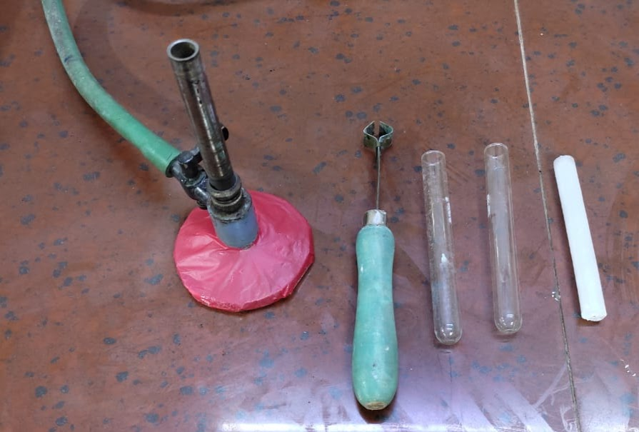
What do we need?
Test-tubes
Test-tube holder
Heat Source
  Bunsen burner OR Spirit Lamp
  (does not produce soot)
  OR
  Candle – produces soot which will need to be wiped off
Bunsen burner
Test-tubes
Candle
Test-tube holder

Slide 3
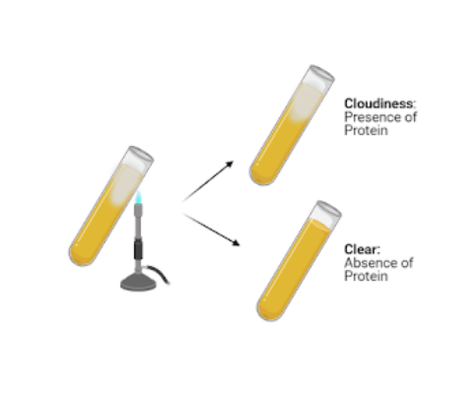
How is the test done?
Pour a sample of urine into a test-tube
Hold the test tube with a holder
Heat the sample, holding the test-tube inclined over the flame so that just the upper part of the urine is heated.
Allow to just - boil, and then remove from flame.
Compare the heated portion with the lower portion.
(Test tubes can be re-used after washing with soap and water, then rinsing well in running water and air drying in inverted position)

Slide 4
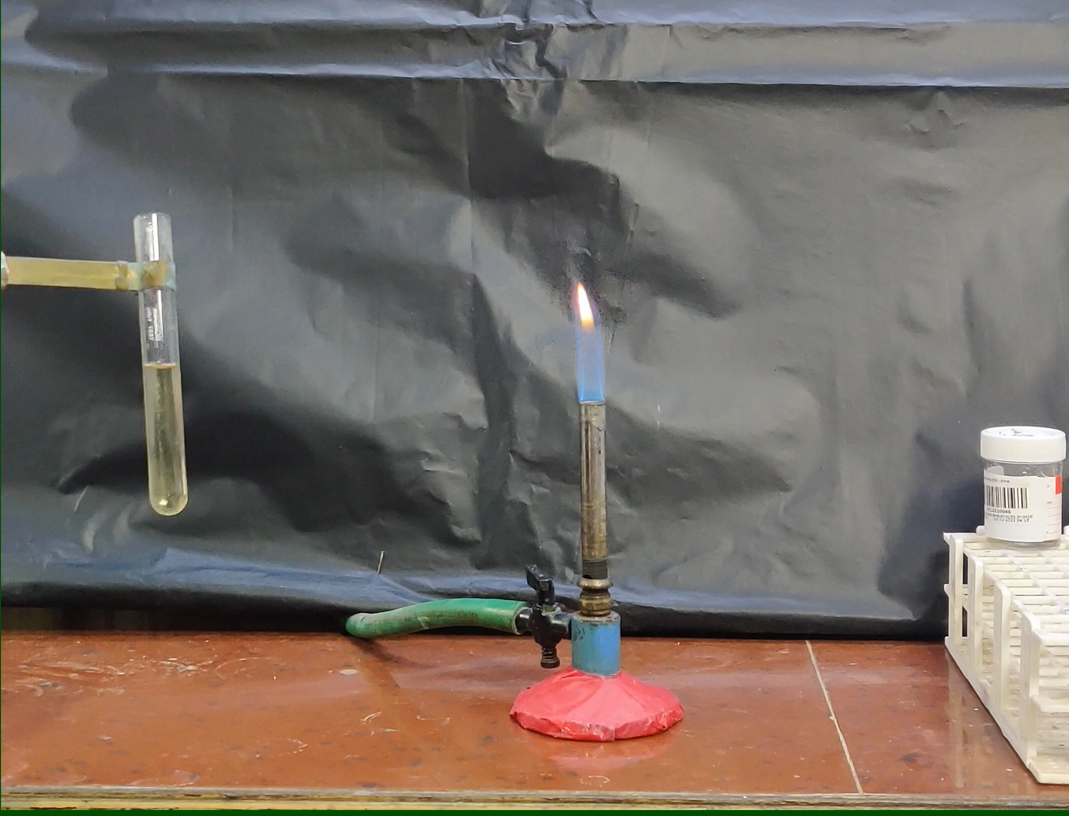
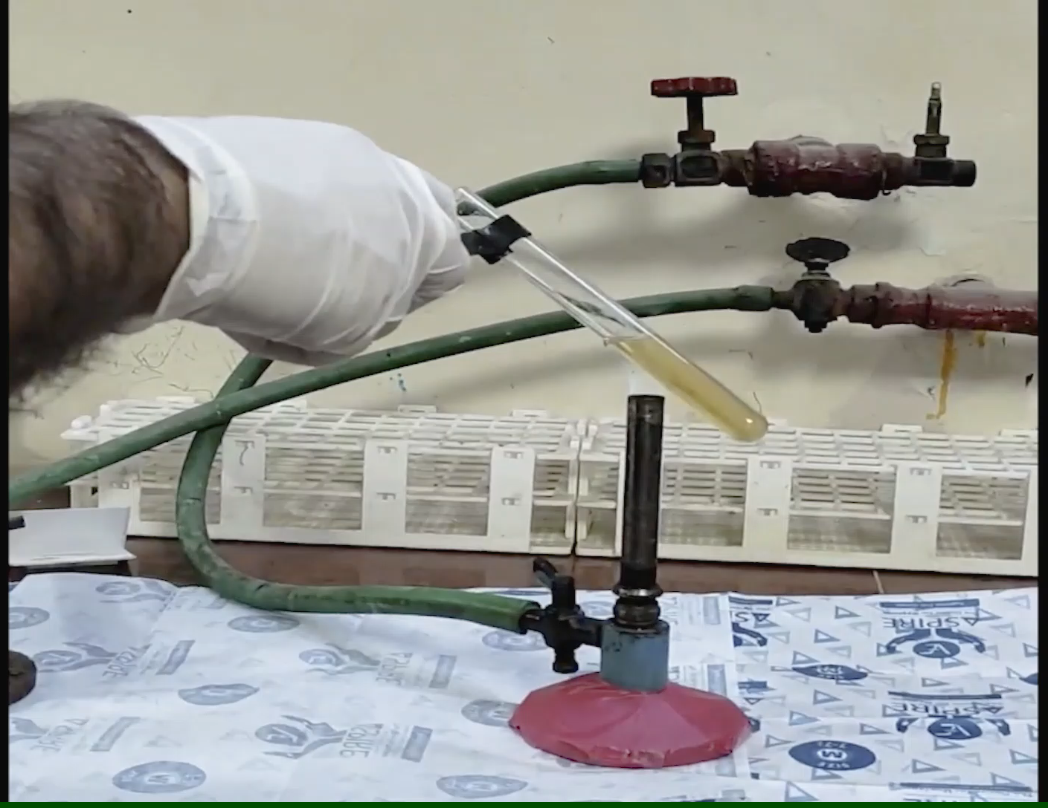
Demonstration using a Bunsen Burner
No protein in urine
Presence of Protein in urine
Video (click on the play button)
The urine remains clear after boiling
Video (click on play button)
There is a white coagulum formed where the urine has been heated

Slide 5
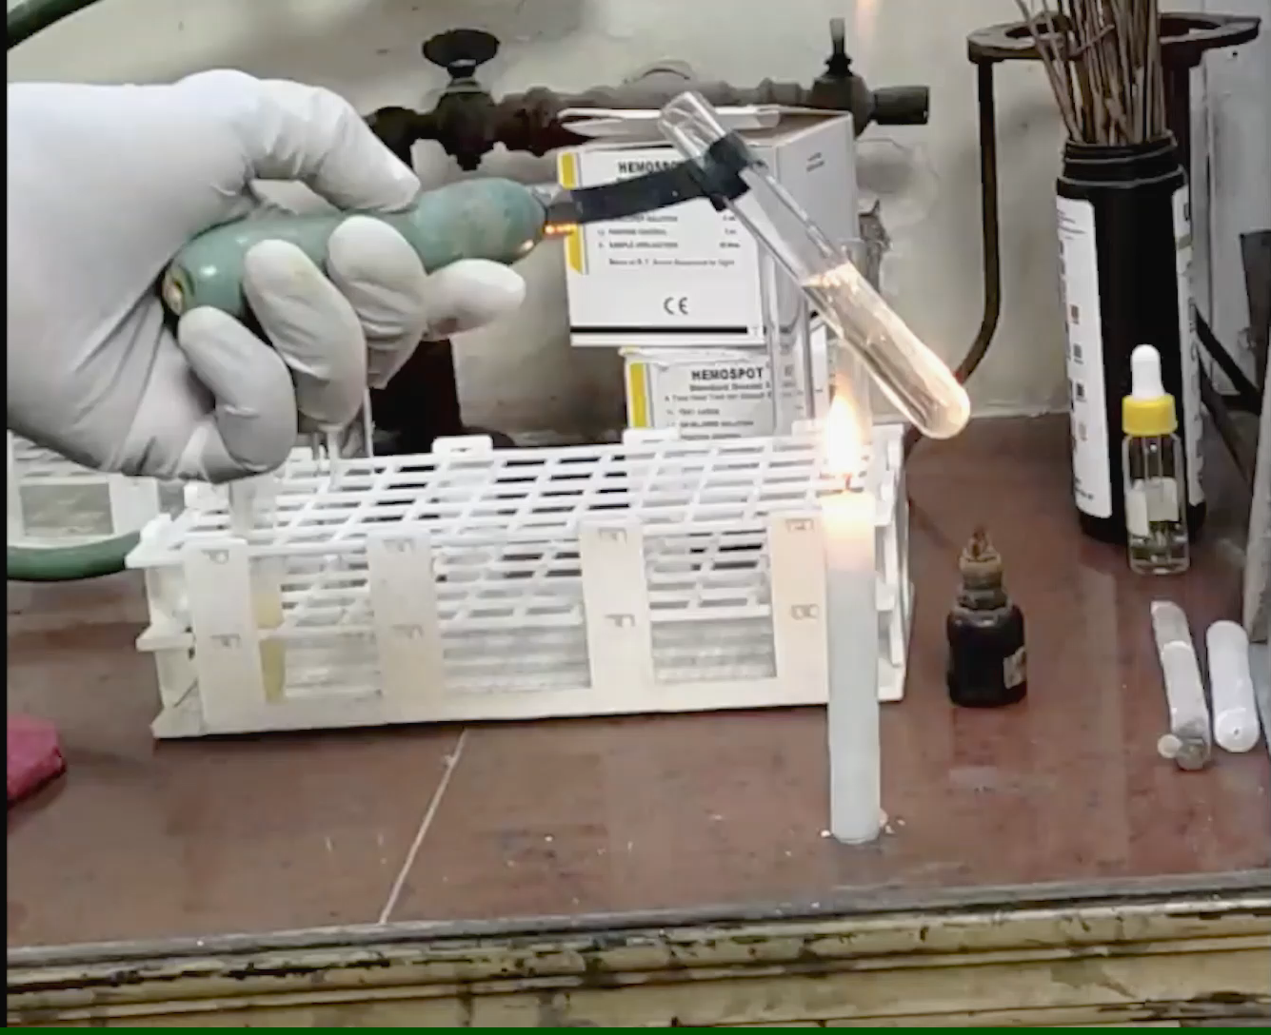
Demonstration using a Candle
Video (click on the play button)
The soot which is deposited on the test tube needs to be wiped off once it is cool.
Here, the white coagulum formed indicates presence of protein.

Slide 6
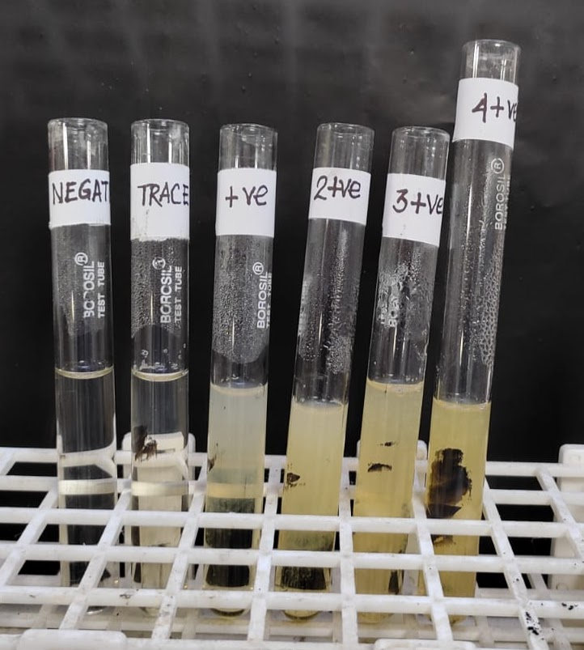
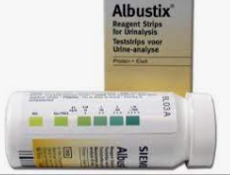

Different grades of urine protein :
The density of the turbidity formed depends on the amount of urine protein.
Here comparison is made with dipsticks urine protein measurements.

Slide 7
Points to note:
This is only a screening test and needs to be confirmed by dipsticks or laboratory testing.
Phosphate in urine can also cause similar turbidity. Addition of 2-3 drops of 3% acetic acid will lead to clearing of the coagulum in case of phosphate but not in the case of protein.
Please discuss with your Medical Team before making any changes to your/ your child’s treatment.

Slide 8
Mr Partha Pratim Das, Department of Clinical Pathology,
Dr Sushmita Banerjee, Department of Pediatrics,
Calcutta Medical Research Institute, Kolkata, India.

