Slide 1
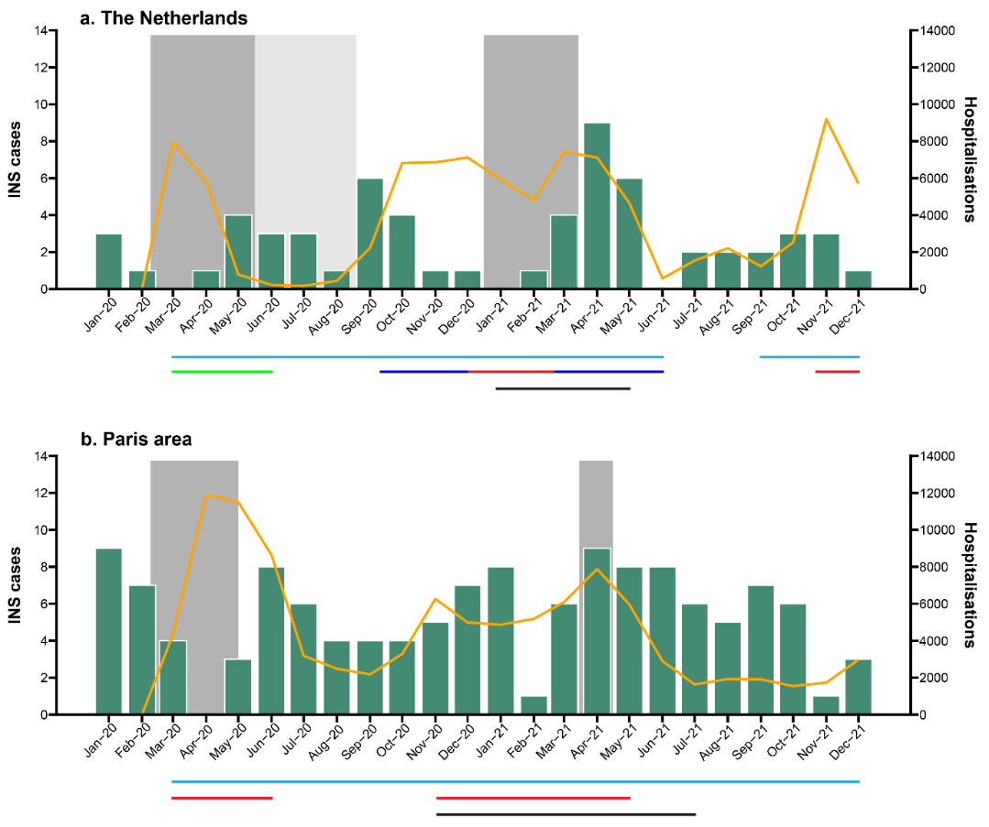
Incidence of idiopathic nephrotic syndrome during the Covid-19 pandemic in the Paris area (France) and in the Netherlands
HYPOTHESIS: Incidence of childhood idiopathic nephrotic syndrome (INS) was lower during Covid-19 lockdowns
DESIGN & OUTCOMES:
NL
Incidence
n = 128
Before vs. during Covid-19
Lockdown vs. no lockdown
Schools closed vs. open
INS
Age 1-16 y
2018-2021
Paris
n = 324
INS onset triggered by virus?
2017-2021
CONCLUSION: Incidence was comparable before and during the Covid-19 pandemic, but was significantly lower when schools were closed during lockdown.
Veltkamp et al. 2023

