Slide 1
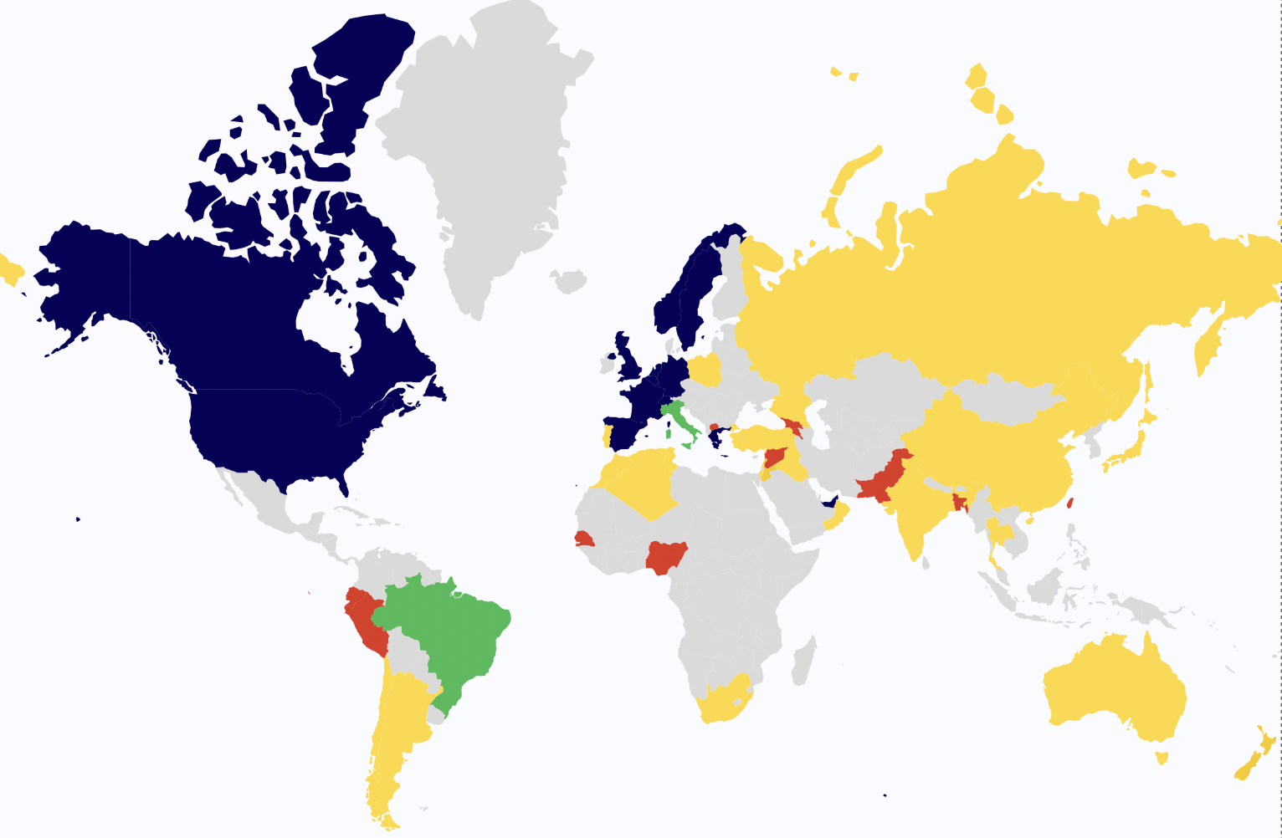
Worldwide disparities in access to treatment and investigations for nephropathic cystinosis: a 2023 perspective
HYPOTHESIS: Access to investigations and treatment has improved over the last decade, but disparities remain worldwide.
DESIGN & OUTCOMES
 | Developing economies and economies in transition |  | Developed economies
 | 2011 | 2022 | 2011 | 2022
Access to investigations
Genetics availability | 23% | 63% | 70% | 100%
Intra Leukocytes-cystine levels availability | 0% | 30% | 94% | 95%
Access to treatments
Cystagon® | 54% | 63% | 100% | 100%
Procysbi® | X | 7% | X | 74%
Cysteamine eye drops | 21% | 63% | 89% | 95%
Cystagon® Procysbi® in few centers
Cystagon® + Procysbi® No access to cysteamine
Comparing 2011 and 2022 in Developed / Developing countries
Access to the various forms of cysteamine
CONCLUSION: Improved availability of genetic and intra leukocyte cystine level testing, and of cysteamine in low-income countries over the past decade. Worrying inequalities remain compared to developed countries, notably in terms of access to Procysbi® and patient reimbursement globally.
Regnier et al. 2023

