Slide 1
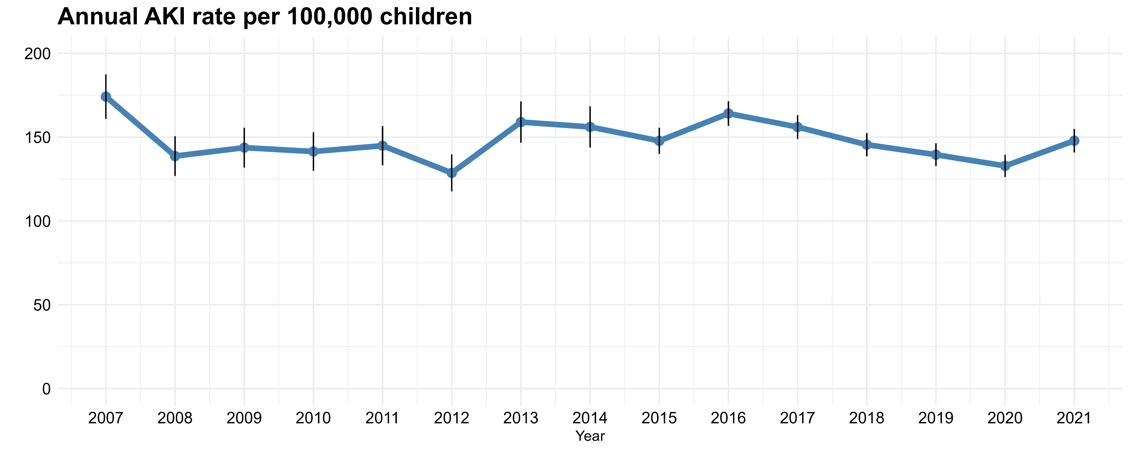
Fifteen-year temporal changes in rates of acute kidney injury
among children in Denmark
HYPOTHESIS: The rate of acute kidney injury (AKI) among children has changed over time
DESIGN & OUTCOMES:
Annual AKI rate per 100,000 children
Population-based cohort study of Danish children from 2007 to 2021
16,345 AKI episodes
CONCLUSION: The rate of acute kidney injury among Danish children was stable from 2007 to 2021.
Høyer et al. 2023

