Slide 1
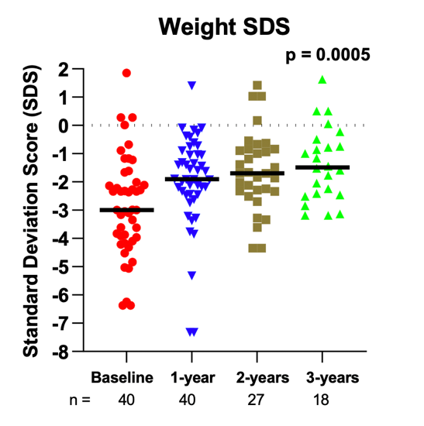
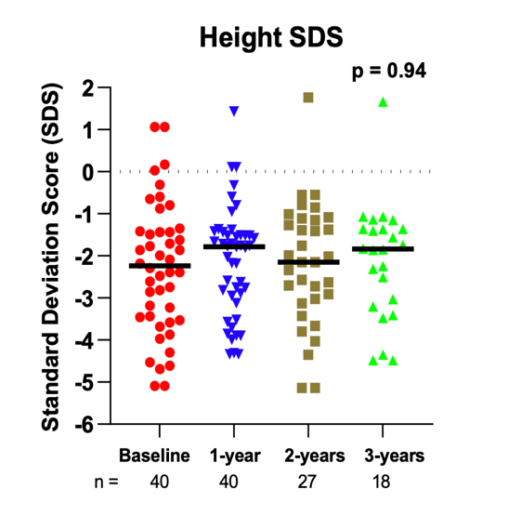
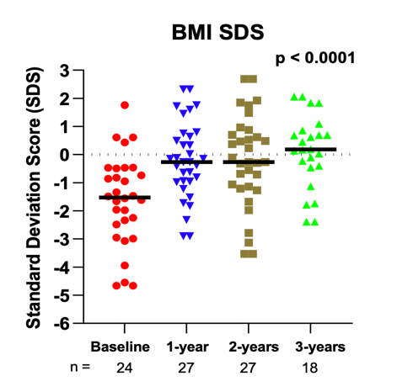
The effect of gastrostomy tube feeding on growth in children with
chronic kidney disease and on dialysis
HYPOTHESIS: To explore the effects of G-tube feeding, including the nutritional composition of feeds, on growth.
DESIGN & OUTCOMES:
Correlations
Single-centre longitudinal follow-up of children with CKD 3-5D
Weight-SDS increased with % energy requirements
Height-SDS correlated with eGFR, but not with any nutritional parameters
40 children
- 77% < 5 years
- 27 on dialysis
- G-tube feeding for median 5.3 years
Alshaiban et al. 2024
CONCLUSION: G-tube feeding improved weight-SDS and BMI-SDS without leading to obesity. Height-SDS increased into the normal range but did not reach statistical significance.

