Slide 1
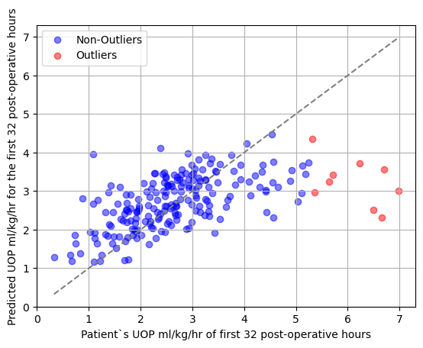
External validation of a clinical mathematical model estimating
post-operative urine output following cardiac surgery in children
AIM: To externally validate a clinical mathematical model predicting urine output during the first 32 post-operative hours in
pediatric patients who underwent cardiac surgery with cardiopulmonary bypass.
DESIGN & OUTCOMES:
Post-operative urine output predicted by the formula
$$Q_{u}=6.06 [(({\frac{4 W+7}{W+90}) 558) (1−Hct) ]}^{1.01 }\left(\frac{(p{H)}^{0.07}}{(CP{B)}^{0.01 }(VI{S)}^{0.08}(CV{P)}^{0.04} }\right)$$
213 pediatric cardiac surgery patients from Cleveland Clinic Children’s (2018 to 2023)
Resulted in
Median absolute error: 0.54 (95th% CI: 0.52- 0.56)
Mean squared error: 0.97 (95th% CI: 0.89- 1.05)
R2 Score: 0.29 (95th% CI: 0.24- 0.34)
CONCLUSION: The clinical mathematical model achieved encouraging external validation results for predicting post-operative urine output in pediatric cardiac surgery patients.
Baloglu et al. 2024

