Slide 1
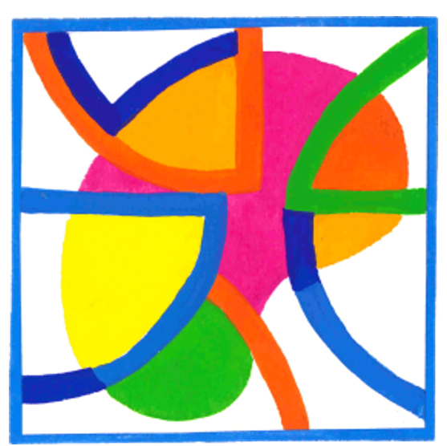
Psychological distress in adults after pediatric kidney replacement therapy
AIM: Psychological distress is impaired in adults after paediatric kidney replacement therapy.
DESIGN & OUTCOMES:
Swiss Pediatric Renal Registry (SPRR)
Comparison to general population:
Similar overall psychological distress
Comparable symptoms of anxiety, depression and somatization
80 adult patients with pediatric kidney disease
Associated factors:
Unemployment
Taking psychotropic drugs
CONCLUSION: Psychological distress in adults after pediatric kidney replacement therapy in Switzerland mirrors the general population. A few subgroups were affected and may need attention when taking care of these patients.
Laube et al. 2024

