Slide 1
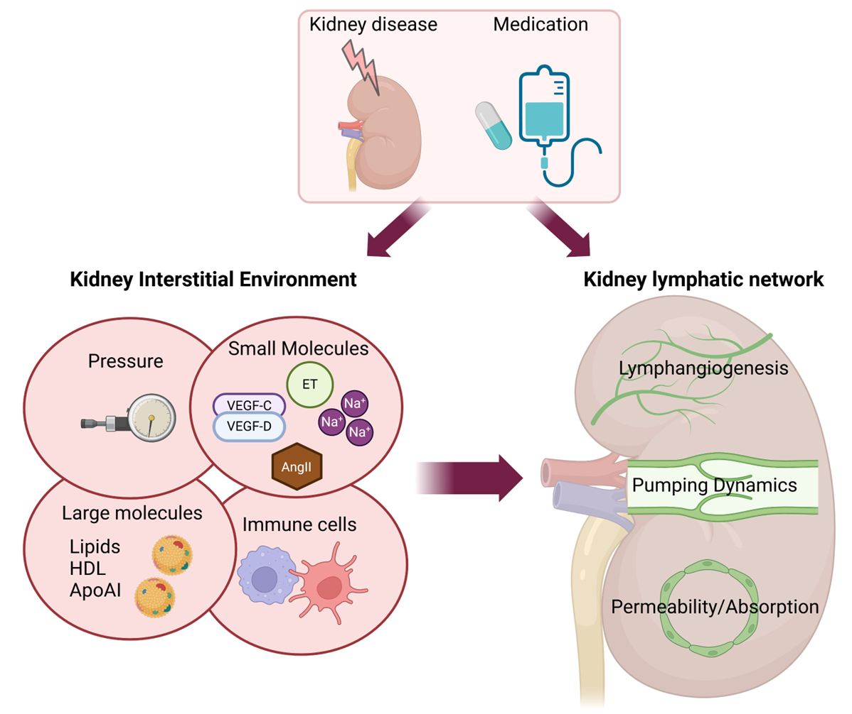
Moving toward a better understanding of renal lymphatics: challenges and opportunities
Key points:
1. Lymphatic vessel development parallels kidney maturation. Abnormal lymphatics are associated with developmental abnormalities of the kidneys.
2. Factors within the kidney interstitium modulate lymphatic vessels.
3. Advancements in lymphatic biology and therapy have previously focused on lymphangiogenesis. Additionally, we consider vascular dynamics to further our understanding of normal and pathologic role of lymphatic vessels.
4. Although no specific drugs target lymphatic contractility, some commonly used drugs have underappreciated effects on lymphatic pump functions.
TAKE HOME MESSAGE We consider development, structure, and function of renal lymphatic vessels and how disease modifies constituents within the kidney interstitium which modulate lymphatic architecture and actions. Currently, no medication targets lymphatics, but some drugs in clinical use have underappreciated lymphatic effects.
Zhong and Liu et al. 2025

