Slide 1
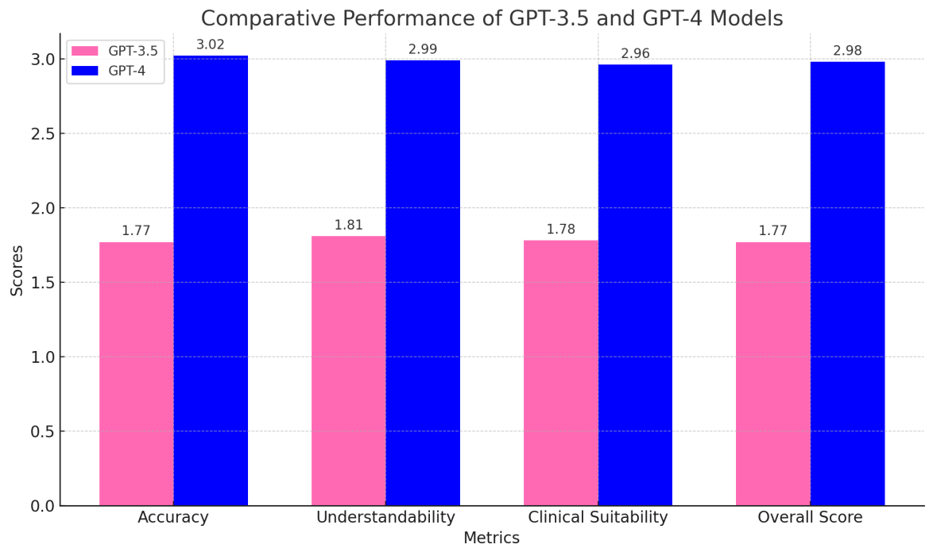





Assessing the performance of large language models (GPT-3.5 and GPT-4) and accurate clinical information for pediatric nephrology
AIM: This study aimed to evaluate the clinical decision-making performance of two AI-based language models, GPT-3.5 and GPT-4, in pediatric nephrology.
DESIGN & OUTCOMES: Forty pediatric nephrology specialists with ≥5 years of experience rated GPT-3.5
and GPT-4 responses to 10 clinical questions using a 1–5 scale via Google Forms. Statistical
analyses included independent t-tests, Cronbach’s alpha for reliability, and Cohen’s d for
effect size.
n=40
GPT-3.5
Conclusions:
GPT-4
Pediatric nephrology specialists
CONCLUSION: While GPT-3.5 and GPT-4 provided a foundational level of clinical decision support, neither model exhibited superior performance in addressing the unique challenges of pediatric nephrology.
Sav 2025

