Slide 1

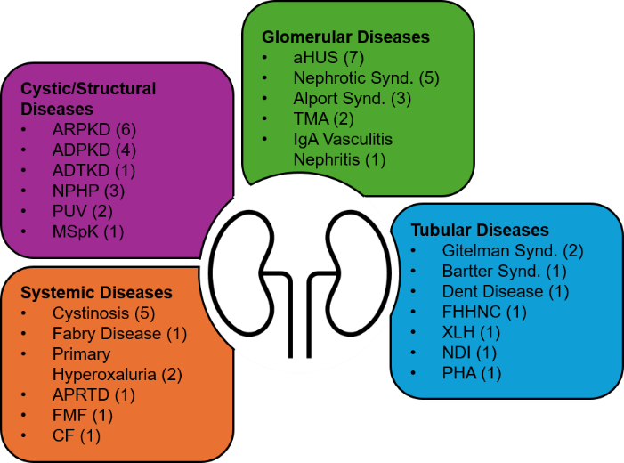












Risks and benefits of ChatGPT in informing patients with rare kidney diseases (RKD): An explorative assessment by ERKNet
AIM: Evaluating ChatGPT in providing information to patients and families with RKD.
Q1
A1
What is [RKD]?
Will I/my child be very sick?
Should we get genetic testing?
Helpful diet changes or supplements?
Alternative treatments?
Second opinion near [city]?
Any reliable info sources?
Explain disease in simple language.
Results: Correctness & Helpfulness
RKD
Q2
A2
ChatGPT
Qx
Ax
Explaining RKD
Simple language
Giving prognosis
Genetic testing
Alt. treatments?
Other info sources?
ePAGs = patient advocacy groups
experts
ePAGs
28 RKD
“Pretend you were a newly diagnosed patient”
Results in general: experts & ePAGs
“Correctness”: experts
“Helpfulness”: ePAgs & experts
“Chose any RKD”
“Copy & paste structured patient questions (Q) into ChatGPT”
How helpful is ChatGPT informing patients & families?
Empathy?
Safety?
46 experts
12 ePAGs
12 countries
Score answers (A) for
correctness & helpfulness
CONCLUSION: ChatGPT holds great potential for patient and family empowerment, enhancing communication between patients and professionals. Accurate prompting strategies improve safety.
Van Eerde and Teixeira et al. 2025

