Slide 1
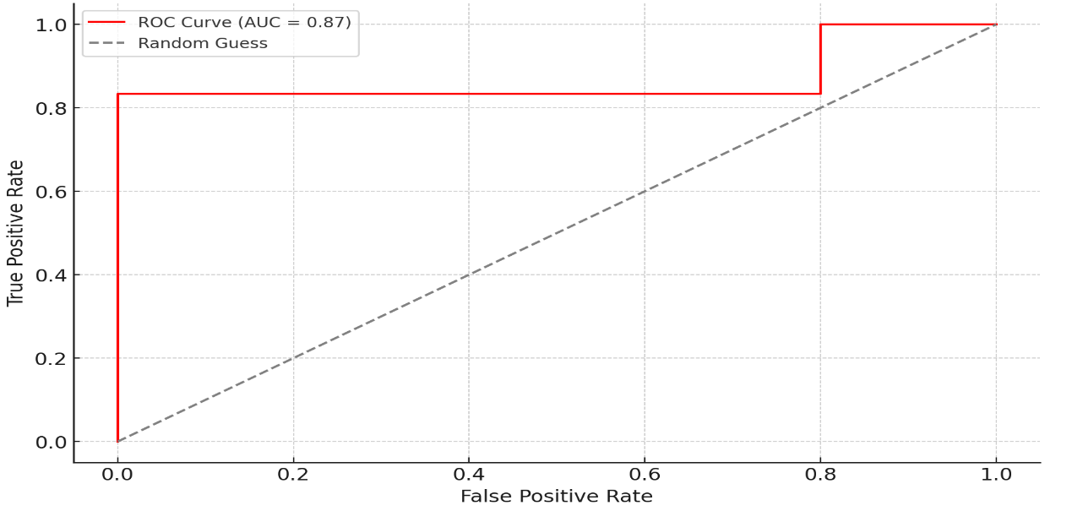
The gut microbiome and metabolome in children with a first febrile urinary tract infection: A pilot study
AIM: Investigate gut microbiota differences between children with first fUTI and healthy controls and predict UTI risk.
 | fUTI | Controls | p-value
Butyrivibrio | 3.404 (±4.797) | 7.273 (±6.446) | 0.045
Coprococcus | 0.154 (±0.335) | 0.374 (±0.438) | 0.029
Eubacterium | 0.576 (±1.326) | 0.799 (±0.846) | 0.038
Shannon index | 2.516 (±0.860) | 3.067 (±0.546) | 0.033
DESIGN & OUTCOMES
17 children with a first fUTI
2.73 ± 2.98 years
Gut microbiome
Gut metabolome
Urine metabolome
18 healthy controls
4.39 ± 3.16 years
ROC Curve for best combination of features: Breastfeeding (months), Shannon index, Faecalibacterium, Escherichia
CONCLUSION: This study links gut microbiome changes to fUTI onset in children, showing reduced alpha diversity and lower abundance of beneficial bacteria, including short-chain fatty acid producers, compared to healthy controls.
-----
Piteková et al. 2025

