Slide 1
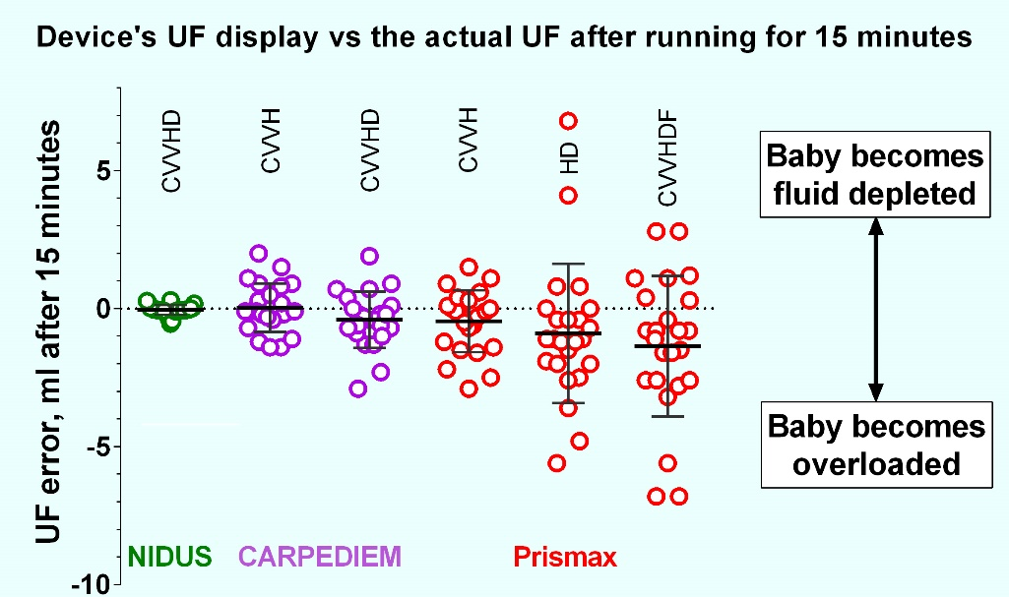
In vitro measurements of ultrafiltration precision in hemofiltration and haemodialysis devices used in infants, Part 2*
AIM: To determine whether CARPEDIEM and PrisMax have sufficient precision of ultrafiltration control to treat small babies
(*Part 2: Comparison of PrisMax and CARPEDIEM with 2022 data on NIDUS, when Prismaflex and Aquarius shown to be imprecise)
DESIGN & OUTCOMES:
CARPEDIEM & PrisMax reasonably precise.
NIDUS fluid control more precise.
All 3 devices tested in vitro:
- NIDUS tested and reported in 2022.
- CARPEDIEM & PrisMax tested now.
Treated a ‘baby substitute’ saline bag.
Quantity of fluid removed measured by weighing and compared with the device’s reported UF volume.
NIDUS CVVHD tested in 2022
CARPEDIEM
CVVH & CVVHD
PrisMax CVVH,
CVVHD & CVVHDF
CONCLUSION: PrisMax and CARPEDIEM control fluid ultrafiltration better than Prismaflex and Aquarius, but the novel volumetric circuit of the NIDUS infant haemodialysis device is the most precise for small babies.
Crosier et al. 2025

