Slide 1
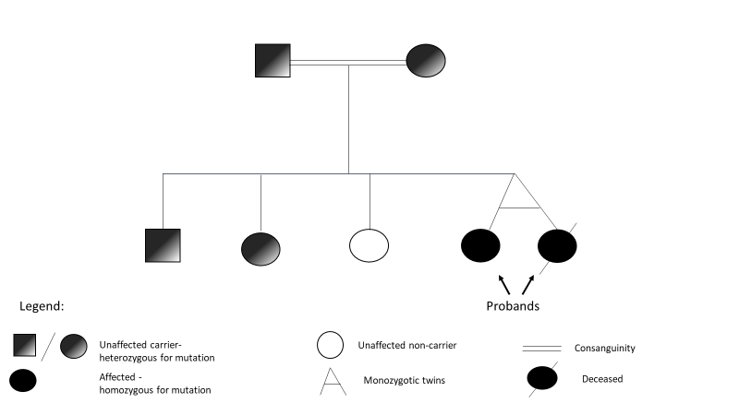
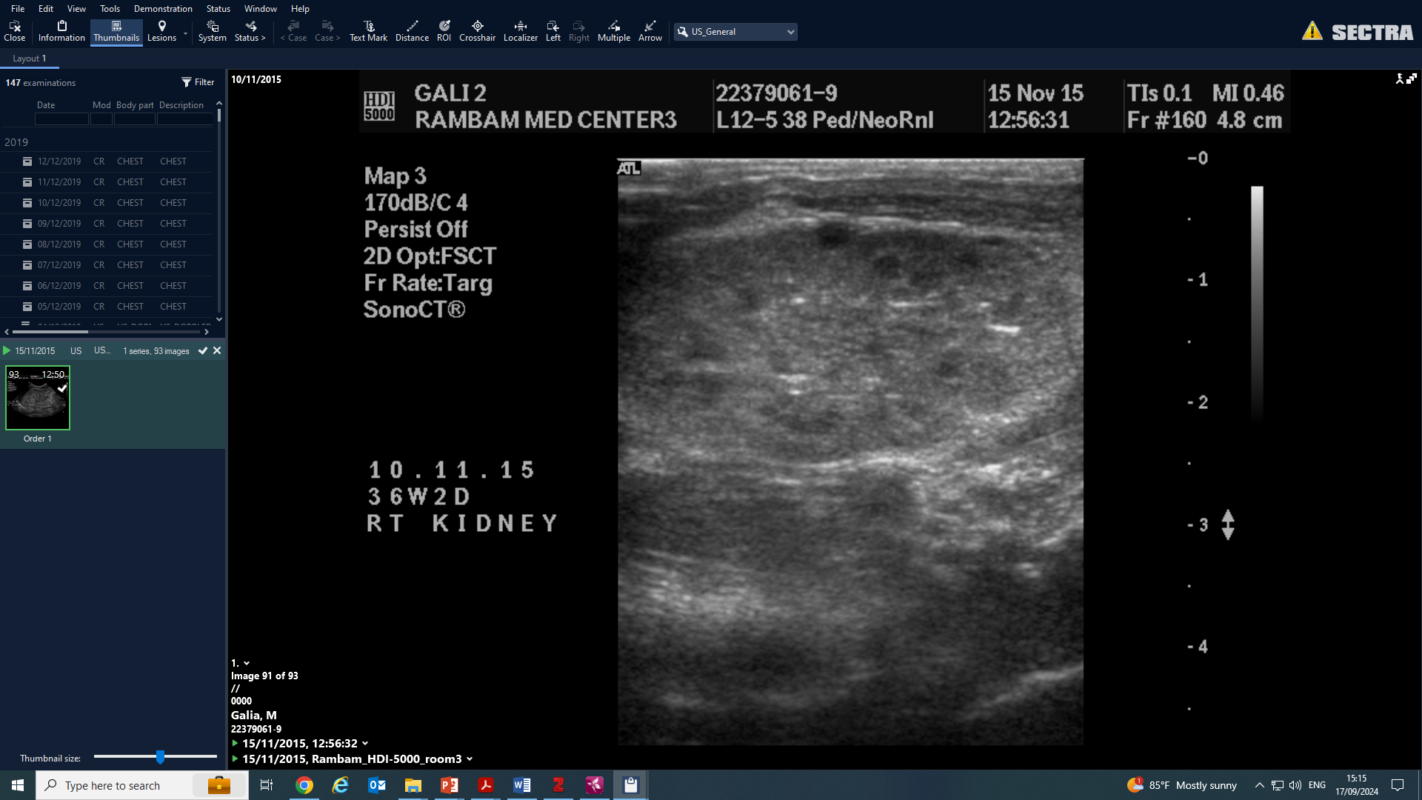
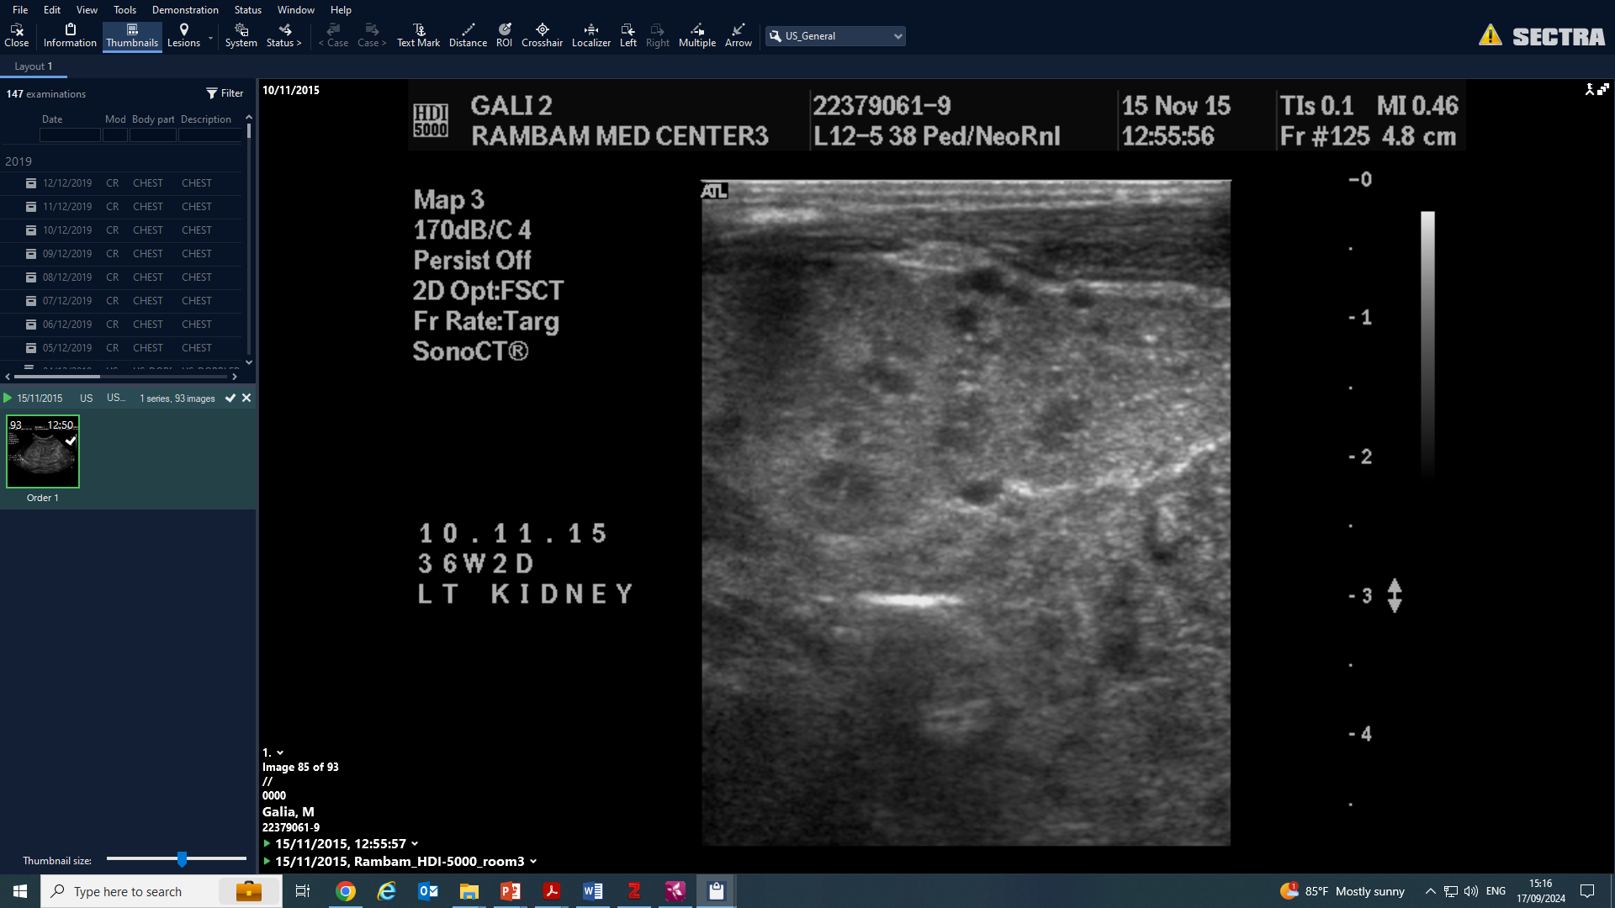
Expanded CRB2-related disease phenotype: Multisystem involvement and post-transplant complications in monozygotic twins
AIM: Expand the phenotypic spectrum of CRB2-related disease, highlight management challenges,
and underscore the need for genetic re-analysis in rare diseases.
Case Presentation:
Monozygotic twins diagnosed with congenital nephrotic syndrome with multisystemic involvement
No mutation identified on TSO1 clinical exome → later, whole exome seq. revealed novel pathogenic homozygote variant in CRB2
Treated over the years with supportive care, both survived infancy and progressed to kidney failure
Post transplant complications:
1st twin- unexplained severe neurologic damage post-transplant, delayed graft function, died of severe fungal infection
2nd twin- multiple complications suggestive of immune dysregulation
Familial Segregation of the CRB2 variant
Kidney US- twin A showing bilateral echogenic large kidneys
Right Kidney
Left Kidney
CONCLUSION: Our findings expand the phenotypic spectrum of CRB2-related disease and underscore the complexity of managing such cases. This report highlights the evolving nature of genetic testing and the potential for novel findings to emerge from timely re-analysis of genetic data.
Plonsky Toder et al. 2025

