Slide 1
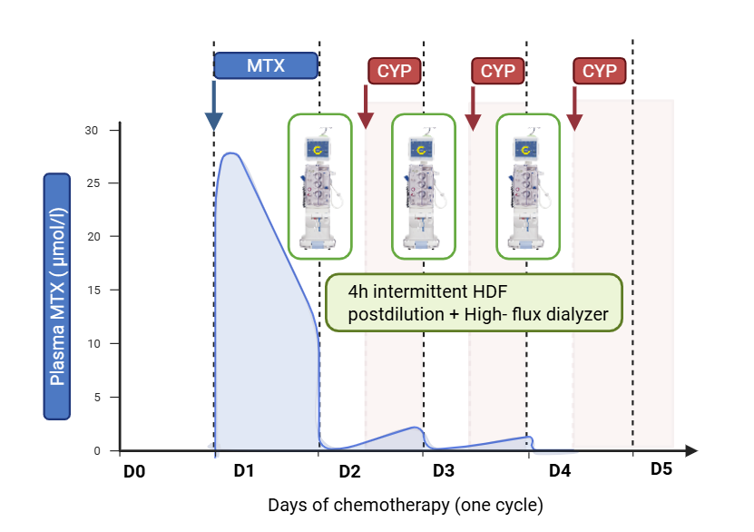
Primary renal diffuse large B-cell lymphoma
presenting as new-onset kidney failure
AIM: A practical approach to optimize chemotherapy on kidney replacement therapy in a rare case of primary bilateral renal diffuse large B-cell lymphoma presenting with kidney failure.
A biopsy-first approach is preferred over nephrectomy due to the potential for kidney function recovery.
Despite rare biopsy-related tumor seeding risks, targeted transcutaneous biopsy remains safe.
Adaptation of chemotherapy dosing to eGFR is essential to avoid overexposure and toxicity.
Optimize highly efficient hemodialysis sessions (HDF with high-flux dialyzers) permits tailoring the timing of chemotherapy exposure, avoiding chemotherapy accumulation, and minimizing side effects.
Although large B-cell lymphoma responds well to chemotherapy, kidney outcomes depend on tumor infiltration, residual function, and nephrotoxic drug exposure.
CONCLUSION: Managing chemotherapy in kidney failure is challenging and requires a multidisciplinary team to adjust drug dosing and hemodialysis protocols, improving patient tolerance while maintaining treatment efficacy.
Bertacchi et al. 2025

