Slide 1





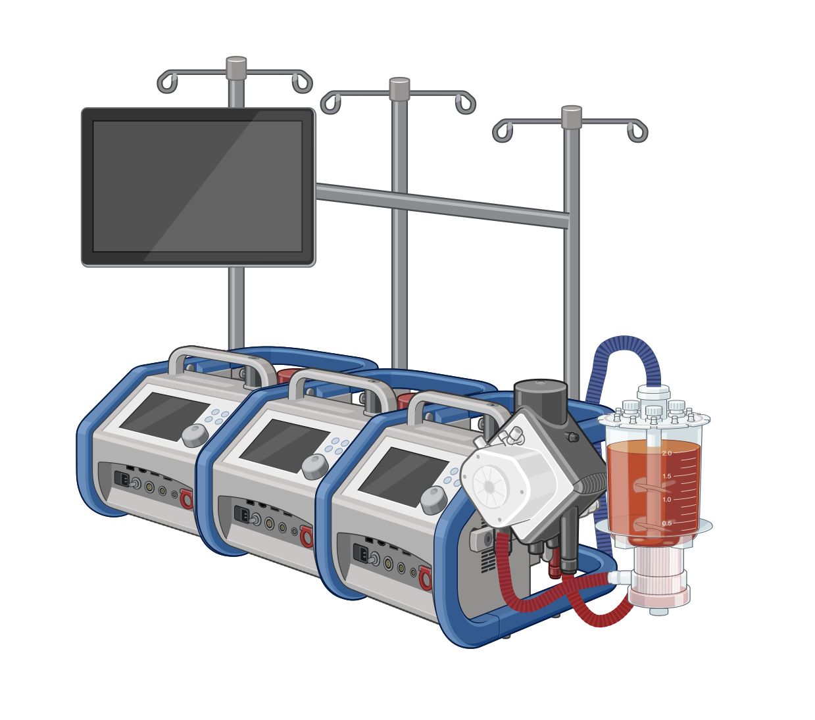
Impact of acute kidney injury and dysnatremia on length of stay
in infants after cardiac surgery
AIM: Evaluate AKI occurrence, its association with intensive care unit length of stay (ICU-LOS) and impact of dysnatremia in an AKI setting
DESIGN & OUTCOMES
AKI in neonates and infants
in conjunction with:
AKI in neonates (0-28 days)
No impact on ICU-LOS
213 infants with
228 congenital heart operations
61% AKI
Equally in neonates and infants 1-12 months
(n= 140)
Hyponatremia
2-3 x longer ICU-LOS
AKI in infants (1-12 months)
50% longer ICU-LOS
Hypernatremia No impact on ICU-LOS
Retrospective single center study
Risk factors independently associated with Acute Kidney Injury (AKI)
Reduced furosemide sensitivity / higher doses
Hypernatremia
Prolonged Cardiopulmonary
Bypass duration
Na⁺
CONCLUSION: AKI following congenital heart surgery occurs frequently and is associated with longer ICU-LOS in infants 1-12 month of age. Concomitant presence of hyponatremia leads to longer ICU-LOS in both neonates and infants 1-12 months.
Kronborg et al. 2025

