Slide 1
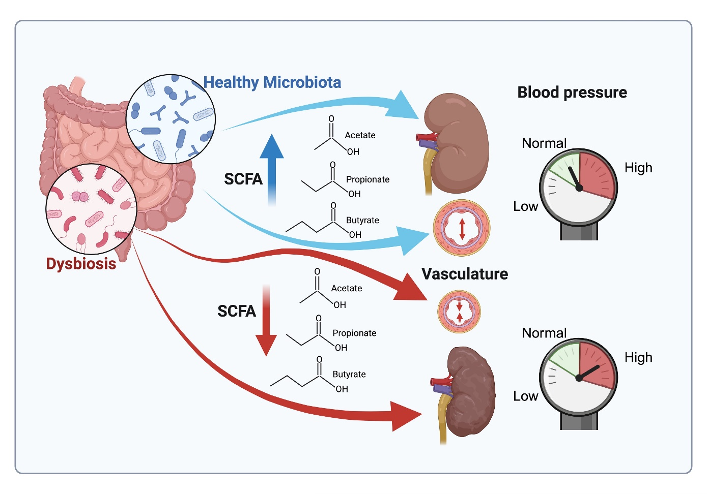
Therapeutic strategies for hypertension: exploring the role of microbiota-derived short-chain fatty acids in kidney physiology and development
Key points:
1. Short-chain fatty acids (SCFAs) produced by the gut microbiota play a key role in modulating kidney function.
2. SCFAs regulate blood pressure through interactions with specific G protein-coupled receptors.
3. Gut microbiota-derived SCFAs contribute to maintaining renal epithelial integrity and reducing inflammation.
4. SCFAs impact renin release and arterial tone, resulting in the maintenance of proper blood pressure control.
5. SCFA signaling presents a promising avenue for novel therapeutic strategies targeting hypertension.
TAKE HOME MESSAGE: Microbiota-derived SCFAs are pivotal for kidney development and proper blood pressure control.
Tortelote 2025

