Slide 1
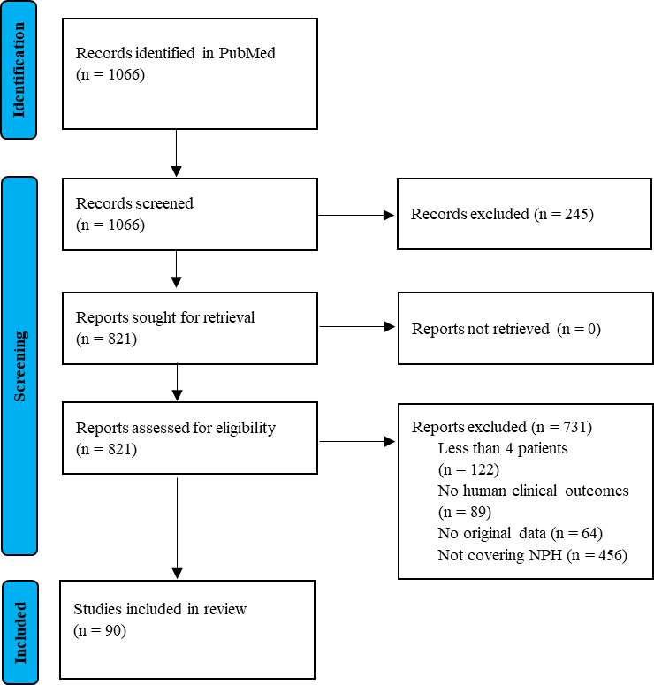
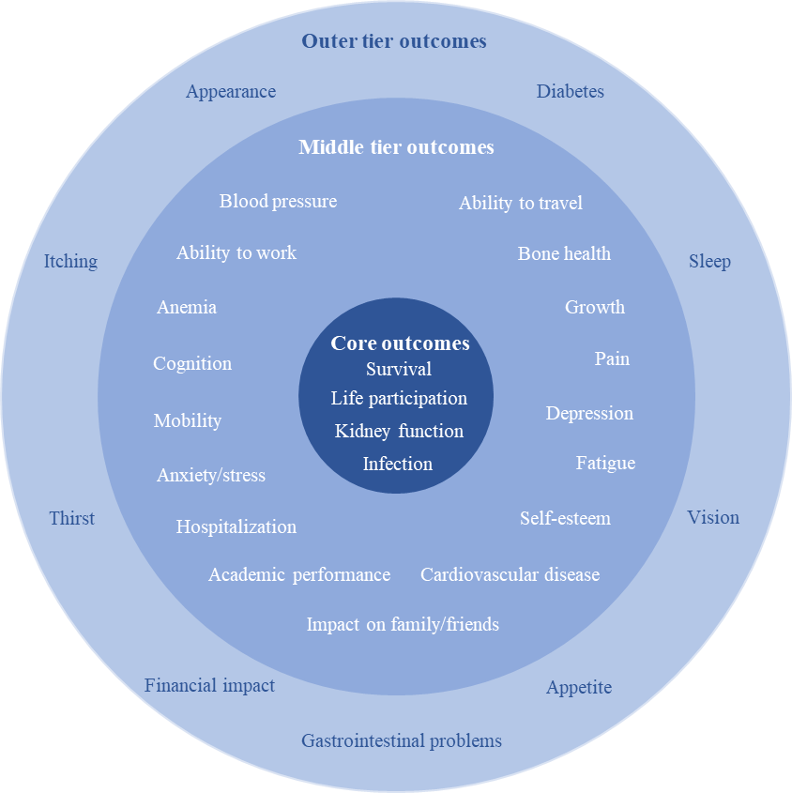
Time for disease-specific patient-reported outcome measures: systematic review on outcomes reported in clinical research on nephronphthisis
AIM: To analyze the use of clinical data, surrogate parameter, and patient-reported outcomes in NPH research to date, with a focus on the Standardized Outcomes in Nephrology (SONG) project outcomes for children with chronic kidney disease (SONG Kids)
DESIGN & OUTCOMES:
identification of studies
Outcomes identified in NPH research
100% reported clinical outcomes
85% reported surrogate outcomes
only 41% reported patient-reported outcomes
Number of studies
No of SONG Kids core outcomes reported (out of 4)
Overlap with validated SONG Kids tool
Only 22% overlap with core outcomes
24% overlap with at least one middle tier outcome
66% overlap with at least one outer tier outcome
No instruments validated for NPH were used
(adapted from https://songinitiative.org/projects/song-kids)
CONCLUSION: There is a notable absence of patient-reported outcomes in NPH research. Disease-group (CKD) specific instruments fall short in adequately reflecting the full phenotypic spectrum of individual diseases, emphasizing the necessity for the development of disease-specific PROMs.
Mareike Dahmer-Heath et al. 2024

