Slide 1
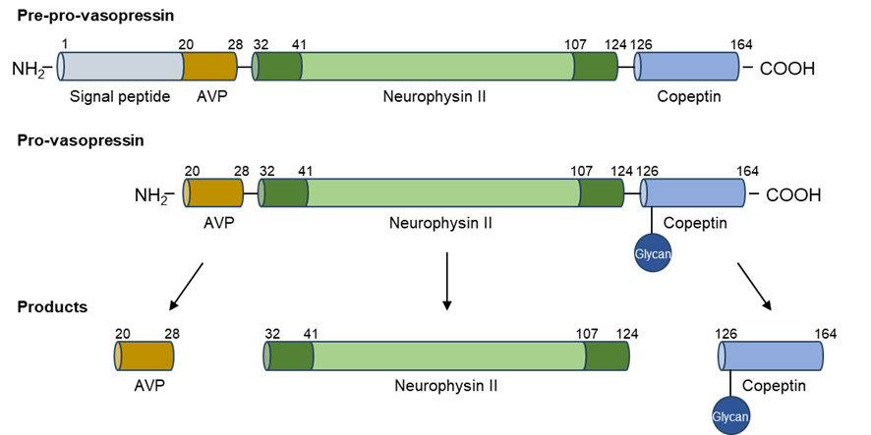
Copeptin in the diagnosis and management of renal tubular disorders
Copeptin → glycopeptide derived from the precursor of arginine vasopressin (AVP)
Released in equimolar amounts with AVP
Stable and easy-to-measure surrogate for AVP
Responds to osmotic, hemodynamic and stress-related stimuli
Diagnostic biomarker:
-Polyuria-polydipsia syndrome
-Hyponatremia
-Monosymptomatic nocturnal enuresis
Prognostic biomarker:
-Associated with albuminuria and kidney function decline
-Predicts response to tolvaptan and CKD progression in ADPKD
Potential role in primary tubulopathies:
-Assessment of volume status
-Evaluation of secondary nephrogenic diabetes insipidus
-May guide treatment to prevent CKD progression and other complications related to chronic volume depletion
TAKE HOME MESSAGE: Copeptin is a reliable and easily measurable biomarker that aids in the diagnosis of water balance disorders. It may also serve as a prognostic marker in tubulopathies and other kidney diseases.
Madariaga et al. 2025

