Slide 1
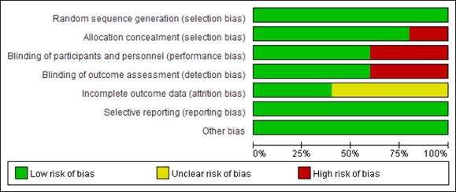

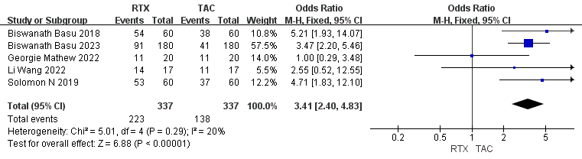





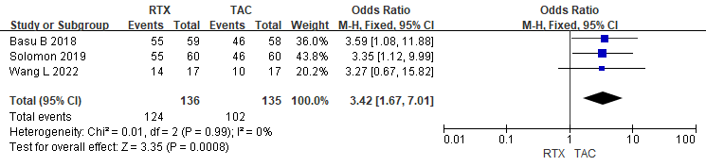
Rituximab in pediatric refractory nephrotic syndrome: A systematic review and meta-analysis evaluating therapeutic efficacy and adverse event profiles
AIM: To evaluate the clinical effectiveness and related adverse event profiles of rituximab in pediatric RNS.
DESIGN
OUTCOMES
6 studies were included, comprising 494 pediatric NS patients
Methods
Normal kidney
Nephropathy
Urinary protein
（>3.5 g/d）
Hypoalbuminemia
（<30 g/L）
Literature Research
Data Analysis
Hyperlipidemia
CONCLUSION: The efficacy and safety of rituximab are superior compared to second-line immunosuppressants in pediatric RNS.
Junchao et al. 2025

