Slide 1
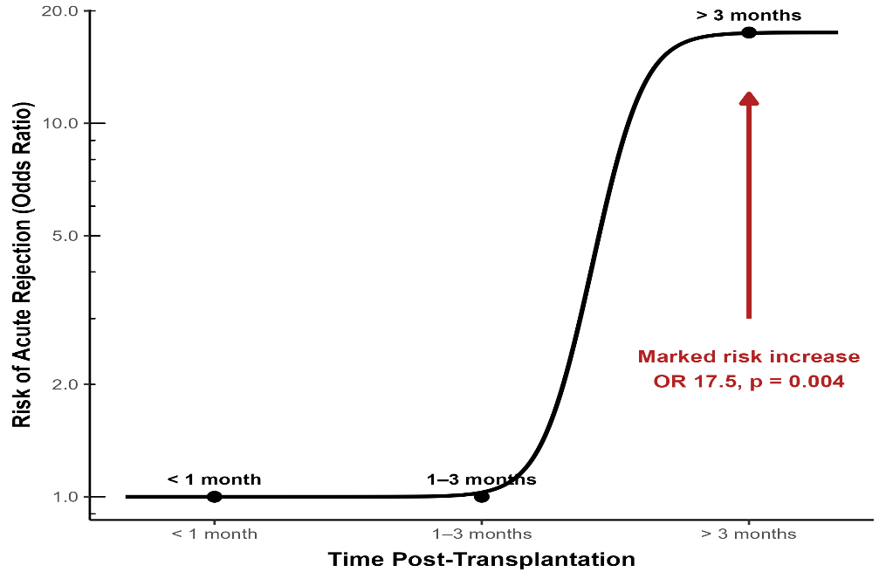
Influence of intra-patient variability in tacrolimus trough levels on
acute rejection in pediatric kidney transplant recipients
AIM: Investigate the association between intrapatient variability (IPV) of tacrolimus trough levels and rejection risk
DESIGN & OUTCOMES:
100 pediatric patients post-kidney transplant followed up for 1 year
Stratification based on Time in Therapeutic Range (TTR) of Tacrolimus 78%
Low TTR (N=80)
High TTR (N=20)
Risk of rejection increased significantly with higher dose-normalized tacrolimus troughs after 3 months post-transplant.
Unlike TTR, coefficient of variation (CV%) was significantly higher in acute rejection cases.
CONCLUSION: Therapeutic drug monitoring of tacrolimus trough levels is significantly important post-kidney transplantation to ensure stable CV%, especially 3 months after transplantation.
Fadel et al. 2025

