Slide 1
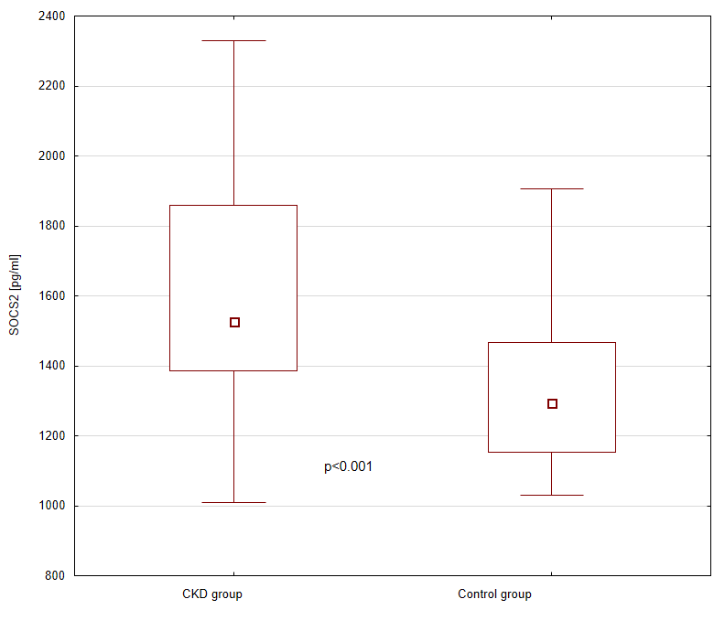
Suppressor of cytokine signaling 2 is associated with growth impairment in pediatric chronic kidney disease
AIM: To evaluate serum SOCS2 levels in children with CKD compared to healthy controls and explore the possible relationship between circulating SOCS2 concentration and growth parameters
DESIGN & OUTCOMES:
In CKD patients
serum SOCS2 concentration
SOCS2 and eGFR correlate with HtSDS
55 children
with CKD
SOCS2 is higher in short-statured children
basic biochemical parameters
ROC-derived cut-off value for short stature: SOCS2 1418.3 pg/ml
AUC 0.78, 95%CI 0.64-0.91
27 matched healthy controls
HtSDS
serum SOCS2 levels
CONCLUSION: SOCS2 is elevated in children with CKD and associated with growth impairment. These results suggest that SOCS2 may serve as a useful biomarker of growth impairment.
Deja et al. 2025

