Slide 1
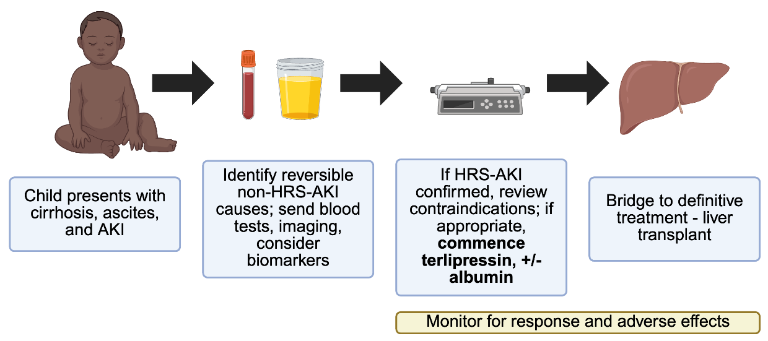
Terlipressin in paediatric
hepatorenal syndrome-acute kidney injury (HRS-AKI)
Key points:
1. 5–10% of children with chronic liver disease develop HRS-AKI, placing them at high risk of morbidity and mortality.
2. Liver transplantation is the mainstay of treatment, but adult studies suggest that medical management with terlipressin can potentially reverse HRS-AKI.
3. Careful selection of patients to treat with terlipressin is mandatory, starting with a low escalating dose of terlipressin with frequent monitoring for adverse effects.
4. International collaborations and efforts to publish data in this cohort, supplemented by further research into the predictive role of biomarkers to diagnose the precise type of AKI, will improve outcomes for this high-risk group.
Flow chart for presentation of child and investigation and treatment for HRS-AKI. Created in BioRender.
TAKE HOME MESSAGE: Adult trials and limited paediatric data support a role for terlipressin in the management of paediatric HRS-AKI, but more research is urgently needed.
Alexander et al. 2026

