Slide 1
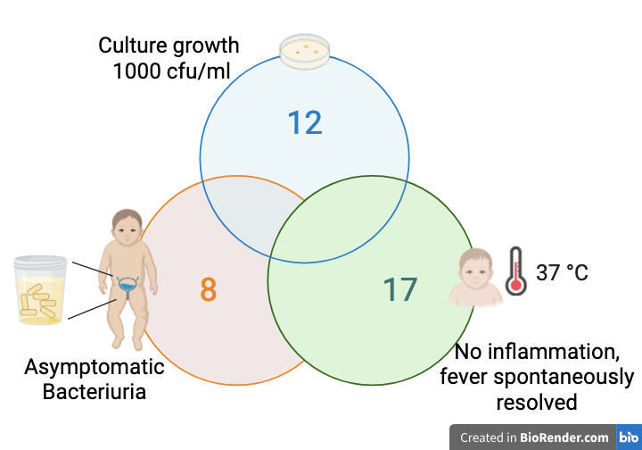

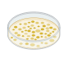
Clinical relevance of urine cultures in low-risk febrile infants <3 months with negative urine dipsticks
AIM: To determine the prevalence of clinically relevant UTI in febrile infants <3 months of age with negative dipstick tests
20 clinically irrelevant isolated urine cultures
DESIGN & OUTCOMES:
Prospective observational study
Out of 65,197 PED visits, 1st Oct 2022 – 11th Nov 2023
20 isolated growth
24 mixed growth
111 febrile infants with negative dipsticks
44 positive
urine cultures
Contamination
No clinically relevant UTIs were found
CONCLUSION: Clinically relevant UTIs are rare in febrile infants <3 months without risk factors and negative dipsticks. Routine urine cultures should be reserved for infants with indications of UTI or serious bacterial infection.
Sjöstedt et al. 2026
Prospective observational study

