Slide 1
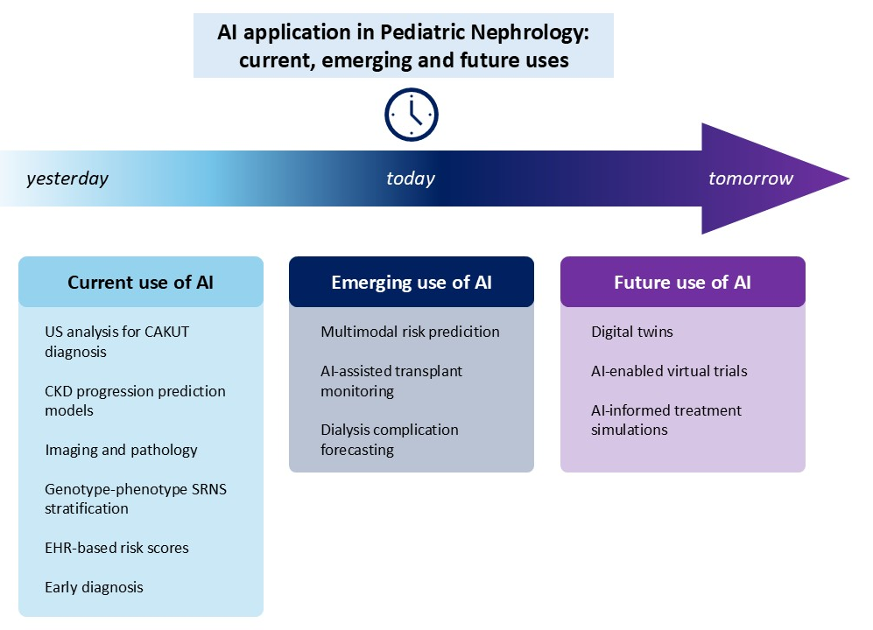
Artificial intelligence in pediatric nephrology: current applications and emerging frameworks for evidence generation
Key points:
Artificial intelligence (AI) is increasingly applied in pediatric nephrology to support diagnosis, risk stratification, imaging and pathology interpretation, and outcome prediction across chronic kidney disease, dialysis, and transplantation, leveraging rich longitudinal and multimodal pediatric data.
AI should be viewed as an adjunct to, rather than a replacement for, clinical judgment and conventional research methods, enhancing prognostication, personalization of care, and management of uncertainty in rare and heterogeneous pediatric kidney diseases.
A major promise of AI lies in extending evidence generation in settings where randomized trials are difficult or unfeasible, including through analysis of real-world data, causal inference approaches, and emerging concepts such as digital twins and virtual trials.
Realizing the clinical and research potential of AI in pediatric nephrology requires methodological rigor, external validation, transparency, and robust ethical and regulatory governance, with particular attention to equity, consent, and long-term implications for children.
TAKE HOME MESSAGE: Across pediatric nephrology, AI is emerging as a practical clinical and research adjunct that supports diagnosis, prognostication, and treatment personalization while also enabling novel approaches to evidence generation where traditional trials are limited.
Pellegrino et al. 2026

