Slide 1
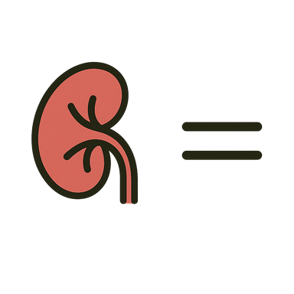







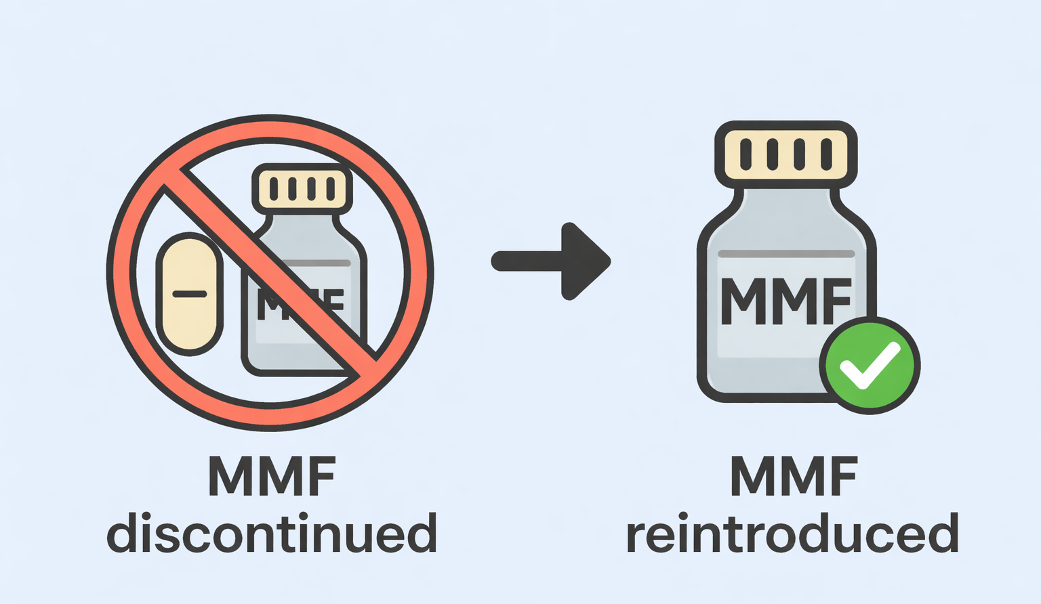

Temporary mycophenolate discontinuation and reintroduction in pediatric kidney transplantation: predictors and long-term outcomes
AIM: To investigate the long-term outcomes, feasibility of reintroduction, and predictors of MMF discontinuation in pediatric kidney transplant recipients.
DESIGN & OUTCOMES:
Pediatric Kidney Transplant Cohort
Results
No difference
in eGFR trend
No increase in rejection rate
dnDSA:
no difference
Hospitalizations:
no difference
MMF discontinued
MMF continued
65 pediatric kidney
transplant recipients
33% required
temporary MMF
discontinuation
MMF discontinuation was predominantly viral-driven (mostly BK virus)
Younger age → higher likelihood of requiring MMF discontinuation
Reintroduction of MMF successful in most
CONCLUSION: Temporary MMF discontinuation, when clinically indicated and followed by cautious reintroduction, was not associated with adverse long-term graft outcomes; Younger age at transplantation was associated with an increased likelihood of MMF discontinuation.
Plonsky Toder et al. 2026

