Slide 1
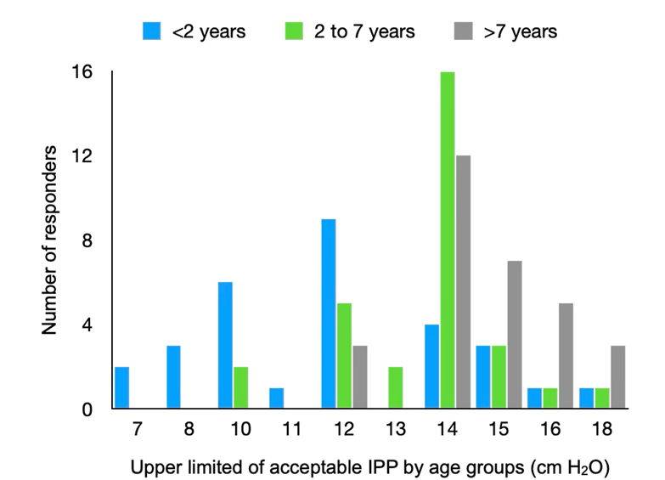
Intraperitoneal pressure measurement in children on peritoneal dialysis: a review and European practice survey
Key points:
Adequate intraperitoneal dialysate volumes are essential to balance optimal solute and fluid removal against the risk of increased intraperitoneal pressure (IPP) in acute and chronic PD.
Few small observational studies in children and adults provide limited evidence on the safe upper limit of IPP and related complications, the impact of IPP measurements on outcome is uncertain.
In a practice survey 68% of European pediatric dialysis centers report routine IPP measurements, but mode and frequency, upper IPP limits and interpretation of IPP vary considerably.
We suggest age- and body surface-adapted standardized three-point IPP measurements and upper safety limits, as a prerequisite for valid and comparable scientific data.
Acceptable upper limits of IPP across age groups according to 30 European pediatric dialysis centers, routinely measuring IPP.
TAKE HOME MESSAGE: While the rationale for IPP measurements is convincing, standardized protocols and large scale, systematic prospective studies are needed to demonstrate the benefits of routine IPP assessment.
Zaloszyc et al. 2026

