Slide 1
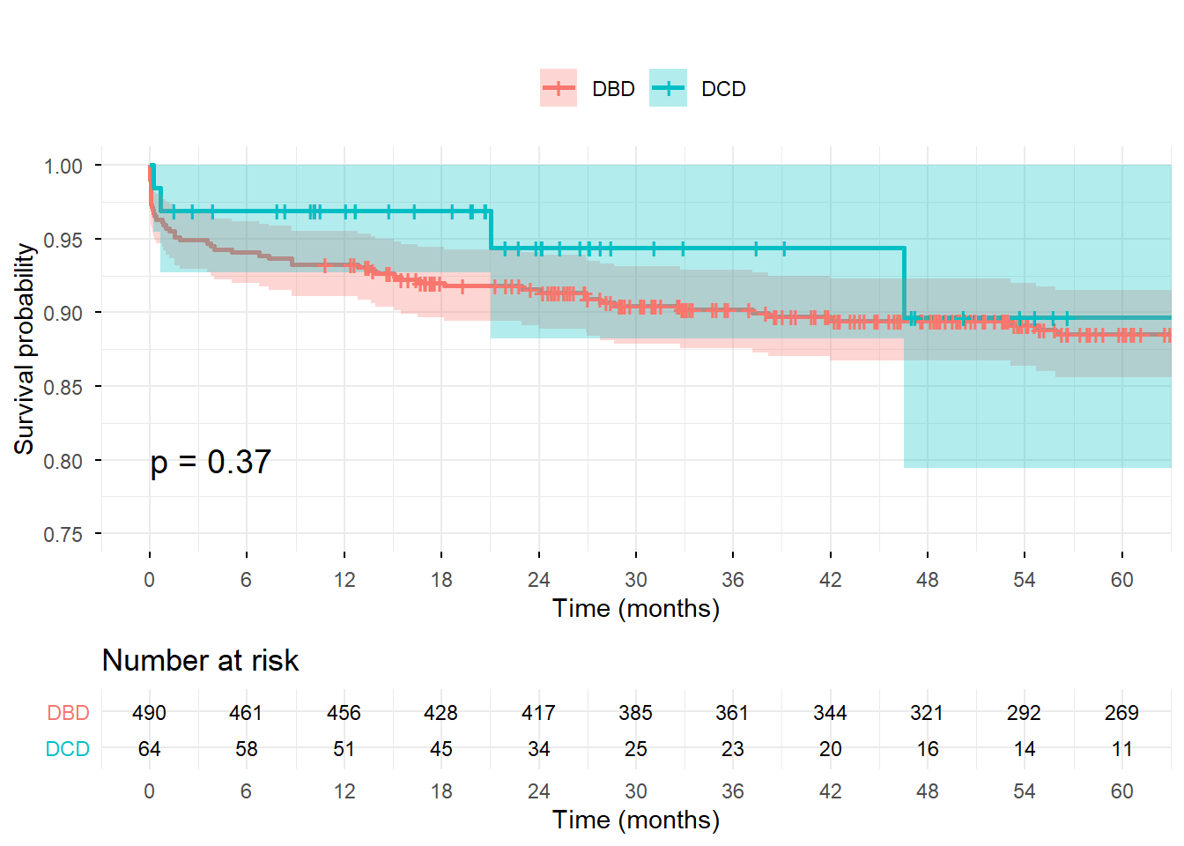
Pediatric kidney transplantation using donors after circulatory death: a national experience from Spain
AIM: Feasibility of DCD donors for pediatric KT: Spanish national experience.
Kidney graft survival
DESIGN & OUTCOMES:
Exploratory risk factors in DCD KT
64 DCD kidney transplants
2013-2024
Pediatric recipients (<18 years)
All Spanish transplant
centers
DGF12.5%
Donor age <5y & >40y
fWIT
CIT >15h
Rapid recovery (p<0.05)
Compared with:
490 DBD kidney transplants
2013-2024
Pediatric recipients (<18 years)
REPIR I Registry data
Significant Differences: DBD vs. DCD KT
Creatinine and donor age in DCD group
DGF rates: 5.9% (DBD) vs. 12.5% (DCD)
5-year kidney graft survival:
88.5% (DBD) vs. 89.7% (DCD)
CONCLUSION: DGF risk linked to rapid recovery technique. DCD graft survival not inferior to DBD. Feasible option for pediatric recipients under select conditions.
Herrero-Goñi et al. 2026

