Slide 1
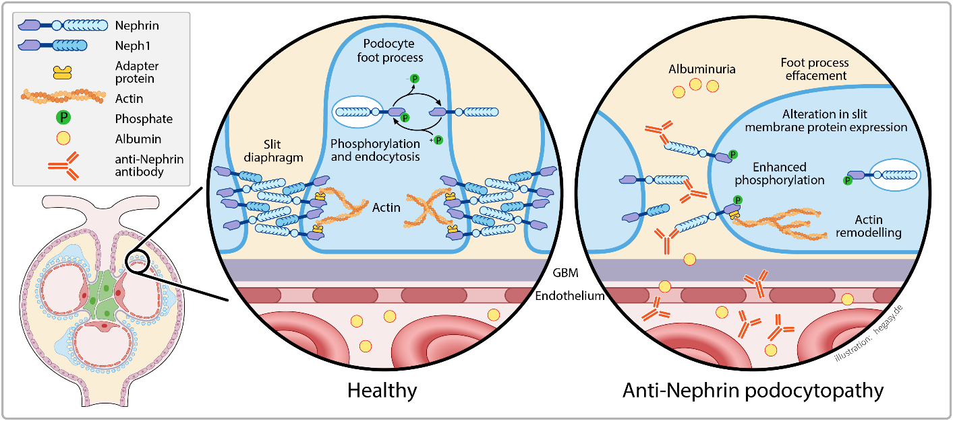
Anti-nephrin antibodies in pediatric nephrotic syndrome:
a new paradigm
Key points:
Anti-nephrin autoantibodies
1. have been detected in a large proportion of pediatric nephrotic syndrome patients
2. provide a serological marker for antibody mediated podocytopathy
3. induce phosphorylation of nephrin and lead to changes in slit membrane protein expression
4. are associated with steroid-sensitive forms and higher risk of relapse in transplanted patients.
Current concept in anti-nephrin mediated podocytopathy
TAKE HOME MESSAGE: The detection of anti-nephrin autoantibodies sheds new light on pediatric nephrotic syndrome and paves the way for further clinical trials to evaluate the role of B-cell targeting therapies.
Mühlig, Hengel et al. 2026

