Slide 1
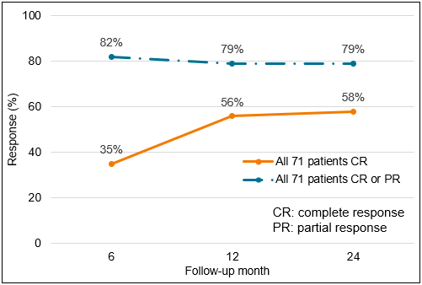
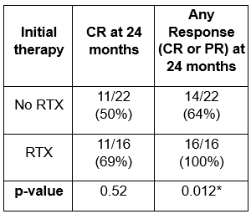
Clinical presentations, treatments, and outcomes of pediatric lupus nephritis: a prospective cohort study from the Pediatric Nephrology Research Consortium
AIM: Assess outcomes in pediatric lupus nephritis (pLN) with initial therapy of mycophenolate (MMF) versus IV cyclophosphamide (CYC), with and without rituximab (RTX)
At 24 months:
DESIGN & OUTCOMES:
MMF without RTX (n=33)
6-, 12-, and
24-month outcomes
58% CR
79% any response (CR or PR)
108 patients aged <21 years with ≥class III pLN
vs.
CYC without RTX (n=18)
Response rate
Infection rate
MMF or CYC with RTX (n=20)
pLN relapse rate
Significant increase in any response at 24 months with addition of RTX
vs.
Prospective,
multi-center study
MMF or CYC without RTX (n=51)
Rate of steroid use
CONCLUSION: MMF and CYC had similar efficacy as initial therapies for pLN. Adding RTX may have benefit in achieving long-term response.
Phillips et al. 2026

