Slide 1
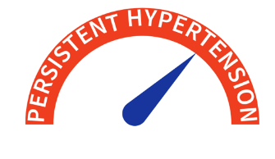
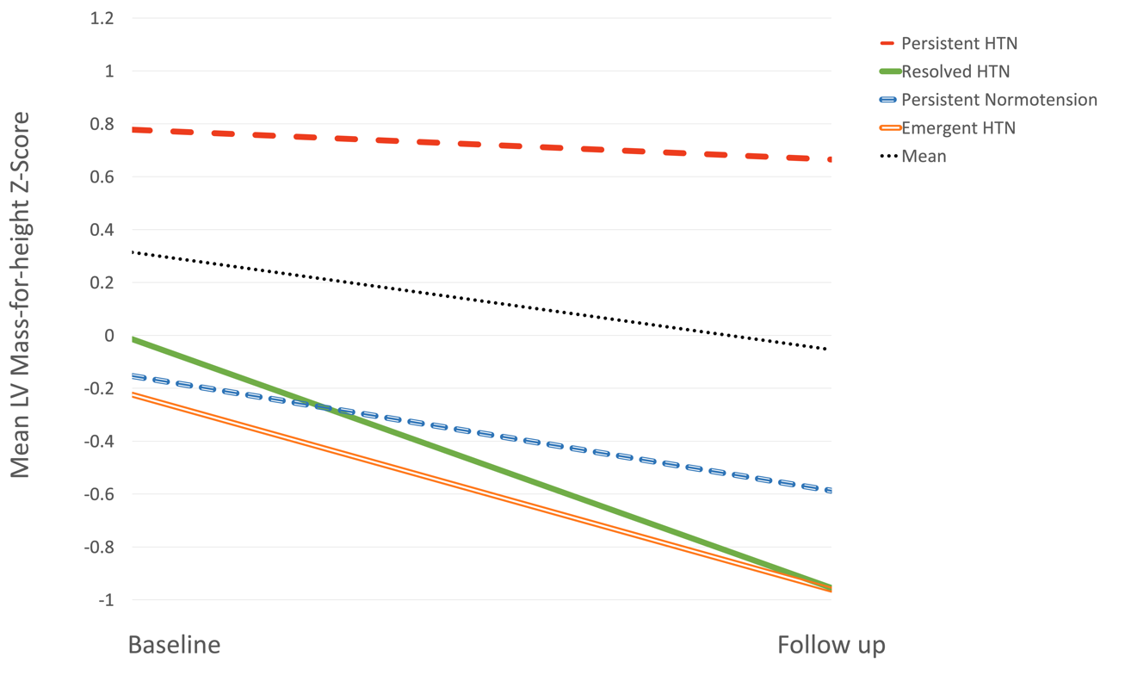

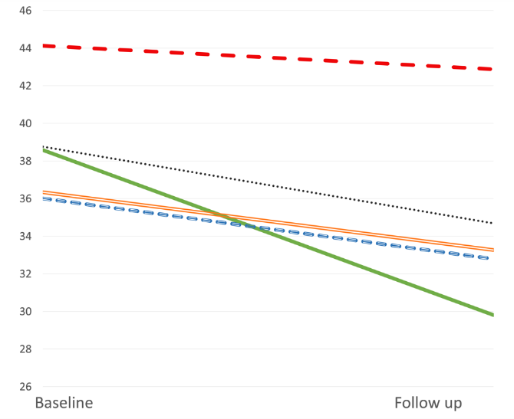
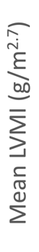


Hypertension control and its association with left ventricular hypertrophy in children and young people on dialysis
Aim: To demonstrate a close relationship between blood pressure and cardiovascular outcomes in CYP initiating dialysis
DESIGN & OUTCOMES:
Four blood pressure trajectory groups categorised:
Persistently hypertensive CYP demonstrate highest risk of hypertension mediated organ damage (HMOD):
32 incident children and young people (CYP):
17 (53.1%) haemodialysis
15 (46.9%) peritoneal dialysis
6-monthly paired echocardiogram and ambulatory blood pressure monitoring (ABPM) up to 1 year following dialysis initiation assessing left ventricular structure and function in relation to blood pressure
Retrospective, single centre, longitudinal observational study
CONCLUSION: Those with persistent hypertension had the highest risk of HMOD including left ventricular hypertrophy (LVH) and increased indexed LV mass compared with those who were persistently normotensive.
Bruce et al. 2026

