Slide 1
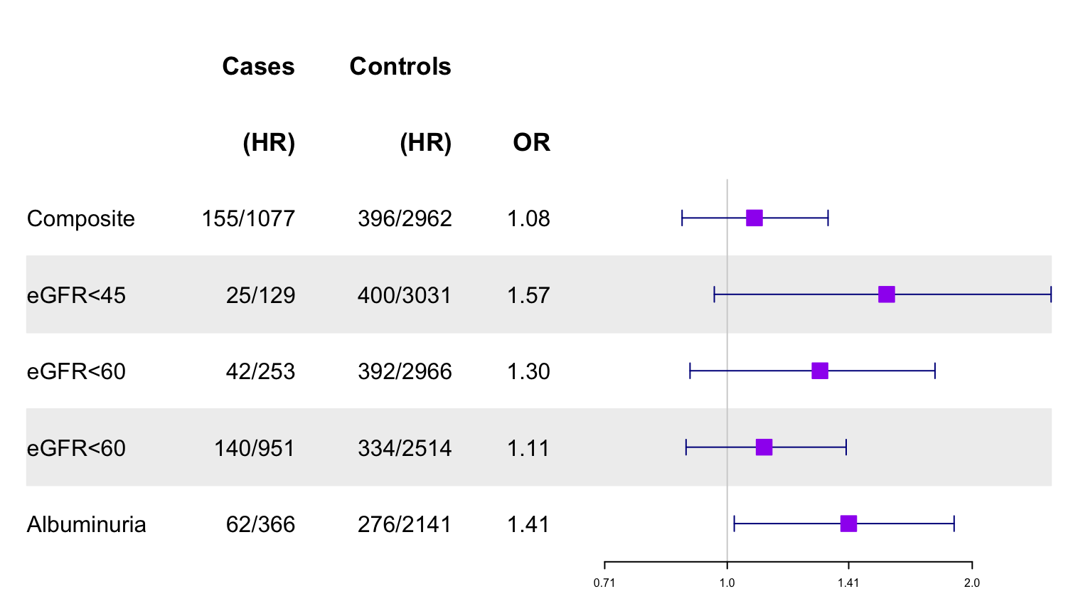
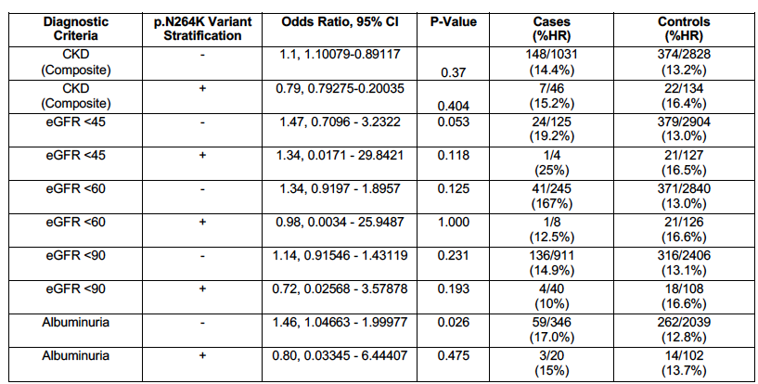
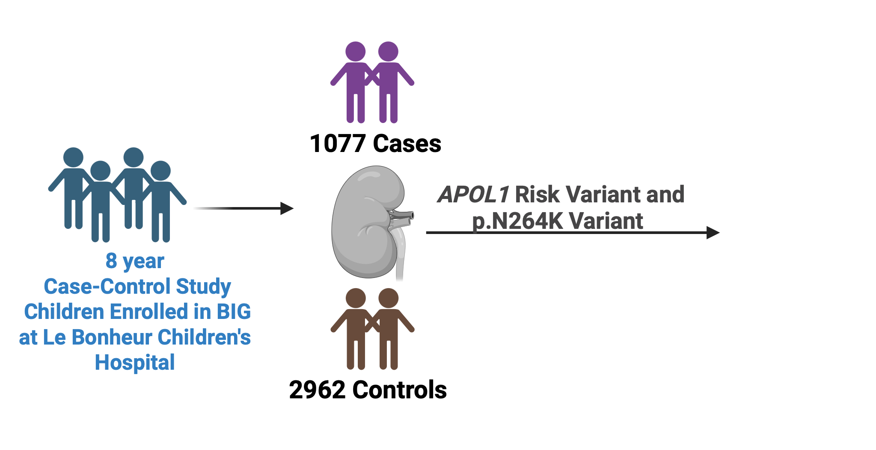
APOL1 and CKD in pediatrics: a study from the Biorepository and Integrative Genomics initiative
AIM: To assess kidney disease risk by APOL1 high risk genotype and the potential protective effect of p.N264K variant in a diverse pediatric cohort
DESIGN & OUTCOMES:
Association of HR (vs.LR) APOL1 with different definitions of CKD in African American children stratified according to pN264K variant genotype
Association of APOL1 high-risk genotype with CKD Cases
High risk (HR), HR denotes G1/G1, G2G2 and G1/G2 , estimated glomerular filtration (eGFR) in ml/min/1.73 m². Albuminuria denotes UACR >30 mg/g. Composite denotes eGFR <90ml/min/1.73 m² or albuminuria present, requiring two assessments at least 90 days apart. P-value < 0.05 considered significant.
CONCLUSION: APOL1 high risk genotypes were associated with albuminuria in African American children. The p.N264K variant may modify this risk, warranting further study.
Zahr et al. 2026

