Slide 1
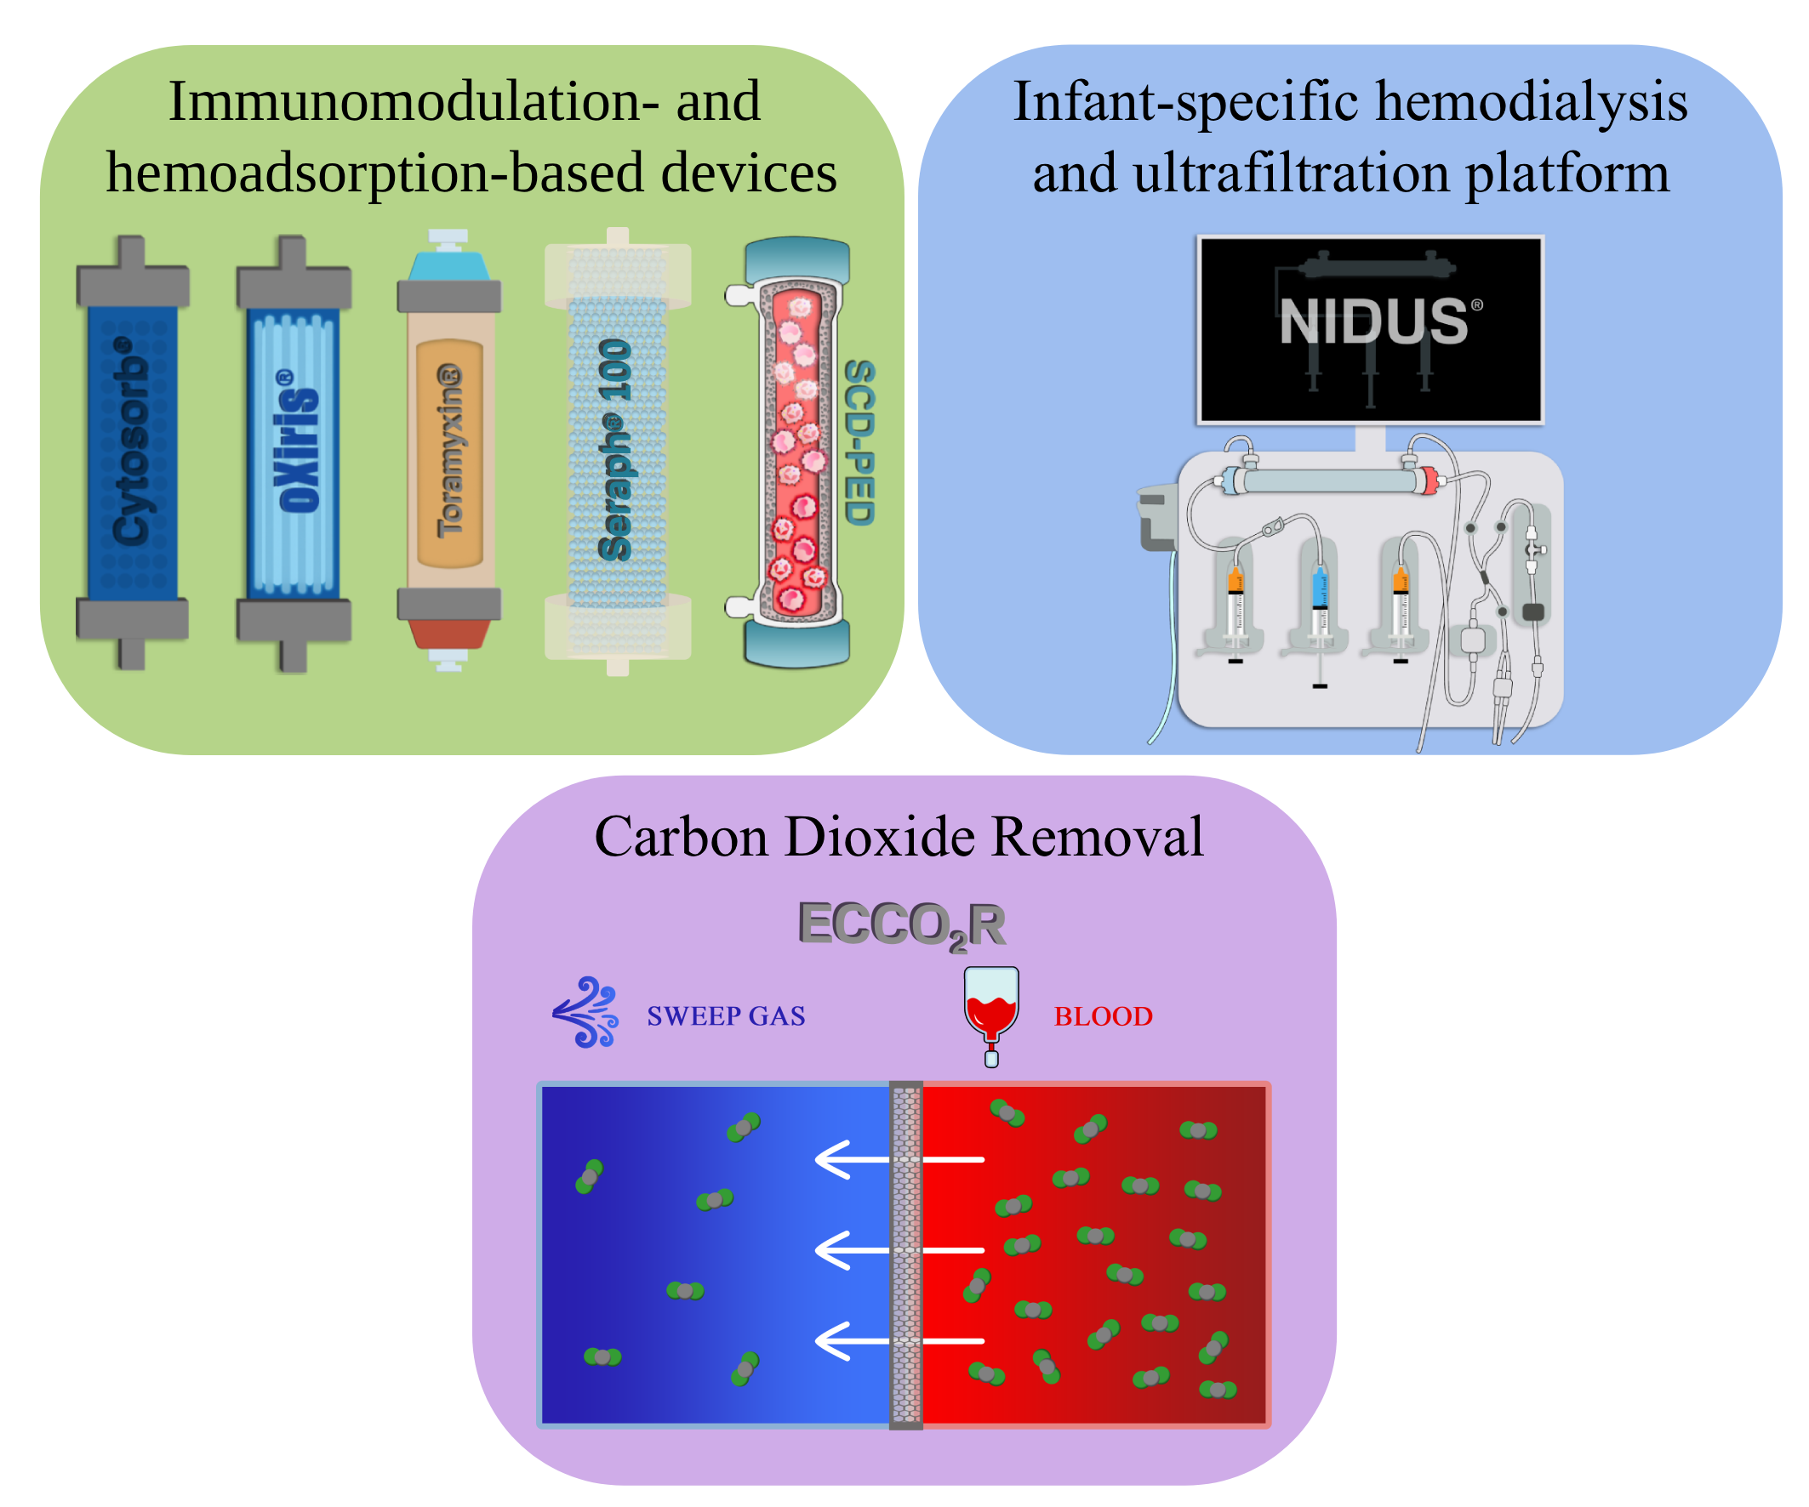
Novel extracorporeal therapies in children
Key points:
1. Novel extracorporeal therapies expand the role of CKRT beyond kidney support to include cytokine, endotoxin and CO₂ removal.
2. Immunomodulation- and hemoadsorption-based devices as well as ECCO₂R may support hemodynamic stabilization and lung-protective ventilation, with potential impact on short-term clinical outcomes.
3. Application of these techniques in children requires an individualized approach and technical adaptations, including the use of pediatric-specific devices.
4. Infant-specific hemodialysis and ultrafiltration platforms such as NIDUS® address existing limitations and enable safe, efficient therapy in the youngest patients.
5. The existing pediatric literature remains limited, warranting prospective research to establish standardized and evidence-based clinical practice.
TAKE HOME MESSAGE: Recent advances in extracorporeal therapies have expanded their applications and enabled therapy to be tailored to pediatric needs. Pediatric evidence remains limited, prospective studies are required.
Skoczyński et al. 2026

