Slide 1
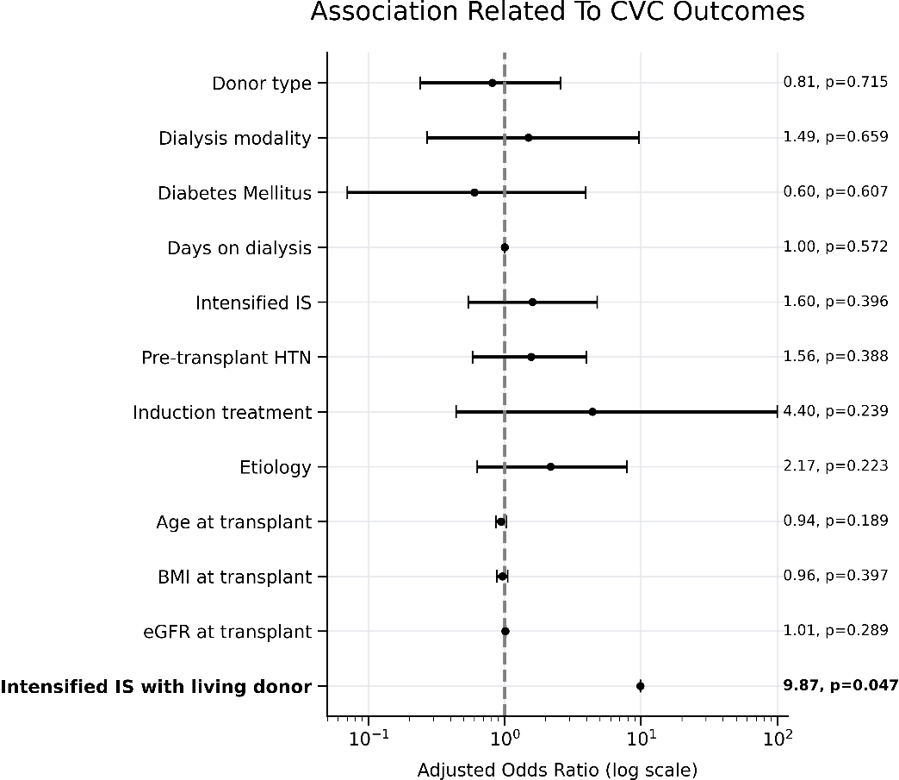
Association between Immunologic Risk Factors and Cardiovascular Complications Following Pediatric Kidney Transplantation
This study aimed to identify modifiable risk factors for cardiovascular disease in kidney transplanted children.
72 pediatric kidney transplant patients
No overt cardiovascular disease
Hypertension occurred post transplant in 42% of the cohort
Living kidney transplants treated with intensified immunosuppression had higher cardiovascular morbidity
Classical CVD risk factors
CKD and transplant related risk factors
Retrospective single-center study
CONCLUSION: Cardiovascular complications in this cohort were driven primarily by immune‑related transplant factors, while hypertension dominated the composite outcome, reflecting early cardiovascular vulnerability.
Pollack et al. 2026

