Slide 1
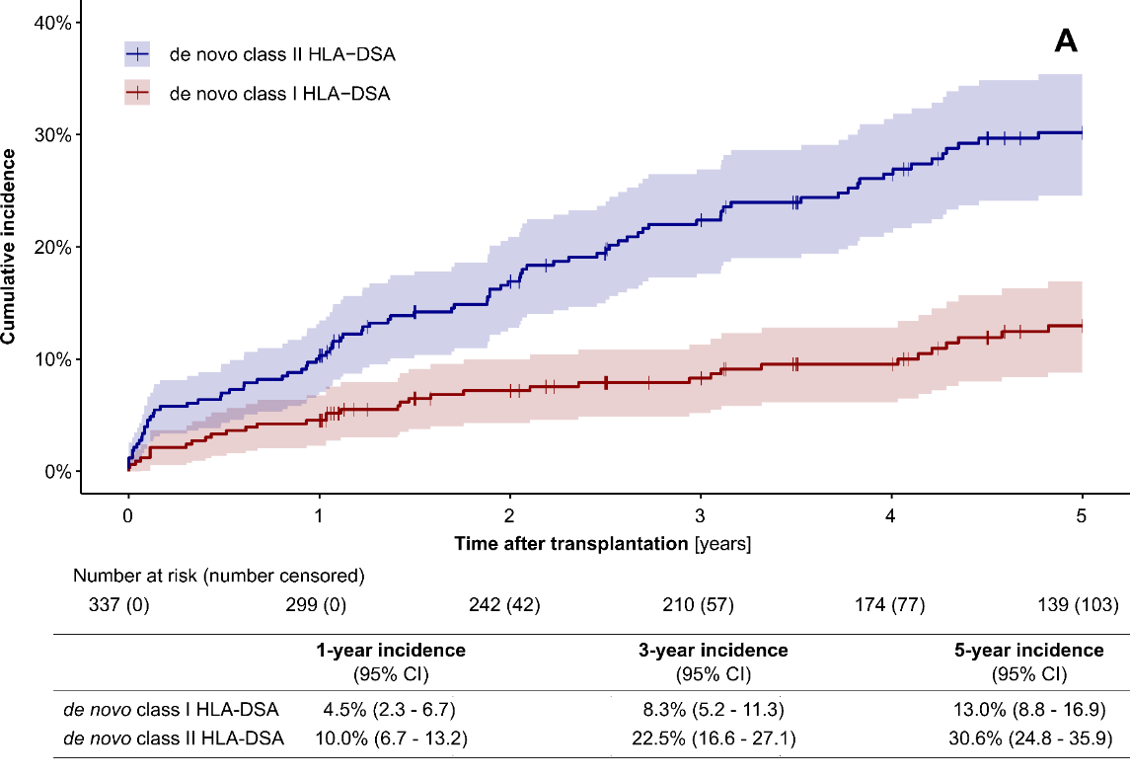
Tailoring of HLA antibody monitoring after kidney transplantation in pediatric recipients
Selected criteria
Suggested monitoring schedule
Low Risk
Primary transplant
Low HLA mismatch (0–2 MM)
Stable tacrolimus (CNI) levels
No prior sensitization
Low Risk
Year 1: Twice (at 3 and 6 to 12 months)
Year 2 and beyond: annually
Moderate Risk
Moderate HLA mismatch / class II MM
Episodic subtherapeutic tacrolimus levels
Prior sensitization (PRA 0-85%), no DSA
Intercurrent infections mandating reduction of immunosuppression
Moderate Risk
Year 1: At least 2 times (at 3 and 6 to 12 months)
Years 2 - 3 and during adolescence: 6-monthly
Year 4 and beyond: annually
High Risk
Re-KTx / high HLA MM (≥5) / PRA (>85%)
Pre-formed DSA or prior AMR
Non-adherence
Minimization of immunosuppression/ CNI withdrawal
High Risk
Year 1: At least 4 times, e.g. every 3 months
Years 2–5: Every 3 to 6 months
Year 6 and beyond: Every 6 to 12 months
Cumulative incidence of de novo HLA-DSA (the center-specific MFI cut-off, [4])
TAKE HOME MESSAGE: Risk-adapted HLA antibody surveillance enables earlier detection of de novo DSAs and subsequently improves the chance of detecting AMR at a more favourable histological stage. The proposed minimum standards are two tests in Year 1, one test annually thereafter, and biannual testing through adolescence.
Fichtner et al. 2026

