Slide 1
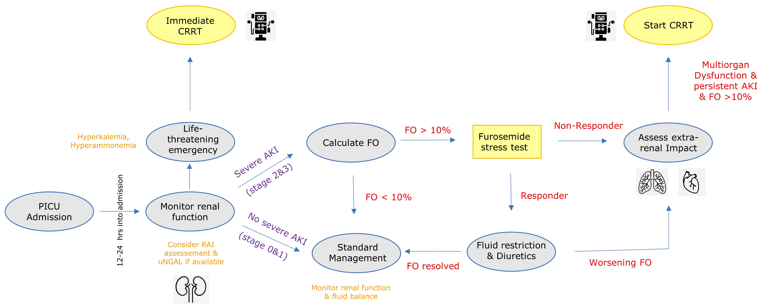
When to start continuous kidney replacement therapy in critically ill children: a practical, PICU-focused, evidence-based review
Key points:
CKRT is the preferred renal support modality in paediatric intensive care to treat children with AKI, FO and non-renal indications. However, timing of initiation remains a contentious and highly variable clinical decision.
Classic indications for dialysis are well established, yet modern paediatric intensive care practice increasingly emphasises earlier intervention for FO and evolving multi-organ dysfunction.
Adult randomised trials have not demonstrated a survival benefit for early CKRT based on biochemical thresholds alone. However, their applicability to paediatric populations is limited by distinct disease biology, developmental physiology, and fluid tolerance.
Current evidence points towards a physiology driven framework for CKRT initiation in critically ill children with emphasis on dynamic assessment of kidney trajectory, fluid balance, and extra-renal organ impact rather than fixed biochemical thresholds or rigid timing paradigms.
TAKE HOME MESSAGE: There is no single correct time to start CKRT in critically ill children. Optimal initiation is a dynamic, individualised decision integrating kidney trajectory, fluid overload, and extra-renal organ dysfunction. A shift away from rigid timing paradigms towards physiology-driven, anticipatory decision-making offers the greatest opportunity to improve outcomes in this vulnerable population.
Cortina & Deep, 2026

