Slide 1
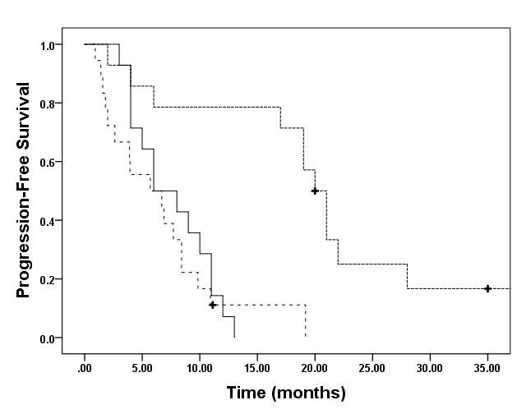
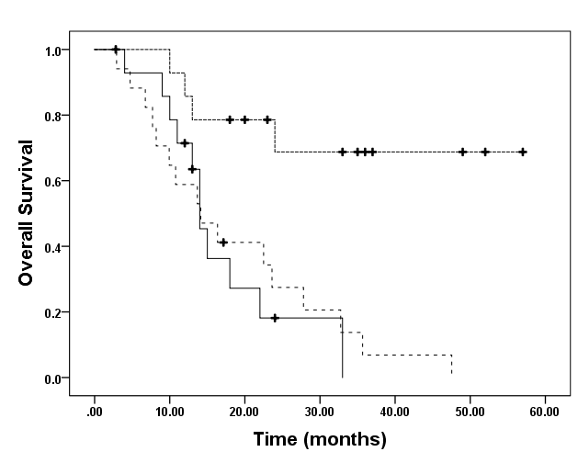
Fig. S1
a)
b)
Homo-HER2
Hetero-HER2
HER2 negative
Homo-HER2
Hetero-HER2
HER2 negative

