Slide 1
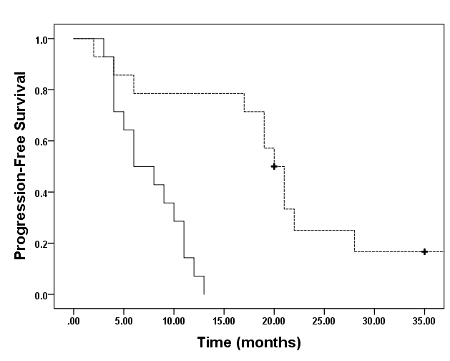
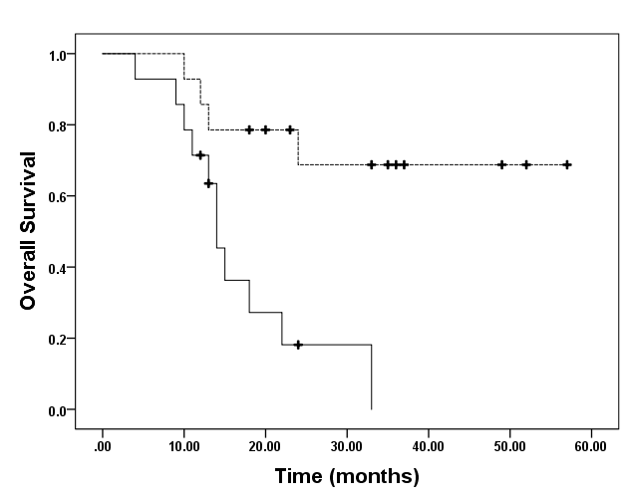
Fig. S2
a)
b)
Median PFS
Homo-HER2 20.0 months (95%CI 17.9-22.1)
Hetero-HER2 8.0 months (95%CI 4.2-11.8)
HR 0.18 95%CI 0.06-0.54
P=0.002
Homo-HER2
Median OS
Homo-HER2 not reached
Hetero-HER2 14.0 months (95%CI 12.4-15.6)
HR 0.09 95%CI 0.02-0.44
P=0.003
Homo-HER2
Hetero-HER2
Hetero-HER2

